Slide 1
Exploration of the Evolution of NR Industrial Pattern in the New Normal Economy
May 2015

Slide 2
1
Analysis on Global Macro-ecology
2
Evolution of NR Industrial Pattern
3
Prediction of NR Pricing Trend

Slide 3
1. Analysis on Global Macro-ecology
1.1
Global easing remains the main keynote
1.2
US economy recovery slows down
Expected interest rate increase is delayed
1.3
Europe easing furthers
Economic prospective turns for the better
1.4
Japan economic growth stalls
Super quantitative easing
1.5
The “new normal” Chinese economy and PBC

Slide 4
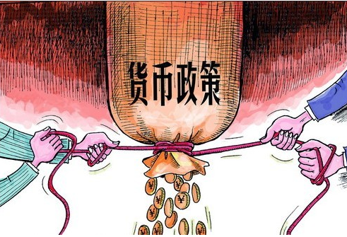
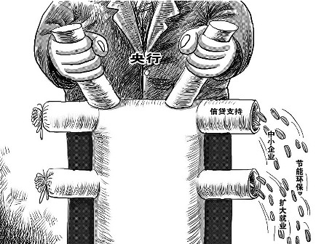
1.1 Global easing remains the main keynote
Global easing remains the main keynote in 2015
Since the economic growth is not sustainably driven, currently, the central banks of US and UK are expected to be cautious in tightening currency policies to maintain the uptrend.
Bank of UK was considered as the first major economy to start increasing the interest rate, but due to the slow down of the economy and the downturn of property market, its currency policy of this year remains almost unchanged.
US economy turned downward in the first quarter. The comprehensive employment index LMCI, on which FED focused, stroke a record low, with inflation data remaining dismal, forcing FED to further delayed the raising of interest rate compared beyond June when it had been expected to occur, and reduce the level of IR raising. Currently, FED is expected to raise IR in September or later than September, and IR will be raised only once in 2015 by 25 base points.
UK
Currency policy
USA
Since the second half of last year, the PBC lowered the RRR and the interest rate through open market operation, continuously injecting capital into policy banks, etc.
China
EU
European Central Bank reduced IR to a record low - 0.05%. In March 2015, European officially launched an asset purchasing plan valued at 1.1 trillion Euro - it will spend 60 billion Euro purchasing governmental and private bonds every month until September 2016.
Central bank
In 2014, the growth of emerging economies turned downward. Several central banks adopted easing currency policy. Low oil price and inflation offered more room where central banks can secure easing currency policy.
Japanese central bank remains annual addition of 80 trillion Yen to the monetary base. With the failure of Japanese “three arrows”, IR will still be kept at an almost-zero level for a long time. Possibility of expand the QE scale exists.
Others
Japan

Slide 5
1.1 Global easing remains the main keynote
Chinese currency policy 2015
From the perspective of the position for FX purchase, there is possibility for PBC to reduce RRR by 25 base points in the second quarter.
Steady growth becomes the main keynote, while low inflation rate creates the condition for easing. It is still far from the ending of currency easing; RRR reduction and IR reduction is conducted alternatively
Date | Policy | Liquidity release
Feb. 5 | RMB RRR for financial institutes is lowered by 0.5% . Additional reduction of 50 base points is made to the urban commercial banks and rural commercial banks which are required for directional RRR reduction. Additional reduction of 400 base points is made to the Agricultural Development Bank of China. | RMB 600 billion
Mar.1 | One-year loan interest rate of financial institutions is reduced by 0.25% to 5.35%; one-year deposit interest rate is reduced by 0.25% to 2.5%. | /
Apr. 20 | From April 20, RMB RRR is reduced by 1% for deposit-taking institutions | RMB 1.3 trillion
Apr. 20 | Approved by the State Council, PBC indirectly injects capital into China Development Bank and State Export-Import Bank by converting the entrusted loan of FX reserve into equity, amounting to $32 billion and $30 billion respectively. The Ministry of Finance injects capital into Agriculture Development Bank of China through tax refund. The initial plan is to refund the tax contributed by Agriculture Development Bank of China year by year. The amount of capital injected will be approximately RMB 150 billion, close to China Development Bank and State Export-Import Bank. | RMB 468 billion
By Apr. 2015 | PBC supplies medium-term basic currency to major commercial banks, policy banks, joint-stock commercial banks, urban commercial banks, etc. through medium-term lending facility. | RMB 435 billion
By Apr. 2015 | Open market operation of PBC (Reverse repo) | -RMB 100 billion
May 11 | From May 11, 2015, RMB one-year lending interest rate for financial institutions is reduced by 0.25% to 5.1%; one-year deposit interest rate is reduced by 0.25% to 2.25%; meanwhile, the interest rate cap of financial institutions is adjusted from 1.3x to 1.5x base rate. | /

Slide 6
1.1 Global easing remains the main keynote
Since 2015, several countries have started currency easing
Region | Interest rate name | Current | Previous | Change in base point | Date of issuance
Switzerland | 3M LIBOR target IR | -1.25% - -0.25% | -0.75% - 0.25% | ↓50 | 2015-01-15
Canada | Overnight target IR | 0.75% | 1.00% | ↓25 | 2015-01-21
Denmark | Deposit IR | -0.75% | -0.50% | ↓25 | 2015-02-05
Sweden | Repo rate | -0.10% | 0.00% | ↓10 | 2015-02-12
India | Reverse repo rate | 7.50% | 7.75% | ↓25 | 2015-03-04
Indonesia | Policy IR | 7.50% | 7.75% | ↓25 | 2015-02-17
Thailand | Policy IR | 1.5% | 1.75% | ↓25 | 2015-04-29
Russia | Benchmark IR | 12.5% | 14.00% | ↓150 | 2015-04-30
Australia | Overnight lending rate | 2.00% | 2.25% | ↓25 | 2015-05-05

Slide 7
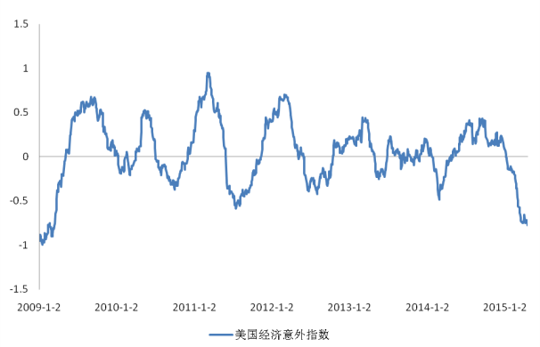
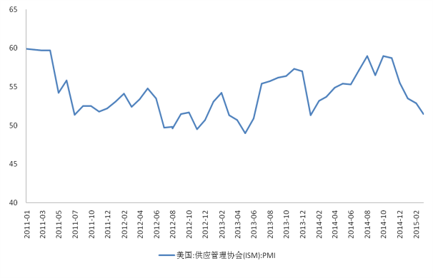
1.2 US economy recovery slows down
Expected interest rate increase is delayed
US economy recovery slows down
As indicated by Bloomberg Economic Surprise Index for statistics over-expectation/disappointment, US economy disappointment strikes a record low since financial crisis; almost all data performance is disappointing except non-agricultural one. Meanwhile, the leading index PMI also indicates unsteady economic slowdown.
US Economic Surprise Index
US PMI Index
US Economic Surprise Index
US Supply Management Association

Slide 8
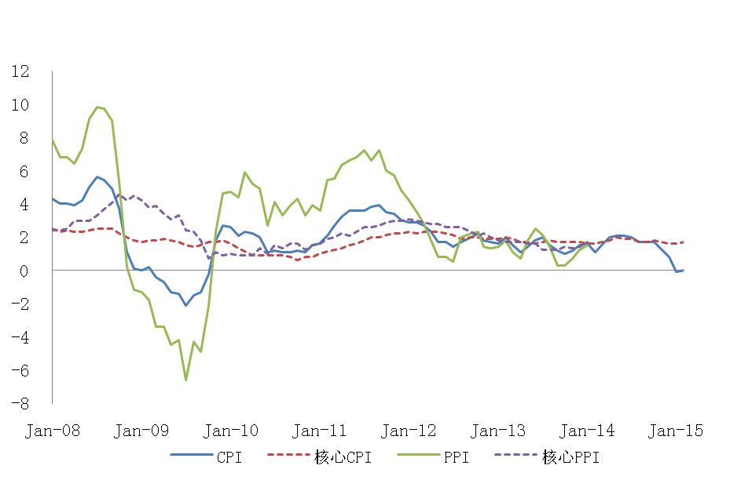
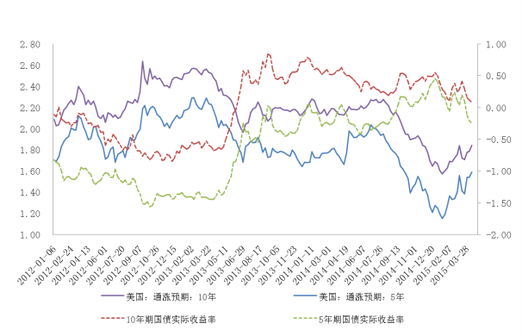
1.2 US economy recovery slows down
Expected interest rate increase is delayed
US inflation is still weak
From mid 2014, CPI is decreasing continuously mainly due to the reduced price of crude oil; meanwhile, TIPS indicates that inflation expectation is at a historically low level; the depressed inflation data weakens the motivation of FED to increase IR.
US Inflation Data
US Government Bond Yield
US Inflation Expectation 10 years
US Inflation Expectation 5 years
Core CPI
Core PPI
10-year government bond yield
5-year government bond yield

Slide 9
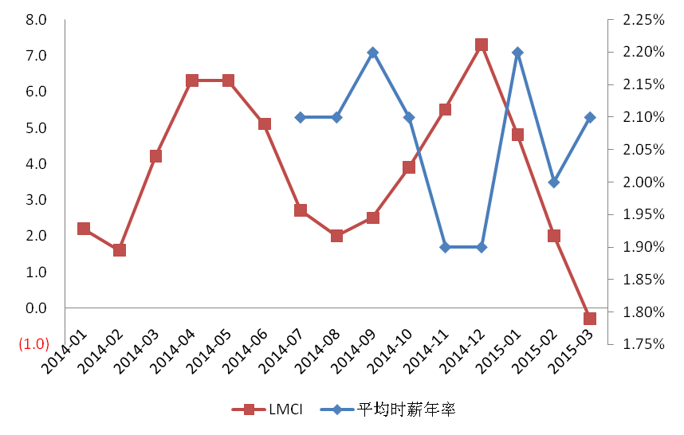
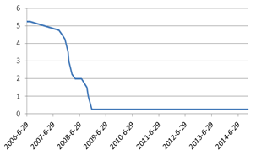
1.2 US economy recovery slows down
Expected interest rate increase is delayed
Employment index which Fed focuses on strikes a record low; IR raising expectation is delayed
LMCI which Fed pays close attention went down from the end of 2014, reduced to negative in march. The only highlight is the relatively steady growth of labor wages, which is around 2% and may contribute to the recovery of inflation.
The comprehensive employment index LMCI, which FOMC focuses on, strikes a record low and the inflation data anchored by currency policy still remains dismal, forcing FED to further delayed the raising of interest rate compared beyond June when it had been expected to occur, and reduce the level of IR raising.
Currently, FED is expected to raise IR in September or later than September, and IR will be raised only once in 2015 by 25 base points.
US LMCI
FED Benchmark IR remains 0-0.25%
over almost 6 years
Annual average hour payrate

Slide 10
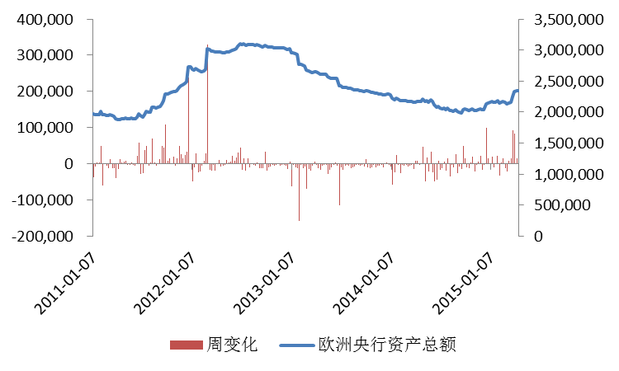
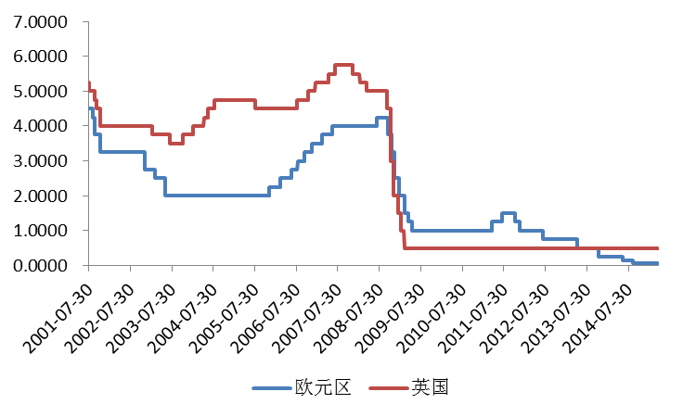
1.3 Europe easing furthers
Economic prospective turns for the better
Europe easing furthers
In March 2015, European officially launched an asset purchasing plan valued at 1.1 trillion Euro - it will spend 60 billion Euro purchasing governmental and private bonds every month until September 2016. Since this March, ECB balance sheet has expanded by 188.226 billion euro.
To elevate inflation, ECB will reduce main refinancing operation IR from 0.15% to 0.05%, with marginal lending/deposit IR reduced by 10 base points simultaneously to 0.3% and -0.2% respectively. Comparatively, Bank of UK has kept unchanged IR for a longer time and is moving towards IR raising.
ECU Balance Sheet (million euro)
IR of ECU and Bank of UK
ECB 0.05%
Bank of UK 0.05%
Weekly Change
Total ECB Asset
Eurozone
UK

Slide 11
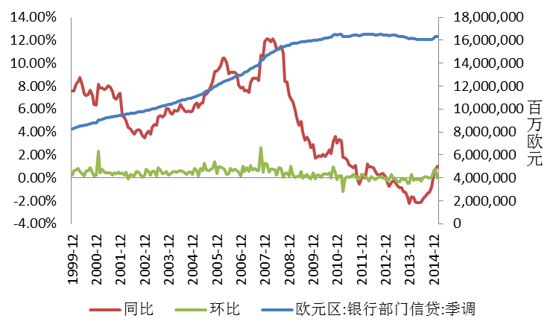
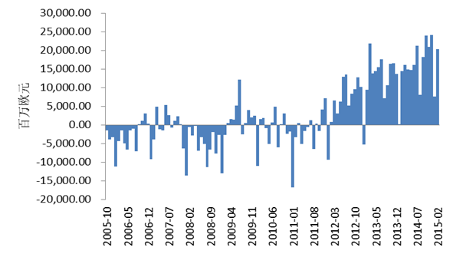
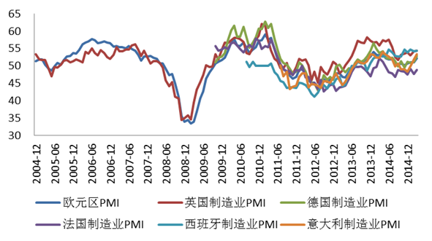
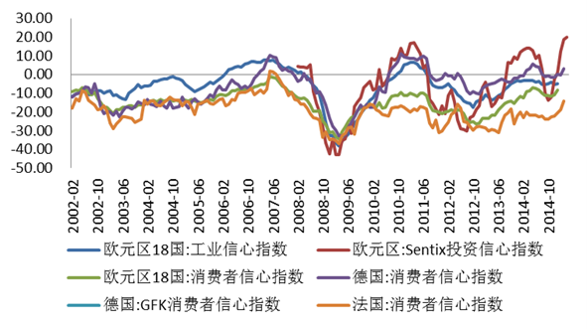
1.3 Europe easing furthers
Economic prospective turns for the better
Economic prospective turns for the better
Bank sector credit turns upwards QE influence on entity economy becomes apparent
Trade surplus recoveries Weak euro assists economic growth
Million
euro
Million euro
YOY
MOM
Eurozone: bank sector credit: quarterly adjustment
Manufacturing PMI picks up
Confidence index in Eurozone
Eurozone PMI
UK Manufacturing PMI
Germany Manufacturing PMI
Eurozone 18 countries: Industrial Confidence Index
Eurozone: Sentix Investment Confidence Index
Italy
Manufacturing PMI
Eurozone 18 countries: Consumer Confidence Index
Germany: Consumer Confidence Index
France Manufacturing PMI
Spain Manufacturing PMI
Germany: GFK Consumer Confidence index
France: Consumer Confidence Index

Slide 12
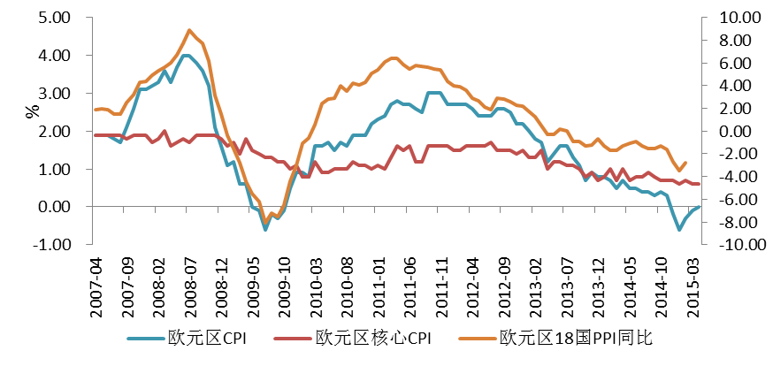
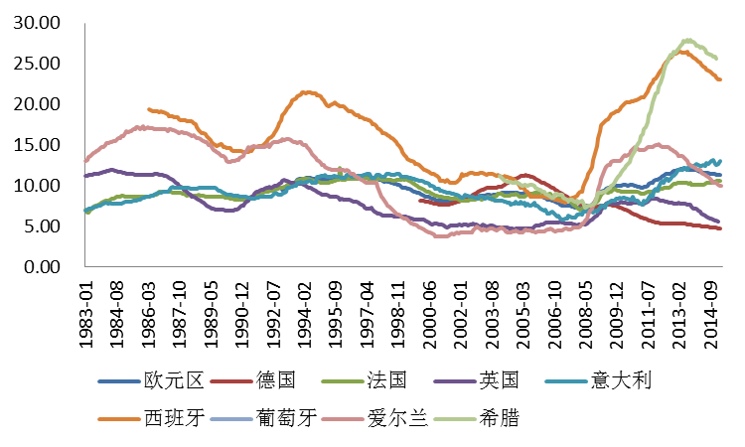
1.3 Europe easing furthers
Economic prospective turns for the better
Deflation and unemployment in Eurozone – turns better slightly
CPI in Eurozone and core CPI are 0% and 0.6%. Although CPI has become positive, it is lower than 1% for a long time. In the future, if EU economy still fails to go out of deflation and the inflation remains under 2% in the long run, from a long-term perspective, ECU will be likely to adopt open QE, expand asset purchases or delay asset purchasing period.
EU unemployment, though still remains double digits, is going down steadily. In Feb., the unemployment in Eurozone is 11.3% (previously 11.4). From below, Greece and Spain, where employment is relatively severe, has seen unemployment rate going down.
CPI&PPI in Eurozone
Unemployment rate in Eurozone
Eurozone
Germany
France
UK
Italy
Eurozone CPI
Eurozone
Core CPI
Eurozone 18 countries PPI YoY
Spain
Portugal
Ireland
Greece

Slide 13
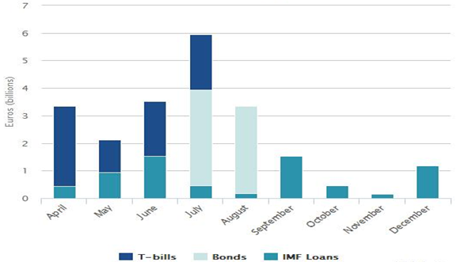
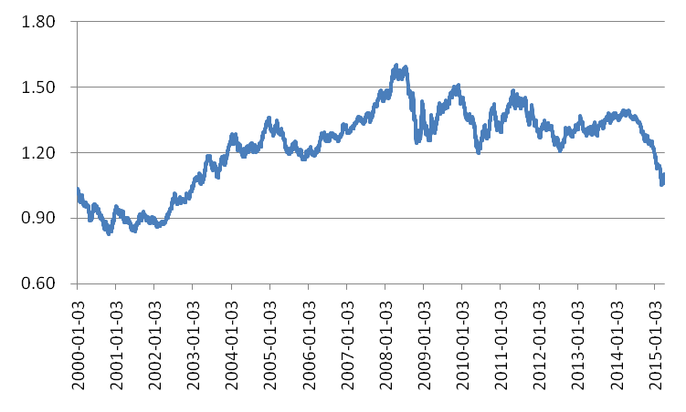
1.3 Europe easing furthers
Economic prospective turns for the better
Breaching risk of Greece is turning higher
From a short-term perspective, rebound demand exists in euro. On the one hand, US economy is disappointing, leading to the adjustment of US dollar index; on the other hand, it reflects the market expectation over EU economy recovery guided by QE. From technical point, euro and US dollar monthly curve is supported at the bottom point.
From a long-term perspective, comparing the currency policies of EU and US, fund still flows from Eurozone to US. In addition, the existing and potential political risks in Greece and Spain also impose pressure on euro. The effective solution to the Greek issue has not been found, so it is impossible for Greece to exit Eurozone. Furthermore, uncertainty increases due to Spain election. Hence, it is inevitable in 2015 that euro will further depreciate against US dollar.
Mature short/long-term national debt and IMF loan of Greece in 2015
Monthly curve of Euro and US dollar

Slide 14
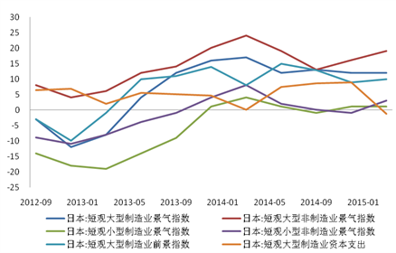
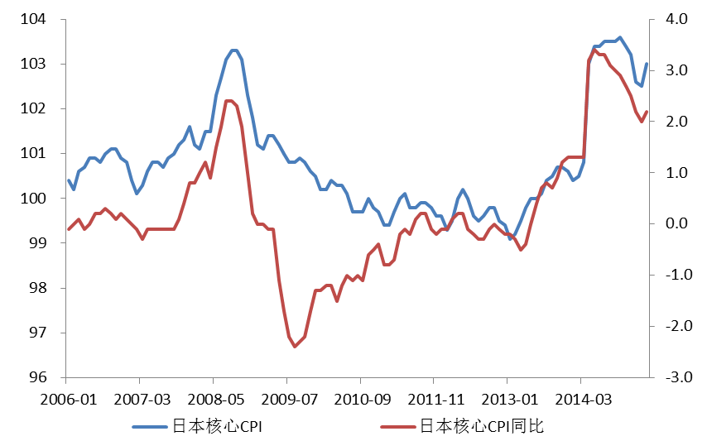
1.4 Japan remains super quantitative easing
Economic growth picks up with falling inflation
After negative growth for two consecutive quarters, Japan GDP annualized growth is 1.5% in the fourth quarter, 2014, with recovery of consumption growth and weakening capital expenditure.
In the first quarter, 2015. Japan tankan sees a falling capital expenditure and confidence in major manufacturing.
With falling energy price stabilized, Japan core CPI sees a YoY growth by 2.2% in March and previous falling trend stabilizes.
Japan: Tankan Major Manufacturing Climate Index
Japan: Tankan Major non-Manufacturing Climate Index
Japan: Tankan Minor Manufacturing Climate Index
Japan: Tankan Minor non-Manufacturing Climate Index
Japan: Tankan Major Manufacturing Prospect Index
Japan: Tankan Major Manufacturing Potential Expenditure
Japan core CPI
Japan core CPI YoY

Slide 15
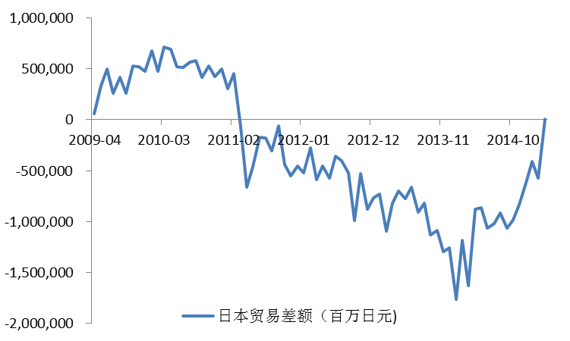
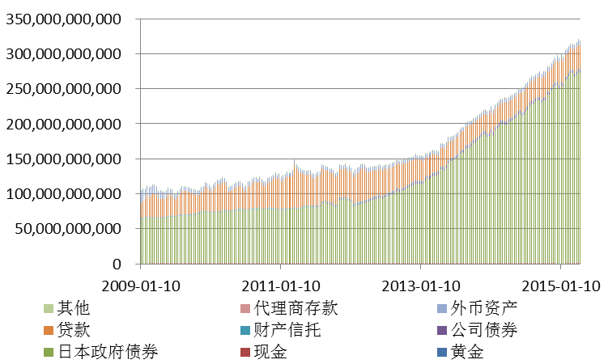
1.4 Japan remains super quantitative easing
Secure QE scale and narrow trade deficit
Since Japan implements currency easing at macro level, Bank of Japan is purchasing government bonds. It debt has reached 325 trillion yen in April 2015, with government debt account up for 84%.
The super QE has led to a significant depreciation in Japanese Yen, thus benefiting export. The commodity trade deficit further narrows since the beginning of 2014 and turned surplus of 3.3 billion yen this March. It expected that Japan will remain super QE policy before its enterprise regains confidence and its economy growth is stabilized.
Other
Agent deposit
Foreign currency asset
Japan Trade Balance (million Yen)
Loan
Property trust
Company bond
Japanese government bond
Cash
Gold

Slide 16
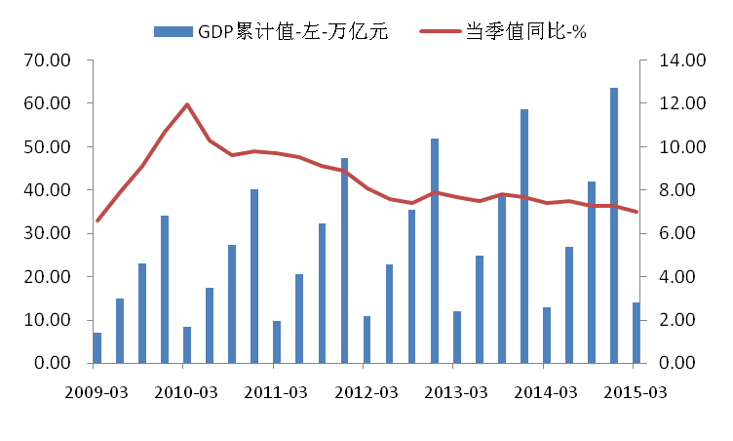
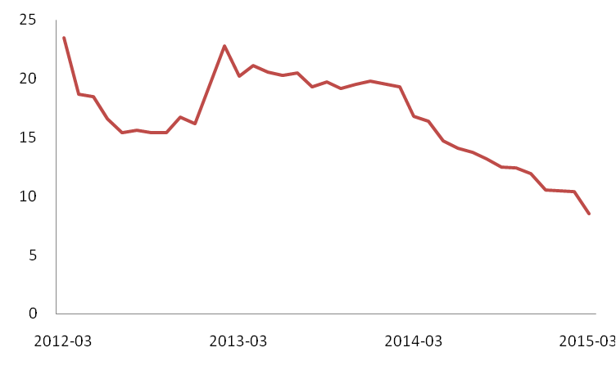
1.5 The “new normal” Chinese economy and PBC
The Chinese economy is under big downward pressure
In the first quarter, the GDP grows by 7% to RMB 14.07 trillion, which drops 0.3% compared to last quarter. The economy downward pressure is rising and new supporting point has not been found yet during economic restructuring.
In economic winter, real estate investment remains downward. In the first quarter, real estate investment only grows by 8.5%, with continuous weakening effect of traditional sectors on driving the economy.
In Q1 GDP growth slows down to 7%
Real estate investment growth remains downward
Accumulative GDP · left· trillion RMB
Quarter value YoY -%

Slide 17
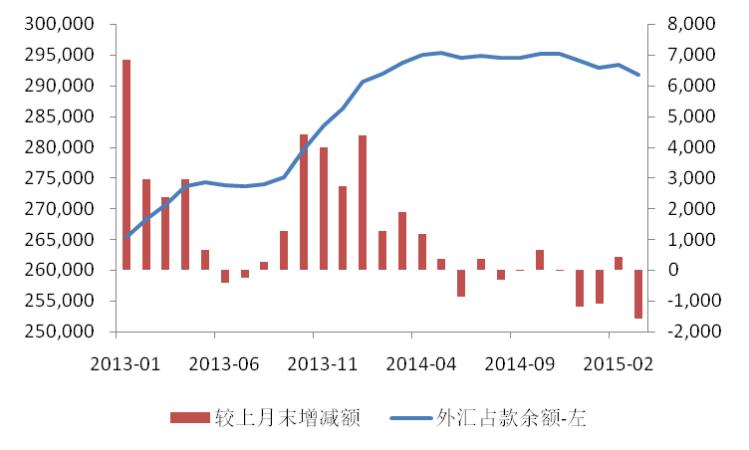
1.5 The “new normal” Chinese economy and PBC
Easing roadmap of PBC
Last Q2, the position of FX purchase grows by RMB 66.2 billion. If this Q2 the current downward trend continues, the liquidity will decrease by almost RMB 300 billion compared to last year, equivalent to reduction of RRR by 25 base points.
If the effect of the RRR and IR reduction is not significant, PBC may raise the degree of easing. It is possible to reduce IR in Q3 (more effective in reducing entity IR). RRR reduction and IR reduction is conducted alternatively.
Decrease of FX purchase positioning
Chinese QE roadmap
Reduce RRR and IR and release bank low-cost fund of bank
Inject capital into policy banks and lead funds to entity economy
Purchase credit assets of commercial banks, fix bank balance sheet and improve credit capacity
1
2
3
Change compared with last month
Balance of forex purchase position
left axis

Slide 18
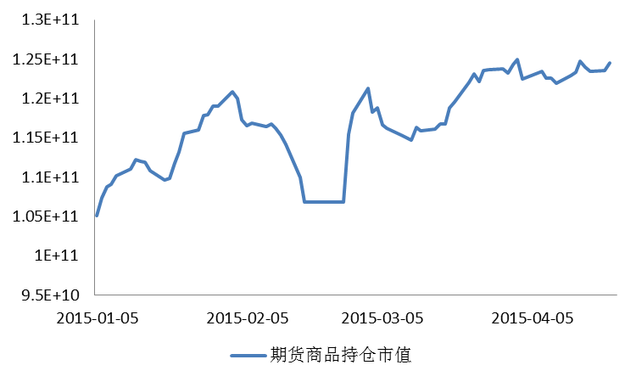
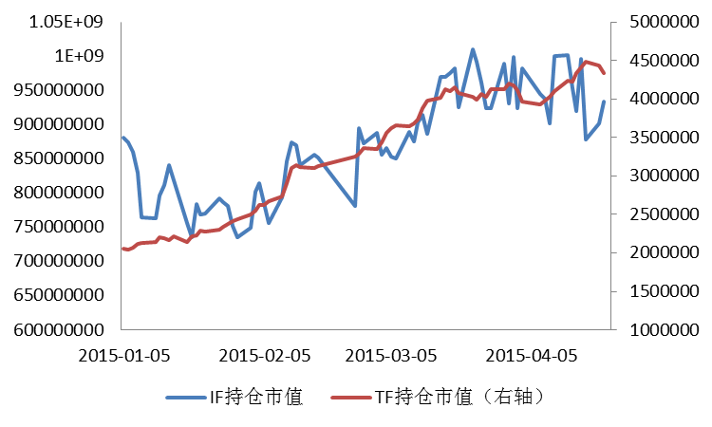
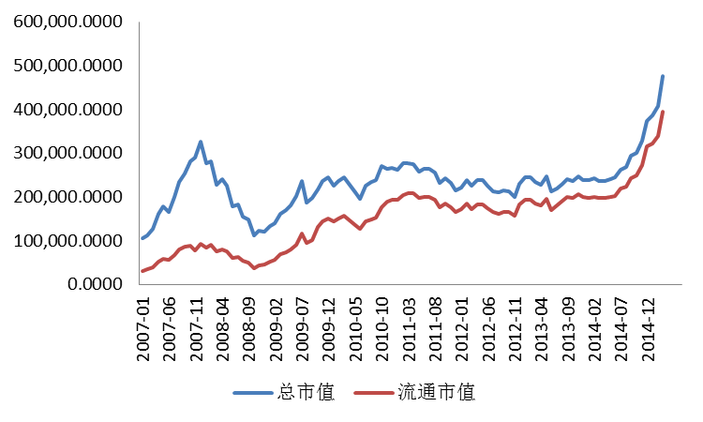
1.5 The “new normal” Chinese economy and PBC
PBC easing roadmap- fund flow
Value of commodity futures position
Value of government bond and stock index futures position
Value of Futures Position
Value of IF position
Value of TF position (right axis)
Value of Shanghai and Shenzhen stock markets (RMB 100 million)
Total value
Circulated value

Slide 19
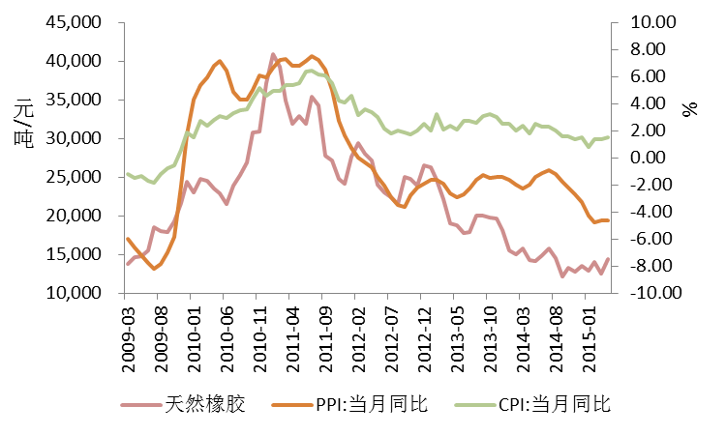
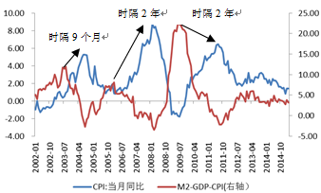
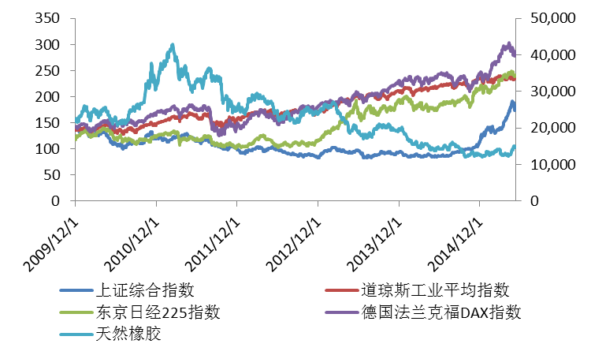
1.5 The “new normal” Chinese economy and PBC
PBC easing roadmap: currency- inflation-commodity
CPI high point appears 1-2 years after the currency over-issuance reaches high point. The current currency over-issuance is 3.2%, leading to a better liquidity.
Commodity market trend is basically aligned with CPI YoY change. Commodity trend drives the inflation change. On the contrary, the change of inflation expectation will also guide the commodity pricing trend. With the implementation of global and Chinese currency easing policy, inflation is expected to significantly rise in the coming one year. Therefore, in the commodity pricing, inflation premium should be considered.
CPI&PPI and NR trend
RMB
/ton
Currency over-issuance and commodity price
NR
PPI YoY
CPI YoY
2 years
2 years
Stock and NR trend
9 months
SHCOMP
DJIA
CPI YoY
M2-GDP-CPI(right axis)
Nikkei 225
German DAX
NR

Slide 20
1.5 The “new normal” Chinese economy and PBC
The Chinese Marshall plan: formation of “OBOR” strategy
Xi Jinping expressed that China is willing to enhance marine cooperation with ASEAN countries and propose the establishment of "21st century maritime silk road" when Indonesia representative delivered a speech at the APEC informal leaders' meeting.
Sept. 2013
Oct. 2013
Xi Jinping noted at the Central Economic Working Conference that the establishment of "silk road economic belt" should be promoted, the development of strategic planning should be pushed and the setup of interconnection between infrastructure should be reinforced; establish "21st century maritime silk road", enhance interconnection between sea lanes and reinforce mutual benefits.
Feb. 2014
President Xi and President Putin have reached the consensus on the interfacing of the Eurasian railway to the “silk road economic belt” and “maritime silk road”.
May 2014
As the first practical platform of “silk road economic belt”, Lianyungang China Harbin International Logistics Facility has been opened/
Nov. 2014
Xi Jinping announced at APEC summit that China will invest 40 billion dollars to setup silk road fund as the dedicated operating fund for OBOR.，
Dec. 2014
The Central Economic Working Conference 2014 noted that OBOR is the priority strategy in 2015 regional development.
Feb. 2015
OBOR working group leadership was unveiled.
Mar. 2015
On March 28, NDRC, Ministry of Foreign Affairs and Ministry of Commerce jointly issued the Vision and Action for Promoting the co-establishment of Silk Road Economic Belt and 21st Century Maritime Silk Road. OBOR roadmap was officially issued.

Slide 21
1.5 The “new normal” Chinese economy and PBC
Chinese Marshall Plan: OBOR strategic priorities
On November 8, President Xi hosted the dialogue on enhancing relationship of interconnection partners at APEC and delivered an important speech “Interconnection Leads Development and Partners Focus on Cooperation”, and clarified five suggestions on promoting interconnection and the establishment of OBOD.
Direction | Take Asia countries as orientation and be the first to realize interconnection in Asia. China is willing to provide more public products to the neighboring countries in Asia through interconnection
Basis | Set up basic frame for interconnection in Asia based on economic corridors.
Breakthrough | Taking transportation infrastructure as breakthrough point, realize early harvest of interconnection in Asia and deploy the railway and road projects between China and neighboring countries first.
Chance | Taking the establishment of financing platform as a chance, China will invest 40 billion dollars to set up the silk road fund.
Bond | Taking cultural and educational exchanges as bond, reinforce the social foundation for interconnection in Asia.

Slide 22
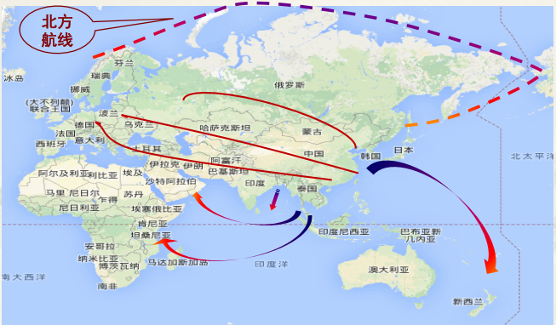
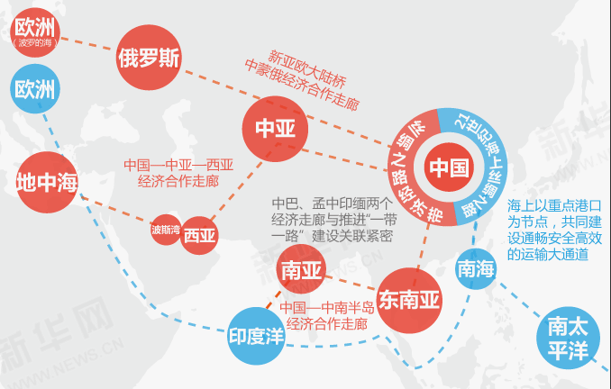
1.5 The “new normal” Chinese economy and PBC
Chinese Marshall Plan: OBOR strategic layout
OBOR strategic plan is China's commitment to seeking the changes of global regional pattern. The massive plan covers the entire Eurasian continent and half Africa. The dynamic Chinese economy will be integrated into global economy by opening sea and land lanes, leading to a more economic and effective integration of energy sources and mines, finance, etc. in Asia, EU and Africa.
The strategy centers on exporting surplus productivity, rich domestic fund and the RMB internationalization. China will be better positioned as a mature, open and massive economy, integrating the surrounding underdeveloped Southeast Asia, South Asia, Middle East, Russia and the debt-suffering EU into its own global economic pattern.
Northern sea route
Europe
Baltic
Russia
New Eurasian Land Bridge
China-Mongolia-Russia Economic Cooperation Corridor
Europe
China-Central-Asia-Western Asia
Economic Cooperation Corridor
Central
Asia
China
Key ports as nodes; set up smooth, safe and effective transportation lanes
Mediterranean
China-Pakistan and Bangladesh-China-India economic corridors are closely related to OBOR
Persian Gulf
West Asia
South
Asia
South
China Sea
Southeast
Asia
Indo-China Peninsula
Economic Cooperation Corridor
Indian
Ocean
South
Pacific

Slide 23
1.5 The “new normal” Chinese economy and PBC
Chinese Marshall Plan: OBOR strategic opportunities
Securities markets have actively responded to OBOR strategy. The bulk commodity market is suffering from the imbalance between supply and demand and the "de-bubbling" stage. Although no surging is observed, most commodities see a stable performance recently, which is attributed to the market confidence raised by OBOR.
Asia Investment Bank will nearly create at least one trillion RMB liquidity for OBOR, and OBOR will bring life to the overcapacity of domestic bulk commodities. The domestic and overseas consumption demands driven by it will be unimaginable. Undoubtedly, bulk commodity will be one of the sectors benefiting most from OBOR.
Golden
Opportunity for
Gold Industry
Countries along OBOR have rich gold resources and high demands. The establishment of gold cooperation and development mechanism will bring golden opportunities to domestic gold market and help improve the pricing power.
Energy
Financing System
Focus on the development of energy financial derivatives of OBOR, including oil & gas goods, futures, financial products contracts, green finance, etc; develop a infrastructure network such as pipeline, grid, hub, etc.; establish energy trading hub to promote pricing power of Asia
Excessive
Productivity
export
“Infrastructure first” is the keynote of OBOR. Manufacturing of energy, HSR, nuclear power equipment, etc. will bring a huge demand for steel and mines. Among the 64 countries along OBOR, over 70% are steel net exporters. OBOR strategy will drive the output of infrastructure construction capacity.
Surging Demand
For Bulk
Commodities
Nonferrous meals such as copper and aluminum, which are used as main consumables in power transmission, will see a surging demand; strategic materials such as coal, petroleum and NR will also face new opportunities.

Slide 24
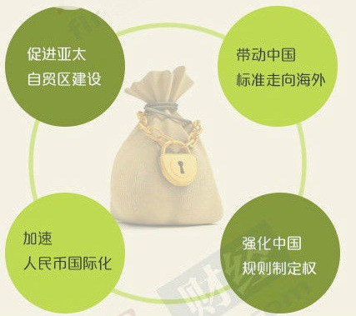
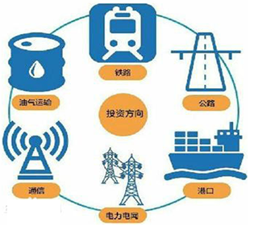
1.5 The “new normal” Chinese economy and PBC
Asia Investment Bank: significance of establishment and investment orientation
Significance
Orientation
Promote establishment of Asia FTA
Bring the Chinese standards to globe
Railway
O&G transmission
Highway
Investment orientation
Accelerate RMB internationalization
Improve the rule-making power of China
Communication
Port
Power grid

Slide 25
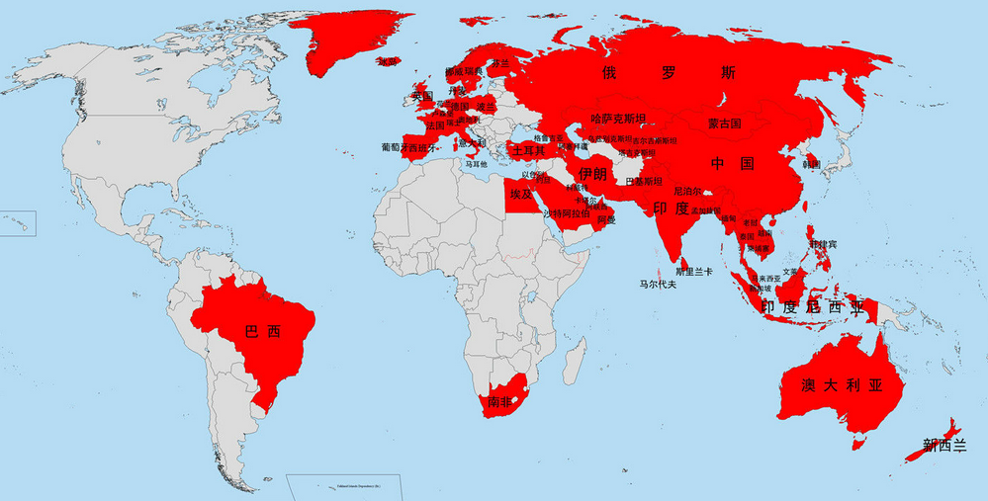
1.5 The “new normal” Chinese economy and PBC
Asia Investment Bank: the first member countries
By April 15, 57 countries have joined Asia Investment Bank as its first members, covering Asia, Oceania, EU, LA and Africa, including traditional developed countries and the emerging economies in Asia-Pacific region. 37 countries are mostly Asian and Oceania nations while 20 are EU, LA and Africa nations.

Slide 26
2. Evolution of NR Industrial Pattern
2.1
Evolution of industrial pattern under the excessive supply and demand background
2.1.1
Crowding-out along industry chain
2.1.2
Profit evolution along industry chain
2.2
New normal and new pattern
2.2.1
Industry integration practice
2.2.2
Significance of purchasing and storage in China
2.2.3
OBOR strategic background
2.2.4
Energy price bear market – falling transportation cost

Slide 27
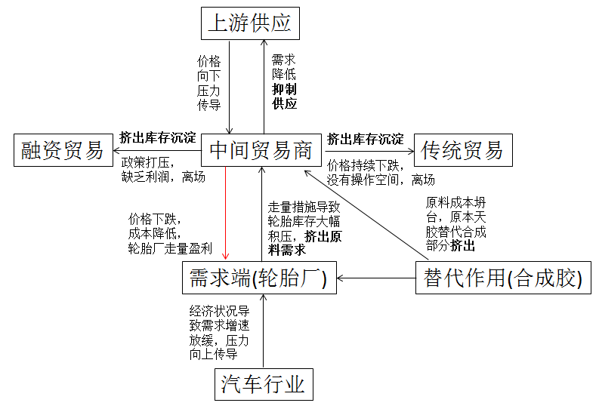
2.1 Evolution of industrial pattern under the excessive supply and demand background
Crowding out between sections of industry chain - most significant in the intermediary section
Upstream supply
1. Conventional dealers are "crowded out" by upstream and downstream.
2. TFs are "crowded out" by policies and financial market environment.
3. Low rubber price leads to capacity passivation, "crowding out" supply increment.
4. Commercial vehicle sector is weakening; tyre sector is faced with integration, "crowding out" poor capacity.
5. Cost collapse. Alternative synthetic rubber will "crowd out" demand of NR
Price pressure transfer downward
Demand reduction restricts supply
Trade financing
Crowd out stock precipitation
Crowd out stock precipitation
Traditional trade
Intermediary
dealer
Policy depression. Low profit and exit
Price remain falling. No operational margin and exit
Sales by volume leads to massive tyre stock. Raw material demand crowded out
Raw Material cost collapses. NR alternative synthetic rubber . Partial crowding out
Price goes down
Cost reduction
Tyre manufacturer profit from sales volume
Demand end
(tyre manufacturer)
Alternative
(synthetic rubber)
Demand growth slows down due to economic conditions. Pressure transfer upward
Automobile industry

Slide 28
2.1Evolution of industrial pattern under the excessive supply and demand background
NR productivity – output - product
Productivity
Massive tree cutting does not occur in producing countries; rubber productivity has not reduced
Output
Due to low rubber price, cutting is suspended and abandoned severely considering economic value ratio, leading to reduced output
Product
Global demand for NR grows by 3.5 – 4% every year and remains relatively stable

Slide 29
2.1Evolution of industrial pattern under the excessive supply and demand background
Supply
Trade
Demand
“Industry+” guides establishment of new industry order
Futures
Supply end
Trade end
Trade end
Demand end
Conventional dealers are transforming to emerging dealers; rubber dealers prosperity turns upward; number of competitive rubber enterprises increases.
With the general situation remaining unchanged, the change in intermediary section structure may bring a demand for more than 20 ton rubber, leading to a premium price.
The circle “downstream tyre enterprises - intermediary dealers- upstream enterprise loss” comes to an end.

Slide 30
2.2 New patterns and new normal
Industry integration practice – experience and lessons
Vietnam government
Vietnam rubber association
Sales headquarter
Other shareholding companies
1. IRCo practice - globalization 2. VRG – institutionalization and nationalization
Thailand
Indonesia
Malaysia
IRCo
As the biggest rubber operation in Vietnam, VRG has more than 40 subsidiaries, tens of farmers and processing facilities through sole proprietorship or joint venture, accounting up for 70% of the total rubber output in Vietnam. VRG integrates advantageous resources and has high pricing risk resistance. With excellent quality and premium price, its products are mainly exported to EU and US markets, producing good economic and social benefits. 。
IRCo, which consists of Thailand, Indonesia and Malaysia, was founded on April 28, 2004, aiming to protect the interests of rubber farmers by taking actions.
But the competition among these three major rubber producers is difficult to be balanced. During the price falling, these pricing alliance members can not trust each other and fail to effectively and resolutely implement the measures. It is either much vaunted or can not produce practical results.
3. Exploration of the Chinese rubber industry
The provincial agriculture reclamation bureaus of Hainan, Yunnan and Guangdong and the Rubber Research Institute under China Academy of Tropical Agricultural Sciences established China State Farm Natural Rubber Alliance and further promoted the establishment of China State Farm Natural Rubber Industry Group to develop a major international rubber company with market competence, resource control and global influence.

Slide 31
2.2 New patterns and new normal
Strategic significance of purchasing and storage in China
Over the 30 years of reform and opening up, China has become the world's factory. Huge demands for "Made in China" promotes surging demand for energy and bulk raw materials.
Strong demands for raw materials make China transform from a net exporter to a net importer with regard to some bulk raw materials, such as coal, petro, corn, rice, etc.
The Chinese manufacturing are under the pressure from low end manufacturing such as Southeast Asia and East Europe and high end manufacturing such as EU, US and Japan.
FX purchasing positioning of PBC increase from nearly RMB 2 trillion in 2002 to about RMB 27.2 trillion today, representing almost 13x growth over a decade; meanwhile, national FX reserve has increased by 12 times to 3.89 trillion dollars.
The world’s factory
Purchasing and
storage capacity
Purchasing
& Storage
National security
Asset allocation
China has not seen significant effect in overseas investment in securitizing assets and the projects with industry background, which reveals the problems of unsmooth and immature domestic and overseas investment channels.
Gain the advantage of differentiated types of allocated asset by increasing physical asset allocation.
Strategic reserve from the national security perspective, in preparation of regional political conflicts

Slide 32
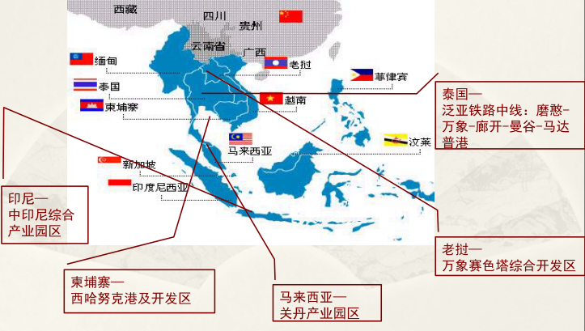
2.2 New patterns and new normal
Strategic effect of OBOR
Taking infrastructure construction as breakthrough, the OBOR strategy will impose profound influence on industries such as energy, chemical and steel. According to the estimation of related organizations, the total planned length of railway in this region will be about 10000 km in the future. Based on the investment of RMB 30 million to 50 million per km, the total investment is expected to approximate RMB 30 billion - 50 billion; the infrastructure investment demand in AP region for the coming 10 years will reach 8 trillion dollars.
According to the estimation of Asia Development Bank, before 2020, the annual infrastructure investment demand in Asia will reach up to 730 billion dollars. The aggregated investment of infrastructure is estimated to exceed 8 trillion dollars. Calculated based on such amount, it will produce a demand for 786,000 heavy-duty trucks in the future, which is equivalent to a demand for 707,400 tons of NR. (each heavy-duty truck has 12 tyres and needs to replace 1.5 tyre per year; each tyre consumes 30kg NR).
Thailand: middle section of Pan-Asia Railway: Mohan – Vientiane-Nong Khai- Bangkok- Port Madapu
Indonesia: China-Indonesia comprehensive industry park
Laos:
Vientiane Saiseta comprehensive development zone
Cambodia: Sihanoukville and development zone
Malaysia: MCKIP

Slide 33
2.2 New patterns and new normal
Crude oil bear market – focus on falling transportation cost
Oil price
US
OPEC
Russia
Political game
Energy revolution; new and old system game. Shale gas revolution
China and Japan nuclear power
revives
As indicated in the report of CNPC, by the end of 2013, the Chinese strategic crude oil storage capacity had reached 140 million barrels. According to the plan published by NDRC, by 2020, China will complete all hardware facilities of oil strategic reserve base phase III, with the accumulative storage capacity increased to 85 million tons, i.e. about 600 million barrels.
According to the estimation Energy Aspects, a London consultant, China purchased 87 million barrels of crude oil for strategic oil reservation in 2014. Additional 20 million barrels may be purchased if China expects to fill in all current reserve facilities.
Influence on domestic market:
1. Remarkable reduction of logistics cost.
2. Strategic reserve of China crude oil.
Falling oil price significantly reduces oil consumption cost for end users.

Slide 34
3. Prediction of NR Pricing Trend
3.1
General supply and demand
3.2
Cost prediction
3.3
Incident influence – political impact, climate factors
3.4
Long-term price cycle
3.5
Short-term fundamental disturbance factors
3.6
Price trend prediction and trading strategies

Slide 35
3.1 General Supply and Demand Pattern
Decreasing pressure of excess
Optimistic
Pessimistic
Optimistic
Pessimistic
As indicated by IRSG statistics, global NR supply and demand will be still in an easing pattern before 2022.
As predicated by IMF, NR stock consumption will reach the peak in 2015-2016 and then turn downward gradually.

Slide 36
3.1 General supply and demand
Over a long term in the future, developed countries and emerging economies will drive the global economy growth alternatively. The developed countries have rigid demand for NR, so the demand will remain relatively stable. Whether the surging growth of NR demand like the Chinese market will occur depends on the economic development of BRICS such as India and Brazil and other emerging markets.
Although Southeast Asia is the main producer of rubber, the countries in this region are mostly at the low end of the chain. In recent years, these countries focus on the development of rubber processing and massive tyre productivity is transferred to them, leading to a sharp increase in rubber demands, particularly in India, Indonesia and Thailand.
China remains the biggest consumer of rubber, where the demand for rubber grows over 6% for two consecutive years. However, with the economic restructuring in China, the slowdown GDP growth, turning point of real estate market and the replacement of its status as "world's factory", the rubber consumption growth in China is expected to slow down.
According to our prediction model, by 2020 global NR will still oversupplied; the turning point of supply and demand will emerge in 2021.
After 2015, the excess will decrease gradually; global stock consumption will reach the peak in 2017 and then turn downward.

Slide 37
3.2 Cost analysis
From a static perspective, currently the cost of an old rubber tree in Southeast Asia is 400 - 500 dollars; a new tree 1200 dollars; the cost in Africa is 1500 dollars; the cost in the Chinese private sector is RMB 16000/ton; the farming cost is about RMB 20,000/ton. In recent years, labor cost and production materials cost are rapidly increasing, accounting up for about 60% of the total production cost.
Production cost in Southeast Asia (e.g. Thailand)
Currently, rubber plantation owner and farmers in Southeast Asia adopt a profit sharing model; in Thailand and other countries, the share is 4:6 (about 5:5 in Malaysia). Each tapping worker can produce 3 tons in a year, which means rubber farmer gains 1.2 ton/year, 0.1 ton/month (based on 20 working days in a month).
From Jan. 1 2013, minimum daily pay in Thailand is adjusted to 300 THB, which will remain unchanged for two years. The daily pay in 2015-2025 is calculated incrementally based on average salary growth rate 7.35 for Thailand agriculture (annual average of 2011-2013).
Factory cost in theory is calculated based on the following equation: (rubber cup price/0.975+7+2)/FX rate*1000. Processing cost is 7 THB/kg; Cess tax is 2 THB/kg; drying rate is 0.975. Currently, since the raw material price has fallen below the line meeting the minimum daily pay requirement of rubber farmer, the actual processing cost is lower than theoretical one.
The estimation of cost has not taken exchange rate fluctuation, cess tax, and annual output change of tapping workers.
 | Min. pay/day (THB) | Monthly rubber tapping (ton) | Rubber farming cost in theory (USD/ton) | Factory cost in theory(USD/ton)
2014 | 300 | 0.1 | 1875 | 2204
2015 | 322 | 0.1 | 2013 | 2346
2016 | 346 | 0.1 | 2161 | 2497
2017 | 371 | 0.1 | 2320 | 2660
2018 | 398 | 0.1 | 2490 | 2835
2019 | 428 | 0.1 | 2673 | 3023
2020 | 459 | 0.1 | 2870 | 3224
2021 | 493 | 0.1 | 3080 | 3441
2022 | 529 | 0.1 | 3307 | 3673
2023 | 568 | 0.1 | 3550 | 3922
2024 | 610 | 0.1 | 3811 | 4190
2025 | 655 | 0.1 | 4091 | 4477
东南亚产胶国成本
(以泰国为代表，按最低日薪推算))
Production cost of rubber in China
 | Private sector cost (RMB/ton) | Farming cost (RMB/ton) | Average cost (RMB/ton) | Cost in USD (USD/ton)
2014 | 16000 | 20000 | 18000 | 2306
2015 | 16857 | 21072 | 18964 | 2440
2016 | 17791 | 22239 | 20015 | 2586
2017 | 18808 | 23510 | 21159 | 2746
2018 | 19916 | 24896 | 22406 | 2919
2019 | 21123 | 26404 | 23764 | 3107
2020 | 22438 | 28048 | 25243 | 3313
2021 | 23870 | 29838 | 26854 | 3537
2022 | 25431 | 31788 | 28609 | 3781
2023 | 27130 | 33912 | 30521 | 4047
2024 | 28981 | 36226 | 32604 | 4336
2025 | 30998 | 38747 | 34872 | 4651
According to the survey, the current farming cost of rubber in China is about RMB 20000/ton； the production cost in private sector is RMB 16,000/ton, 60% of which is labor cost. Manual cost increase is estimated based on the national annual salary growth rate 8.93% (average in 2011-2013).
CNY is converted to USD based on RMB 1200/ton duty and 17% VAT, excluding other expenses and exchange rate fluctuation or tax rate adjustment.
Currently NR price is lower than the cost, but on the one hand, rubber famers have to tolerate certain degree of low price due to lack of other revenue; on the other hand, since rubber will still be oversupplied in the coming 3-5 years, the production cost of NR will also be a pressure position for price increase (once profit is gained, supply will be increased depressing the price).
But in a long term, under the market economy conditions, commodity price is unlikely to remain lower than cost for a long time. The loss will be concretely supported by cost in certain degree, but some enterprises will be eliminated and industry integration will occur during this period.

Slide 38
3.3 Incidental influence – Policy impact
Reserve
Duty
Industry alliance
Since 2012, Thailand government and the Chinese government have reserved about 200,000 tons and 355,000 tons of rubber respectively. Although it drove a short-term increase in price, under the massive stock, the purchasing and storage can not change the price trend of rubber; instead, it is worrying that if the government throws the reserve, it will resist the price increase.
In 2014, the Central No.1 Document abandoned the temporary bean reserve policy but implemented a price subsidy, which may indicate the adjustment orientation of agricultural policies. Currently, China is studying the direct subsidy policies for sugar and cotton, for which traditionally reserve polices prevailed.
In case rubber reserve policies are adapted to farmer subsidiary, the rubber price will be further depressed.
According to the tax reduction policy in the Agreement on Commodity Trade signed between China and AFTA , NR is a sensitive products. In 2012, the duty was reduced to below 20% and will be further reduced to 0-5% by 2018. Under the macro environment where China together with AFTA countries establishes FTZ and continue to implement the duty reduction commitment made during its entry into WTO, the import cost of NR in China will further decrease in the future, which will drive the reduction of rubber price to some extent.
Although IRCo attempts to secure the rubber price by restricting export, setting minimum export price, reducing output, etc., they are ineffective to protect and support the rubber price due to lack of fund, game among countries and political factors, etc.
Although IRCo attempts to secure the rubber price by restricting export, setting minimum export price, reducing output, etc., they are ineffective to protect and support the rubber price due to lack of fund, game among countries and political factors, etc.
Regulatory
Car purchasing restriction
Trade barrier
No. 20 standard rubber listing
Since 2013, CBRC, SAFE, Custom, etc. are frequently enhancing their regulatory policies over the trading and financing of commodities, which restricts conventional trading and financing. Some small dealers are faced with the risk of capital chain rupture.
The ever-severing policies may lead to underselling of rubber at low price in a short term, but in the long run, they will contribute to reducing stock pressure caused by financing and export, thus changing the drop-away import pattern in the domestic market.
With ever-severing environmental pollution and increasing traffic congestion in urban area, Shanghai, Beijing, Guiyang, Guangzhou, Tianjin, Hangzhou, etc. are launching car purchasing restrictions.
With growing domestic per-capital income and the pursuit of higher life quality, demand for cars remain a rapid growth. The purchasing restriction has limited influence in some cities compared with the huge car consumptions.
After US imposed a tyre tariff restriction on China in 2009, US implemented the anti-dumping and countervailing measures to the Chinese tyre. If approved, these measures will have a great impact on export of domestic tyres.
Domestic tyre manufacturers are transferring productivity to foreign countries. In recent 3 years, Shandong has transferred a productivity of 400 million units to overseas countries in order to deal with trade barrier.
The anti-dumping and countervailing measures have no impact on global demands.
Currently SHFE and TOCOM are studying the listing of No. 20 standard rubber futures.
The listing of No.20 standard rubber will certainly have a significant effect on the existing SCRWF.

Slide 39
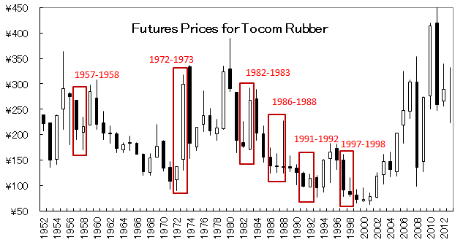
3.3 Incident influence - climate factors
Taking El Nino as an example:
Start and end | Duration (Mth) | Strength
Aug. 1951~Apr. 1952 | 9 | Weak
Apr.1953~Oct. 1953 | 7 | Weakest
Apr. 1957~Aug.1958 | 17 | Strong
July1963~Jan. 1964 | 7 | Weakest
May. 1965~ Mar. 1966 | 11 | Medium
Oct. 1968~ Jan. 1970 | 16 | Medium
June 1972~Mar. 1973 | 10 | Strong
June1976~Mar.1977 | 10 | Weak
Sept. 1982~Mar.1983 | 7 | Strong
Oct.1986~Mar.1988 | 18 | Strong
May1991~June1992 | 14 | Strong
Apr.1993~Nov.1993 | 8 | Weak
May1994~Feb. 1995 | 10 | Medium
May1997~ July1998 | 15 | Strongest
May 2002~Mar.2003 | 11 | Medium
July 2004~Feb. 2005 | 8 | Weak
Sept.2006~Jan.2007 | 5 | Weak
June 2009~ May 2010 | 12 | Medium
The global environment is deteriorating with increasing occurrence of extreme climate and natural disasters. According to the historical statistics of El Nino, it occurs about every 4 years. The next occurrence is estimated in 2017 -2018.
Although the extreme climate has certain influence on the price of natural rubber for its agricultural product property, we still consider the climate offers more support than impact. The price trend of NR is still attributed to its industrial pattern and financial attributes.

Slide 40
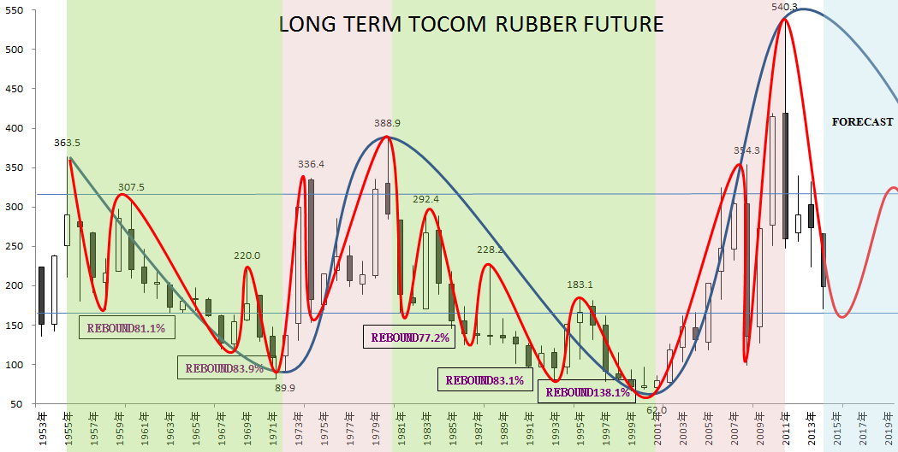
3.4 Long-term price cycle
From the long-term trend cycle of TOCOM rubber:
1. During falling, restoration is driven by external forces for several times. The themes include warfare, policy driver, acceleration of regional economy growth, etc., with a rebound by about 80%.
2. The turnaround of the deterioration in the cycle requires resonance of supply & demand and economy.
3. During the rise, over-optimism - de-bubbling occurs, and push to a new height after rapid restoration and end an entire cycle.
Conclusion:
After statistical treatment and comprehensive prediction, we tend to conclude that a restoration is expected after the current rubber price slumps for almost 4 years. The main price range of rubber is 170 - 310 Yen/kg, i.e. 1700 - 3000 dollars/ton.

Slide 41
3.5 Short-term fundamental disturbance factors
1
With the rubber price going down, the supply acceleration is significantly slowed down compared with ex ante expectation.
2
Under the new normal background, the auto industry sees the ending of rapid growth and a beginning of steady development. Specifically, the medium and heavy-duty trucks, which are more influenced by the demand for rubber raw material, shows a negative growth period.
With the Chinese OBOR strategy, although the practical demands for rubber is not apparent in a short term, the price will respond to the expectation.
3
Upstream jointly supports the price and plans to reduce output, abandoned SICOM pricing system, etc.; raw materials are in short supply and the spot is sold reluctantly.
Once a dealer breaches the contract, the investors who previously sold for hedging and tyre manufacturers will be faced with forced liquidation of futures or the demands for increasing covering, which may drive further rubber price pulse.
The excessive production and marketing of global NR significantly contracted in 2014 and stroke a balance.

Slide 42
3.6 Price trend prediction and trading strategies
Inter-market arbitrage
SCR WF
SHFE
Jan.
May
Sept.
Underlying asset of futures
RSS3
TOCOM
Inter-month arbitrage
Recent month
Far month
TSR20
SICOM
Main force
Sub-main force
No. 3 smoked
rubber sheet
Underlying spot
Non-underlying spot
Arbitrage
Standard rubber
Futures-cash arbitrage
Synthetic
rubber
Futures-cash arbitrage
No. 20
Standard
rubber
Compound
rubber
Domestic
SCRWF
Latex
……
Arbitrage between spots

Slide 43
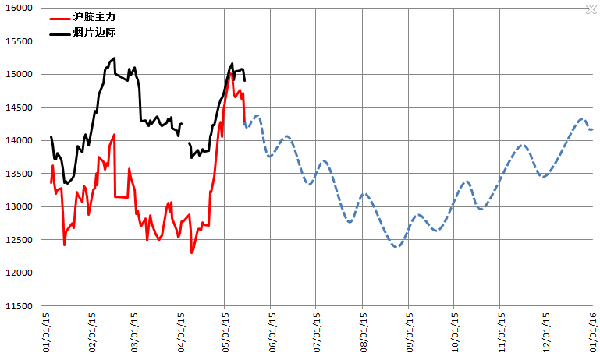
3.6 Price trend prediction and trading strategies
Shanghai rubber major force
Driven by macro financial features
Smoked sheet margin
Imported smoked sheet price as upper margin
FED raises IR
Continuous demands deterioration
Issuance of compound rubber policy
Anti-dumping and countervailing measures in place
Possible reserve throw
Price fall
Spread regression
Price goes up in volatility after repeated release of structure pressure

Slide 44
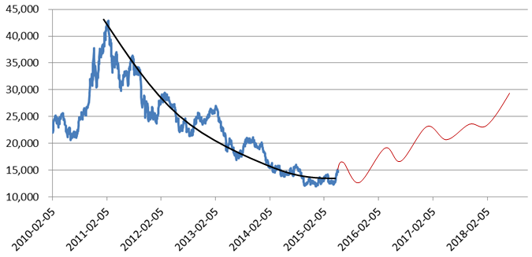
3.6 Price trend prediction and trading strategies
Decline is slowing down
With the growing population and improved revenue structure, people are raising their requirements for life quality and demands for automobile and rubber products; on the other hand, land is becoming scarce and the land supply for rubber plantation is limited.
Stimulated by high profitability, the global tyre productivity is expanded rapidly. The transfer of productivity to rubber producers has become a main trend. under this high productivity pattern, the demand for NR will remain strong.
We are positive about the demand for rubber from BRIC and emerging countries such as India or a surging demand like the Chinese market. The driving force may come from the OBOR and industry integration.

Slide 45
Thank You !
Wang Zhihong
Whiterock Assets Management (Shanghai) Co., Ltd.
wangzh@whiterock.cn

