Slide 1
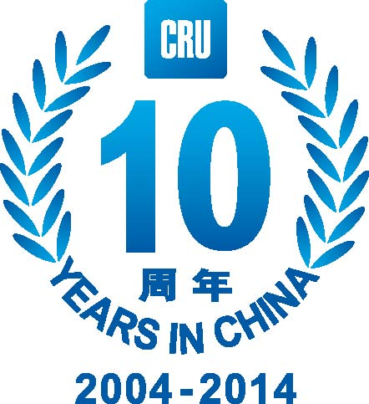
Bulks versus Base Metals
Why base metals prices are set to outperform bulk commodities
John Johnson, CEO, CRU China
www.crugroup.com

Slide 2
Disclaimer
This presentation is supplied on a private and confidential basis to the customer. It must not be disclosed in whole or in part, directly or indirectly or in any other format to any other company, organisation or individual without the prior written permission of CRU International Limited.
Permission is given for the disclosure of this report to a company’s majority owned subsidiaries and its parent organisation. However, where the report is supplied to a client in his capacity as a manager of a joint venture or partnership, it may not be disclosed to the other participants without further permission.
CRU International Limited’s responsibility is solely to its direct client. Its liability is limited to the amount of the fees actually paid for the professional services involved in preparing this presentation. We accept no liability to third parties, howsoever arising.
Although reasonable care and diligence has been used in the preparation of this presentation, we do not guarantee the accuracy of any data, assumptions, forecasts or other forward-looking statements.
Source: CRU
www.crugroup.com
2

Slide 3
Areas for discussion
Starting point, 2014-2015
Bulk commodities, Market outlook, Unrelenting supply
Base Metals, Market outlook, Divergence of views:
  Demand, especially China
  Supply
Conclusions
Source: CRU
www.crugroup.com
3

Slide 4
“CRU China 10 price” index - down 20% in last two years & poor start in 2015
Source: CRU
www.crugroup.com
4
Index of Chinese prices for steel, coking coal, al, cu, ferts, stainless, gold, lead, zinc, & tin January 2012 = 100

Slide 5

The $245Bn reasons to forget 2014
Bulk Commodities:
Down 9.9%, 232$Bn
Base Metals:
Up 3.4%, 11.5$Bn
Precious Metals:
Down 10%, 15.8$Bn
Fertilizers:
Down 19%, 9.1$Bn
Includes
Mined Materials: Bauxite, Met Coal, Met Coke, Iron Ore & Thermal Coal
Base Metals: Al, Cu, Ni, Co, Mo, Sn, Zn, Pb
Precious Metals: Gold, Silver, Palladium, Platinum
Fertilizers: Phosphate Rock, Potash
Iron
Ore
Cu
Coal
Au
Ferts
Source: CRU
www.crugroup.com
5

Slide 6
2015 forecast: Strengthening economy but slow markets remain
Lower oil prices are net positive for the outlook
Modest economic growth in 2015 – US is key
Slow, firm, commodity demand growth
Mining margins & CEOs to remain under pressure
Chinese indicators & US$ strength to drive investor sentiment
A recovery in IPO, M&A activity
CRU expects 7% average y/y price decline across commodity basket
Source: CRU
www.crugroup.com
6

Slide 7
China worries: CRU now expects 7% price decline across basket*
CRU basket of 34 mining, metals and fertilizer commodities
Sulphuric Acid, Potash, Phosphate Rock
Bauxite, Alumina
Cobalt, Coal Tar Pitch, Palladium
Calcined PetCoke, Met Coke, Phosphate DAP, Silicon, Aluminium, Thermal Coal, Chrome Ore, Zinc, Gold, Sulphur
Lead, Ferrochrome, Copper, Platinum, Urea, Nickel
Silver, Ammonia, Silico-Manganese, Met Coal, Tin, Manganese, Molybdenum, Metallics, Brent Crude, Iron Ore
Hot
> 15%
Warm
5% to 15%
Mild
0% to 5%
Cool
-5% to 0%
Cold
-15% to -5%
Freezing
< -15%
Source: CRU *2015 annual average price forecast over 2014 actual annual prices (30th Apr 2015)
www.crugroup.com
7

Slide 8








Bulk Commodities, Market outlook, Unrelenting supply
Source: CRU
www.crugroup.com
8

Slide 9
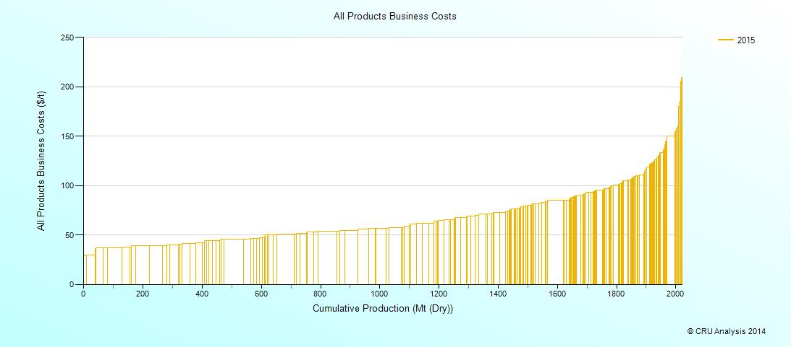
Bulk Commodity producers face multiple threats
slower demand growth
decline in market prices
flexible competitors
new, low cost, production
cost competition
Source: CRU
www.crugroup.com
9

Slide 10
Base Metals, Market outlook, Divergence of views
Euphoria
Optimism
Anxiety
Excitement
Denial
Strategy
Execution
Opportunity
Market Sentiment
Fear
Relief
Capitulation
Despondency
Denial
Anxiety
Hope
Source: CRU
www.crugroup.com
10

Slide 11
Risk appetite to build or finance new base metal mines remains low
Value of Indonesian Exports (1)
Selected mineral ores, $ million
Grades
Operating costs rise as grade falls
Ever larger project scale & capital requirements
People
Easy wins achieved, incremental innovation difficult
Focus on leadership & short term performance
Society
New mines open Pandora’s box on division of returns
water, energy, environment, local & central distribution
Source: CRU, SEKI
www.crugroup.com
11
Notes:
Too this
Grades
Innovation offsets cost impact of grade decline
‘Right-size’ projects capture scale & scope benefits
Distribution
Top-down clarity in pre-tax NPV split mine-by-mine
Delivery of growth in societal returns from mining
People
Highly-valued workforce
Step-change improvement
Focus upon team performance

Slide 12
…and medium term price upside exists. Invest now?
Aluminium
Zinc
Lead
Mt
Wks
Mt
Wks
kt
Wks
Copper
Nickel
Molybdenum
Mt
Wks
kt
Wks
klbs
Wks
Source: CRU
www.crugroup.com
12

Slide 13
China so important for global demand - 44% of global consumption across 15 key commodities in 2014
Note the deficits in supply
in these commodities
Source: CRU
www.crugroup.com
13

Slide 14
China’s medium term demand outlook lower than GDP over next 5 years
Source: CRU
www.crugroup.com
14
Average annual consumption for steel, coking coal, al, cu, ferts, stainless, gold, lead, zinc, & tin

Slide 15
But prospects better in gold & base metals than carbon steel
Commodity | CAGR 2004-2014 | CAGR 2014-2019
Gold | 10.9% | 7.2%
Stainless steel/Nickel | 11.4% | 6.4%
Aluminium | 16.0% | 6.0%
Zinc | 9.3% | 4.3%
Copper | 10.5% | 3.6%
Lead | 12.9% | 2.0%
Fertiliser | 3.4% | 1.6%
Tin | 5.9% | 1.0%
Steel | 11.5% | 0.3%
Coking coal | 11.1% | -0.3%
Total (average of China 10) | 10.7% | 3.2%
Source: CRU
www.crugroup.com
15
Notes:
New one add Tin

Slide 16
Copper still waiting for signs of a Q2 deficit
Cumulative change in global stock position (LME, COMEX, SHFE, bonded) per year, ‘000t
Source: CRU, LME, SHFE, Comex
www.crugroup.com
16

Slide 17
Copper expectations deteriorate on weak start to 2015
World:
+2.3%
Refined copper consumption change in 2015 (y-o-y%)
E&C Europe :
-14.7%
West Europe:
+3.4%
North America:
+2.4%
R.O.K:
-1.3%
> 6%
4% – 6%
2% – 4%
0% – 2%
-5% – 0%
< -5%
China:
+4.0%
Japan
+1.2%
South & Central America:
-2.6%
India:
+5.1%
Taiwan
0%
Asia:
+3.5%
Source: CRU
www.crugroup.com
17

Slide 18
Chinese copper demand soft so far, catch-up expected from June
Destocking of air conditioners to be complete by Q2
Residential AC market, y-o-y % change (RHS) & M units (LHS)
Central gvt shows support for real estate industry
Source: CRU, National Energy Administration, Chinese NBS, chinaiol.com
www.crugroup.com
18

Slide 19
Copper bright spots vs. headwinds for consumption
Base case
y-o-y%
Growth in global production of cars and commercial vehicles
Global demand is still too reliant on emerging market investment, particularly Chinese investment
Trends in capital flows could damage EM investment in 2015
Source: CRU, IEA, LMC Automotive
www.crugroup.com
19

Slide 20
Limited copper mine production growth in 2015, to speed up in 2016
Growth in mine output* ‘000t, and % change
Positive and negative contributors to 2015 growth
1.55Mt
-1.42Mt
* After probability adjustments and disruption allowance
Source: CRU, company reports, media
www.crugroup.com
20

Slide 21
Weakened contribution from copper projects, especially by 2019
’000t
Mines that have recently started-up or are due to start-up with capacity of >100,000t/y
Source: CRU, company reports, media
www.crugroup.com
21

Slide 22
Net of by-product copper cash costs do not tell the whole story
Real (2014$) brownfield expansion and greenfield project costs, $/t
25%
50%
75%
Cumulative production (‘000t Cu)
Source: CRU
www.crugroup.com
22

Slide 23
Refined copper production growth to peak in 2016 at 4.7%, and slow markedly from 2017 onwards
Refined copper production forecast by type
Refined copper output change: 2014-2019
China’s share of world refined copper output
2014
2019
Source: CRU
www.crugroup.com
23

Slide 24
Recent mine project delays cement our medium-term Cu price view
LME cash price and global supply/demand balance, 2013-2019
Source: LME, CRU. Note: Balances after accounting for SRB buying
www.crugroup.com
24

Slide 25
Areas for discussion
Starting point, 2014-2015
Bulk commodities, Market outlook, Unrelenting supply
Base Metals, Market outlook, Divergence of views:
  Demand, especially China
  Supply
Conclusions
Source: CRU
www.crugroup.com
25

Slide 26
Mining & Metal prices recover strongly by 2019 whilst fertilizers lag*
CRU basket of 34 mining, metals and fertilizer commodities
Zinc, Calcined PetCoke, Tin, Nickel, Coal Tar Pitch, Sulphuric Acid, Cobalt, Palladium, Bauxite, Met Coke, Met Coal, Copper, Potash, Aluminium, Alumina, Platinum, Thermal Coal, Phosphate Rock
Ferrochrome, Chrome Ore, Urea, Brent Crude
Lead, Silicon
Manganese
Phosphate DAP, Ammonia, Silico-Manganese, Gold
Metallics, Molybdenum, Iron Ore, Sulphur, Silver
Hot
> 15%
Warm
5% to 15%
Mild
0% to 5%
Cool
-5% to 0%
Cold
-15% to -5%
Freezing
< -15%
Source: CRU *2019 annual average price forecast over 2014 actual annual prices (30th Apr 2015)
www.crugroup.com
26

Slide 27
Conclusions
1. 2015 forecast: Strengthening economy but slow markets remain
2. China worries: CRU expects 7% price decline across basket
3. Bulk Commodities, Market outlook, Unrelenting supply
4. Base Metals, Market outlook, Divergence of views
5. Do you have the risk appetite to invest in new base metals mines?
Source: CRU
www.crugroup.com
27

Slide 28
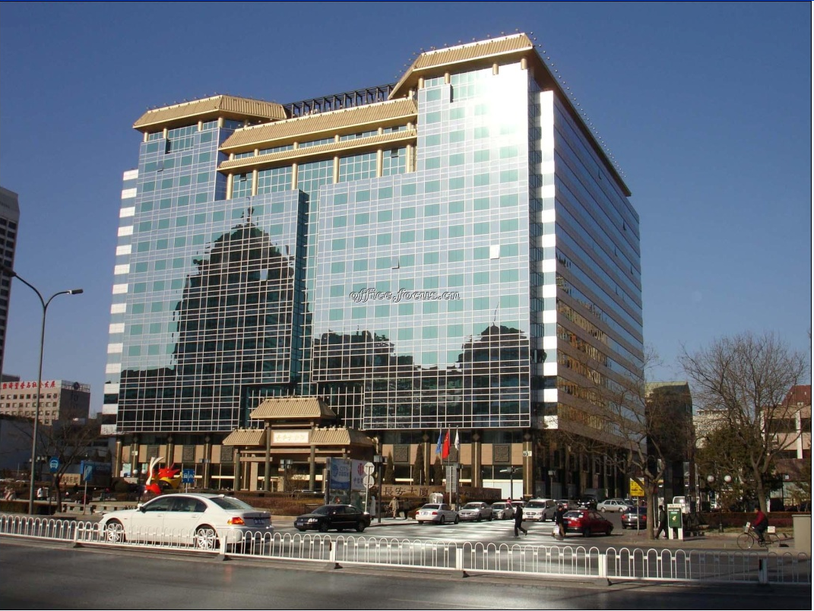



For more information
John Johnson
CEO CRU China
john.johnson@crugroup.com
Tel. +86 10 6510 2208
Mob. +86 13911122605
Mr Lian Liu
Business Development Executive
Beijing, China
Lian.Liu@crugroup.com
Tel. +86 10 6510 2193
Mob. +86 158 1024 1014
Wan Ling
Assistant Chief, China Office
& Head of Asia, Base Metals & Aluminum Ling.wan@crugroup.com
Tel. +86 10 65102183
Source: CRU
www.crugroup.com
28

Slide 29
Thank You！

