Slide 1


Base Metals Outlook
Haihua Shen
Senior Portfolio Manager
HFZ Capital Management Limited
May 28th, 2015
Shanghai, China

Slide 2
Disclaimer
This document is being issued by HFZ Limited (‘HFZ’) and HFZ Capital Management Limited (“HFZC”) and is for private circulation only. HFZ is authorized and registered by the Bermuda Monetary Authority whilst HFZC is authorized and regulated by the Securities and Futures Commission in Hong Kong. The information contained in this document is strictly confidential and has been provided to the recipient for informational purposes only. The information contained herein does not constitute an offer to sell or the solicitation of any offer to buy any securities and or derivatives under any jurisdiction and may not be reproduced, distributed or published by any recipient for any purpose without the prior written consent of HFZ or HFZC. Such offer or solicitation may, subject to applicable securities laws, only be made by the relevant Confidential Private Placement Memorandum. Under no circumstances is the information contained herein to be construed as a prospectus or advertisement. Neither the U.S. Securities and Exchange Commission nor any securities regulator or enforcement body has approved or disapproved of the transactions contemplated hereby or determined if the information is truthful or complete. Any representation to the contrary is a criminal offense.
The value of investments and any income generated may go down as well as up and is not guaranteed. You may not get back the amount originally invested. Past performance is not necessarily a guide to future performance. Changes in exchange rates may have an adverse effect on the value, price or income of investments. There are also additional risks associated with investments in emerging or developing markets.
The information and opinions contained in this document are for background purposes only, and do not purport to be full or complete, nor does this document constitute investment advice. No representation, warranty, or undertaking, express, implied, or limited, is given as to the accuracy or completeness of the information or opinions contained in this document by any of HFZ or HFZC, its partners or employees and no liability is accepted by such persons for the accuracy or completeness of any such information or opinions. As such, no reliance may be placed for any purpose on the information and opinions contained in this document.

Slide 3
Macro: Weak in Q1, but forecasts are optimistic for a recovery
Global GDP was weak in Q1
  Growth in Q1 likely to be between 1% and 1.5% qoq, SAAR, the weakest quarter in 20 years (outside of the global financial crisis).
  Significant negative weather events in North America were a “one-off” although transpiring for the 2nd year in a row.
  More pronounced cyclicality in Chinese demand is also becoming evident.
  Economic activity undermined by significant increase in volatility in oil and other commodity prices.
  Economists hope for a GDP recovery, towards 2.5% - 3.0% in Q2, with government stimulus, QE and household spending the main drivers.
  Geopolitical risks do however remain elevated.
Macro headwinds to commodity prices
  Fed still the only major central bank with a plan to tighten monetary policy; the USD has strong upside risks (still).
  The Q2+ GDP recovery is hampered by adverse productivity trends and signs of excess inventories globally. Indeed, PMI measures are suggesting that the global growth improvement will take place largely in the service sector. Manufacturing to lag, most likely.
  Fundamentally, supply for most commodities is positioned for a stronger demand environment. Excess inventory is evident in energy, agriculture and metals.
  While monetary policy is lax globally, interbank and private sector credit extension is far from lax. Policy rates less linked to private sector rates after 6 years of QE.

Slide 4
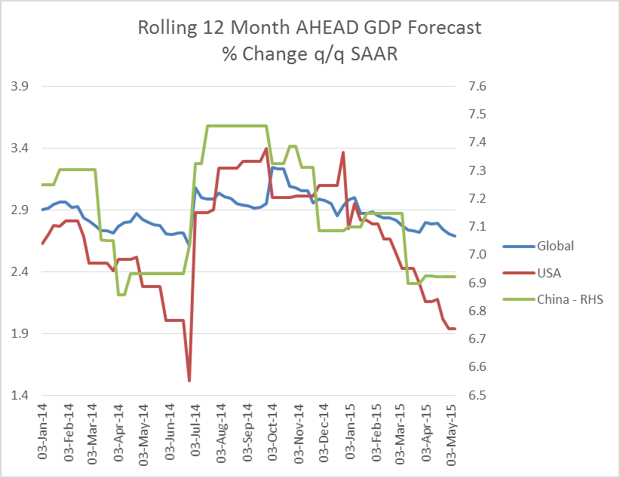
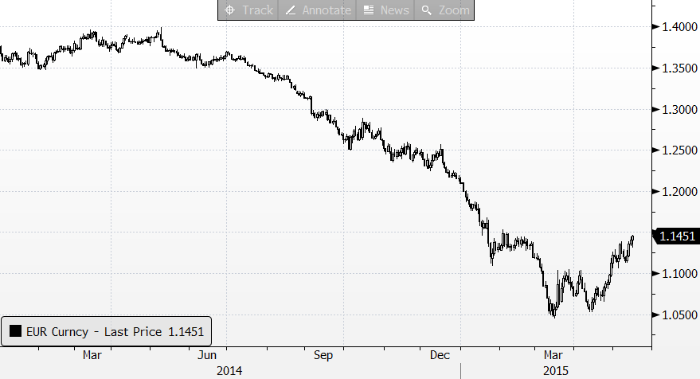
Macro: Weak in Q1, but forecasts are optimistic for a recovery
World growth has been revised down
Euro staged an unexpected recovery
Source: JPMorgan, HFZ Capital Estimates

Slide 5
China metal demand: down and out?
Year to March apparent consumption growth for China copper was ~zero. Real consumption was likely negative.
  Copper demand has been poor.
  The same applies for zinc, aluminium, nickel and lead.
Seasonal uptick for base metals arrived in April, but it lost momentum in May.
Chinese economic data for April was weak; further core softness in IP, FAI, retail sales, but fiscal spending was very strong.
The weakness in consumption indicators and actual consumption raises the prospect that this cyclical credit induced weakness is structural, and permanent.
  Many analysts highlight the visible peak in residential housing sales and starts as the key reason to expect weaker, structural, base metals consumption.
We believe that the weakness in H1 will be partially reversed in H2. Chinese consumption will show + Y/Y comparison in H2.
For base metals, consumption growth will be supported by stimulus combined with an improved global GDP environment
  Non-residential property construction (~50-60% of total construction is doing relative better than the weak residential housing market)
  Consumer goods; autos, white goods supported by the “consumer” economy.
  Broad infrastructure spending – with renewed focus on trade and supply chain infrastructure – such as the “One Road, One Belt” initiatives.
  Exports of semi fabricated and fabricated products, like aluminium semis and galvanized steel, will provide some support to metal demand.

Slide 6
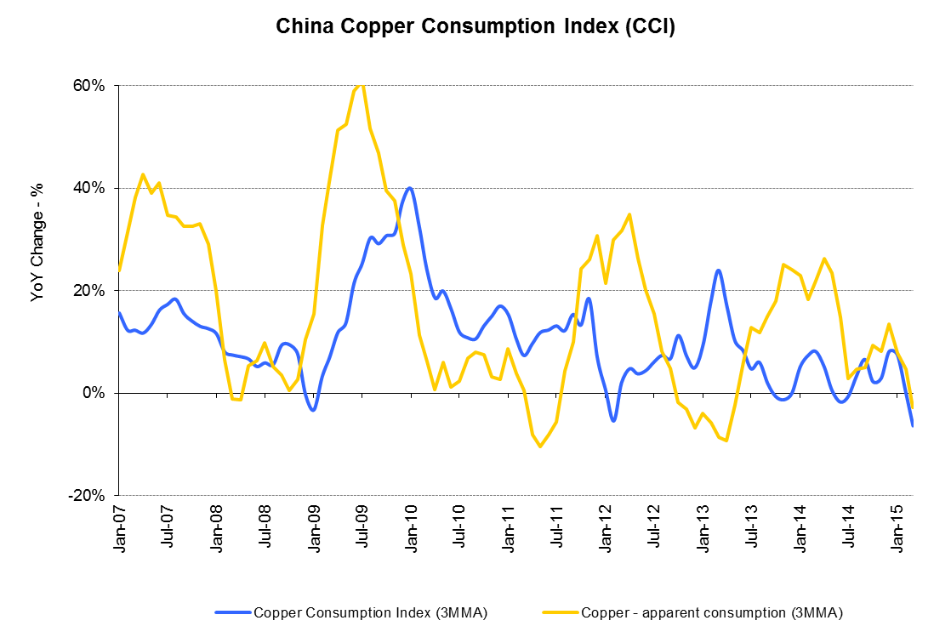
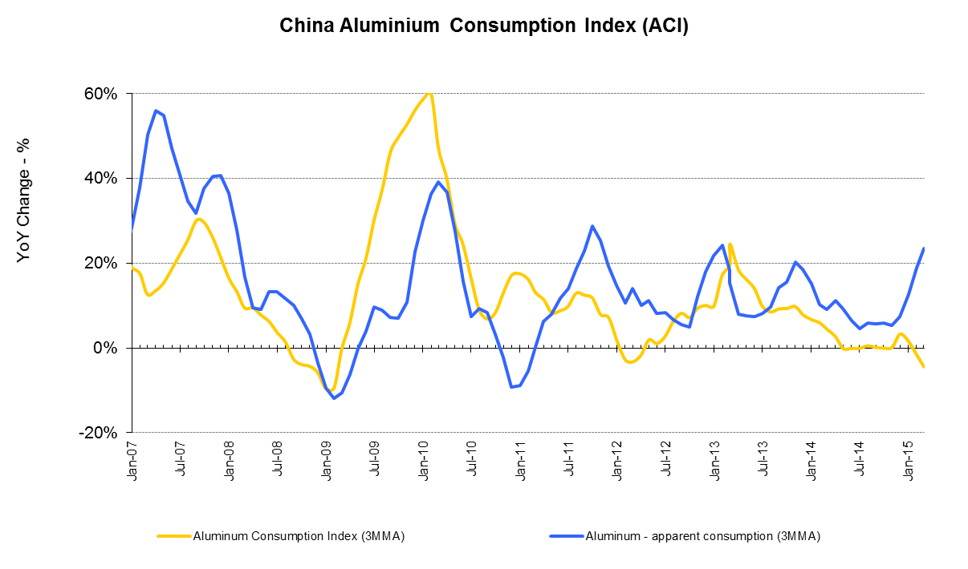
China metal demand: down and out?
Source: Morgan Stanley
Morgan Stanley indicators of consumption point to very weak dynamics in Q1!

Slide 7
Copper: The China story is not so rosy, …
Key driver of consumption (State Grid), shows spending negative year to date
  forecast is for an improvement, but when?
Negative growth in residential housing starts and sales will drag on consumption growth going forward
Scrap market is surprisingly loose in spite of a prolonged decline in scrap imports into China; not only is China producing more domestic scrap (+20%yoy in 2014) but direct scrap use is becoming less important
Net imports of refined cathode remain robust, but nil growth in year on year terms is possible
  Chinese smelters remain active in exporting to bond
Concentrate market remains oversupplied, although tightening currently due to weaker than expected mine production in H1 (rains in Chile, price-induced production cuts, disruptions)
Qingdao has significantly affected the ability of the supply chain to finance itself. With less asset-backed credit available for industry, the number of traders and the resulting import volumes have dropped significantly
Q2 demand season appears to have been softer than usual
Current price environment hard to sustain unless global demand improves but prices will be supported by ongoing supply adjustments.

Slide 8
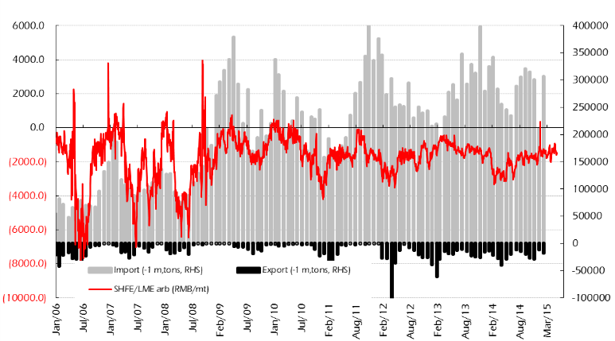
Copper: The China story is not so rosy, BUT…
Global Copper Inventory (MT)
Despite copper price weakness, spot import margins remain negative
Global Copper Inventory (MT)
China Import/Export (MT)
Spot Margin to Breakeven ($/MT)
Source: HFZ Capital Management Limited Estimates, LME, SHFE, Bloomberg
Source: HFZ Capital Management Limited Estimates, LME, SHFE
China Housing Data continues to show tangible signs of slowing
Global Copper Premiums ($/MT)
Y/Y % Change
Copper Premiums ($/MT)
Source: HFZ Capital Management Limited Estimates, Bloomberg
Source: HFZ Capital Management Limited Estimates, Bloomberg

Slide 9
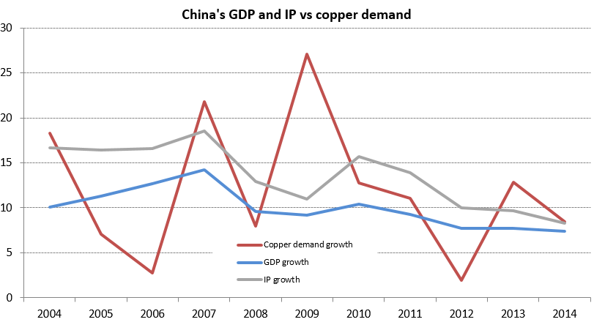
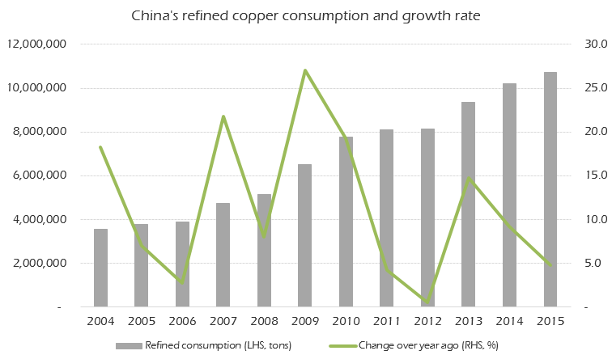
Copper: Actual demand was much better than expected in 2014, Why?
Source: HFZ Capital Management Limited estimates, Wood Mackenzie
Source: HFZ Capital Management Limited estimates, Wood Mackenzie
Copper is a late stage application in the construction cycle.
  Completions were still in positive territory in 2014
Direct use of scrap has been declining. A reverse substitution into Cathode.
Possible negatives in 2015:
  Housing completion is in negative territory now;
  Scrap supply looks adequate;
  Aluminum-alloy cable is being accepted.

Slide 10
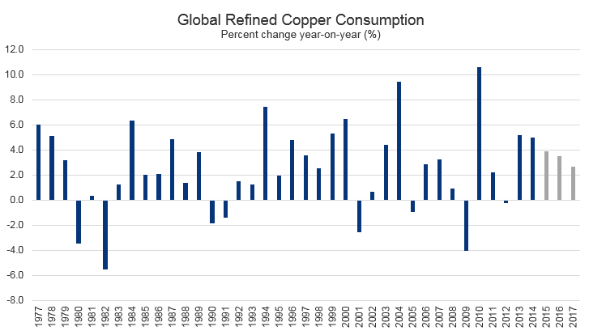
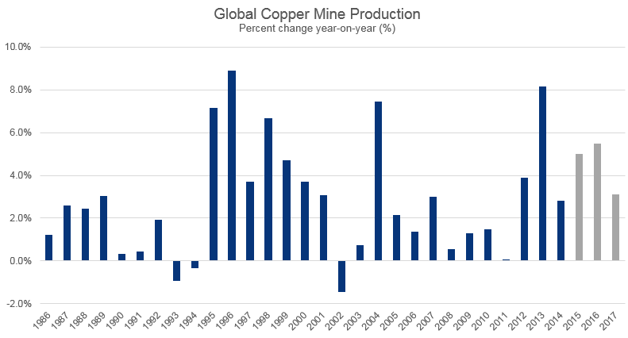
Copper: A demand story or a supply story?
For most of the time, market attention has been focused on the demand side: from macro economic data to industry-specific data points or information like final product production, inventory and premium.
  But on annual basis, global refined consumption growth has been relatively stable; 2.8% per year from 1986-2014.
Occasional economic/financial crises did affect demand, but subsequent economic recovery usually made up the losses in demand.
Global mine supply is more uneven:
  1.2% for the 1986-1994 period,
  5.4% for the 1995-2001 period
  1.7% for the 2002-2011 period
  5.1% for the 2012-17 period.
Chart Sources: HFZ Capital Management Limited estimates, Wood Mackenzie

Slide 11
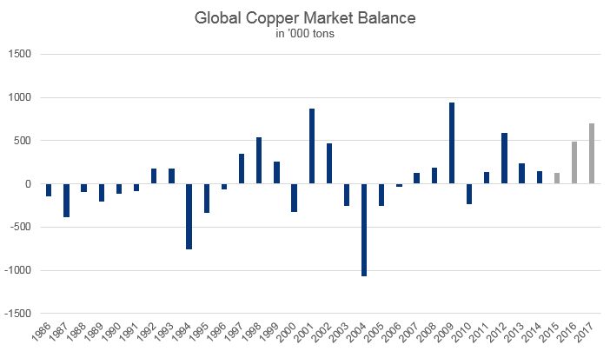
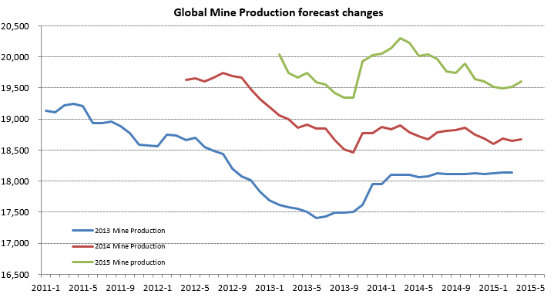
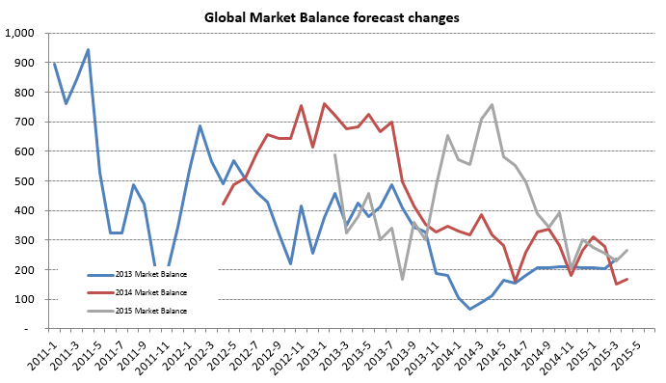
Copper: A demand story or a supply story?
We are now in the period of relatively high mine production growth (2012-2017).
  According to Wood Mackenzie mine supply over this period (before disruptions) should increase 30%.
However, we are now half way through this period, and yet the market surplus is insignificant:
  Global surplus less than 1% of world production!
“Big surplus is coming”, but that has been postponed for the past three years!
Research institutions consistently downgrade their mine output forecast, hence their global refined metal surplus forecast.
Charts Sources: Wood Mackenzie, HFZ Capital Estimates

Slide 12
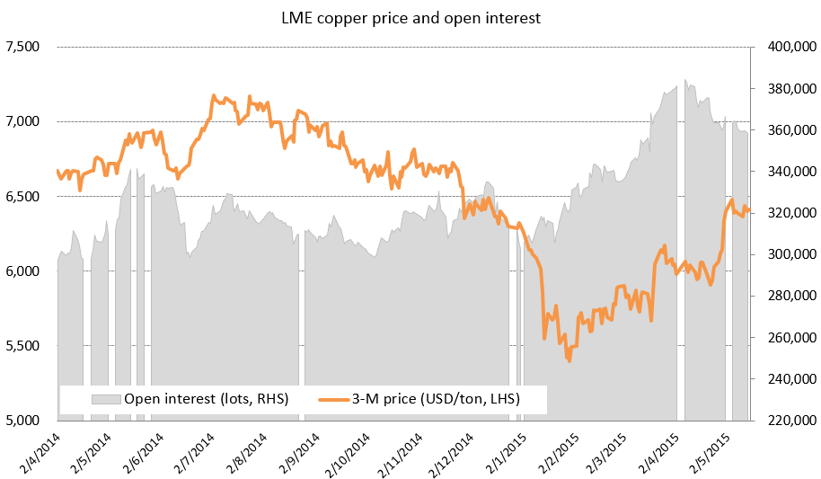
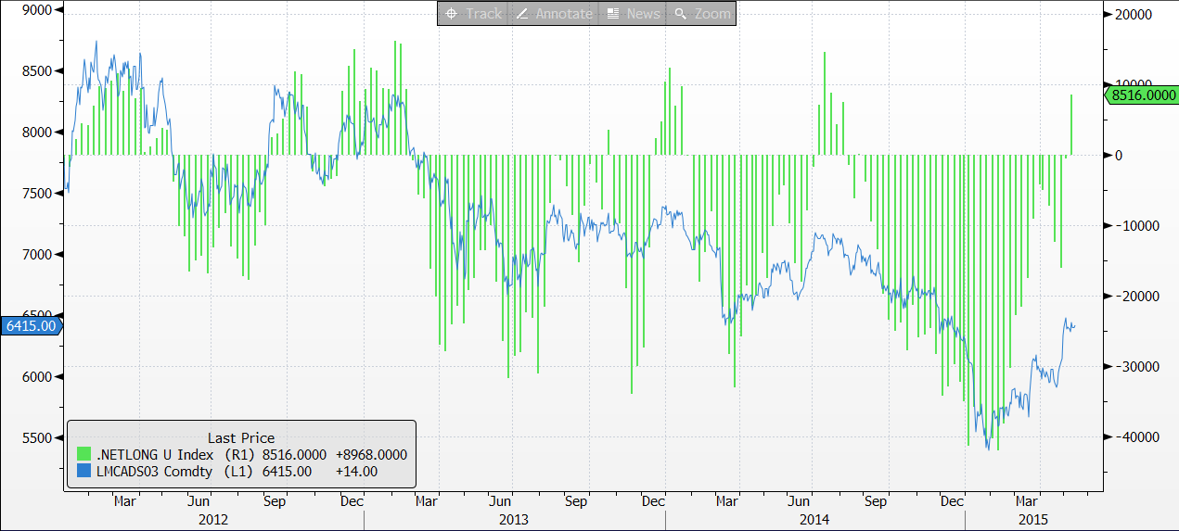
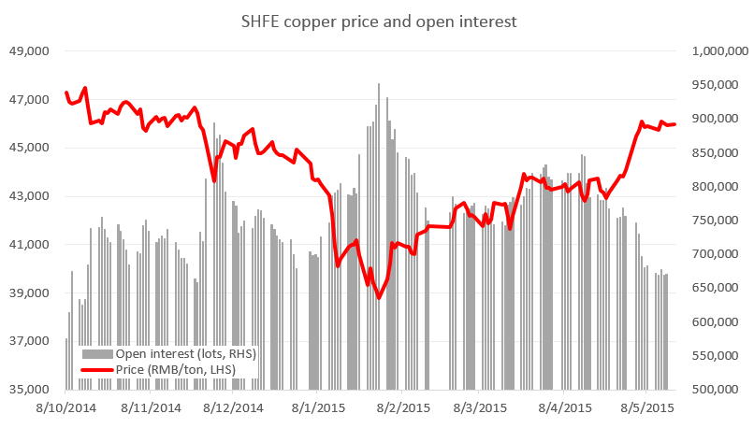
Copper: What has changed since May 1st?
Capitulation of short sellers
Non-commercial players even went long!
What’s going forward?
Financing-related import remains robust, but can Chinese imports be stronger than expected?
Can Chinese physical market provide further support?
Will mine supply shoot on the downside?
Can the physical market tighten further?
Can Chinese economy rebound meaningfully? Will expectation turn into disappointment?
Sentiment can reverse quite easily and quickly!
Charts Sources: HFZ Capital Estimates, Bloomberg, LME, SHFE

Slide 13
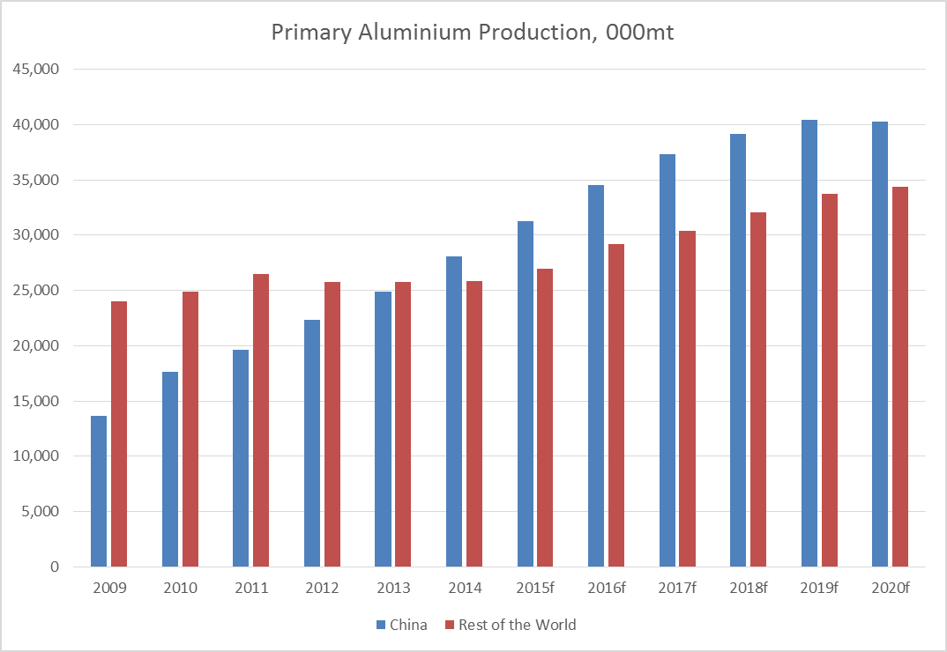
Aluminium: Excess supply in perpetuity?
Excess inventory continues to undermine premia in the west and undermine prices in China.
  Total global aluminium inventory >12 million metric tonnes
The deficit in global supply and demand in 2013-2014 is rapidly coming to an end.
  Both China and the Rest of the World are expected to be in balance / surplus in 2015 and 2016.
Rest of World aluminium production expected to show its strongest period of capacity growth in almost 20 years, over the next 2 years.
  From 2004-2014 the Rest of the World added 2.7mio metric tonnes of productive capacity.
  According to Harbor, from 2014 to 2016 the RoW will add 3.3mio mt of productive capacity.
Aluminium premia have collapsed. The rout is likely not yet over. Consumers have been running hand-to-mouth in light of the doubling/tripling in premia over the last 2-3 years. Now the collapse is taking place they are not in a hurry to cover.
Aluminium production costs have collapsed. From a level of ~$2000/mt the average cost of production has declined to <$1800.
  The USD and the subsequent energy price collapse, along with alternative energy supply in Europe/USA responsible.
Bauxite and alumina shortage arguments have proven largely to be over-hyped. China has significant internal inventory, while new mines opening in SE Asia and West Africa will likely step up to replace the losses from Indonesia.
Sources: Harbor Aluminum, HFZ Estimates
Source: Harbor Aluminum

Slide 14
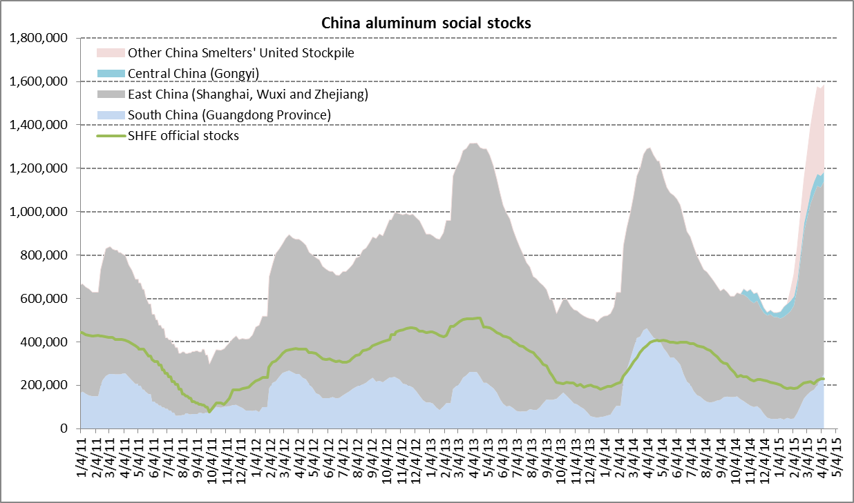
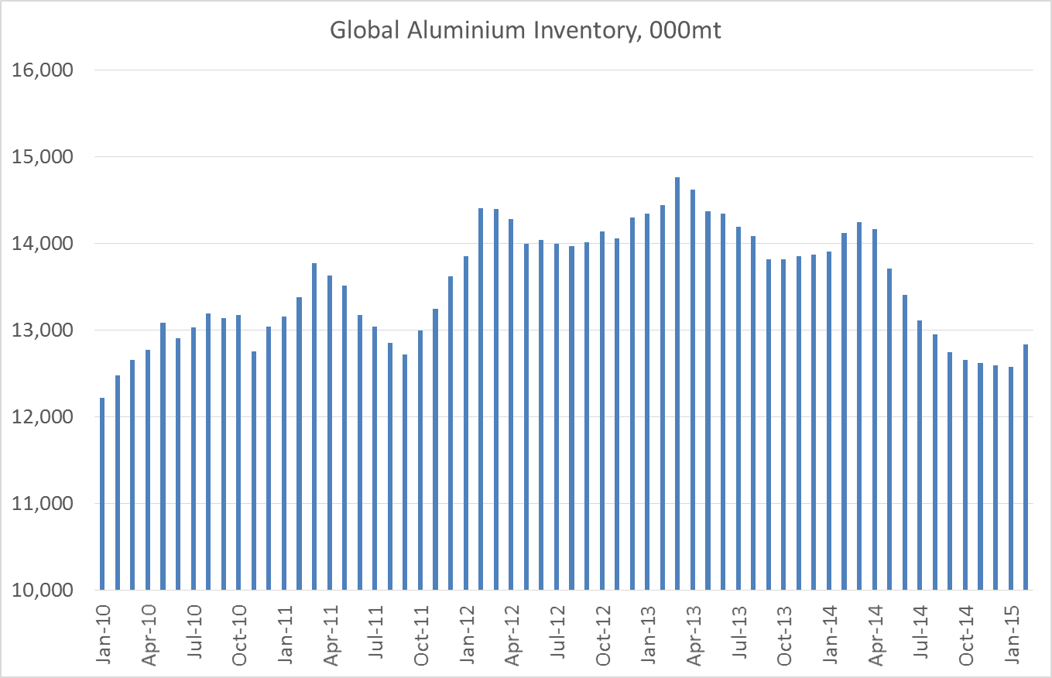
Aluminum: Excess supply in perpetuity?
Global Aluminum Premiums ($/MT)
Chinese Aluminum Inventories (MT)
Premiums ($/MT)
Source: HFZ Limited Estimates, Bloomberg
Source: HFZ Limited Estimates, SMM
China’s Semis Advantage ranges from +$143 to +$318 (May 11, 2015)
Global Inventories remain High….>12 million metric tonnes
Source: Harbor Aluminum
Source: HFZ Limited Estimates, Harbor Research

Slide 15
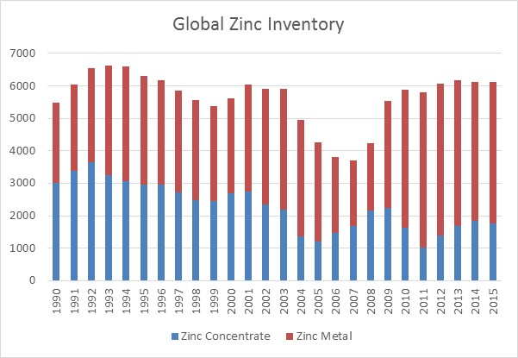
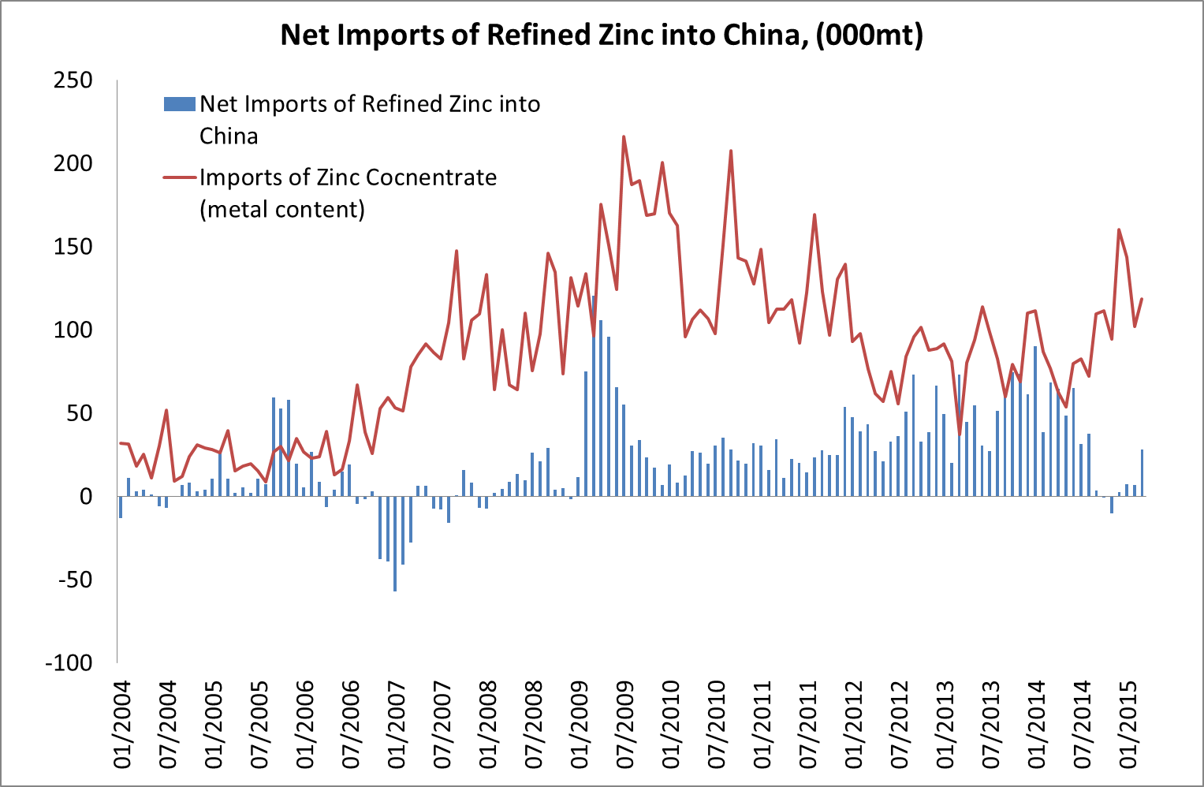
Zinc: Well stocked with improving S&D
The zinc market remains opaque, with the fall in exchange inventories (down 63% since the end of 2012, for a total decline of 800kmt) leading the market to assume that there is a shortage, and/or, the market is structurally in deficit.
However, the reality is that the vast majority of LME load out material has been moved off exchange and remains in financing deals, throughout Europe and the US.
Mine supply is expected to decline in 2015 (-0.5%) after a flat year of production in 2014. However there is likely to be considerable under-reporting of mine supply, especially in Latin America, which is reflected in a weak treatment charge market.
TCs have pushed through to multi year highs in recent weeks/months. Meanwhile the positive spin on zinc is that the closures of Century and Lisheen in Q3 will force the zinc concentrate market into deficit.
  Any zinc concentrate surplus is unlikely to be large nor long lasting given the ability of Chinese and Latin American mines to fill the gap
The import arb for material into China remains deeply negative and when taken in conjunction with weak physical premia suggest that the underlying market dynamic is weak demand.
Zinc’s consumer base (galvanised and diecasting) is being hard-hit by weak domestic demand (autos/construction) and push back on Chinese exports of galvanized steel
Source: HFZ Estimates, CHR Metals
Source: HFZ Estimates, CHR Metals, Bloomberg

Slide 16
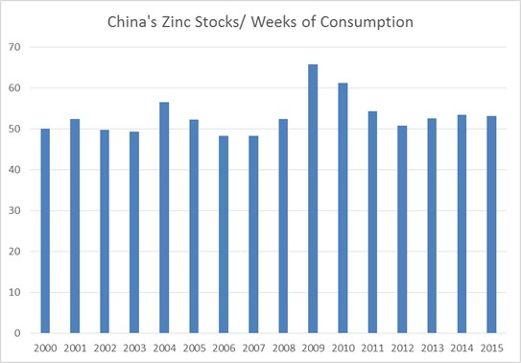
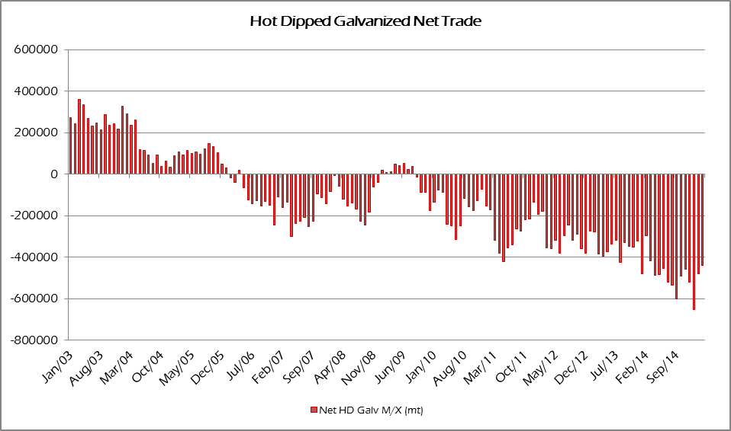
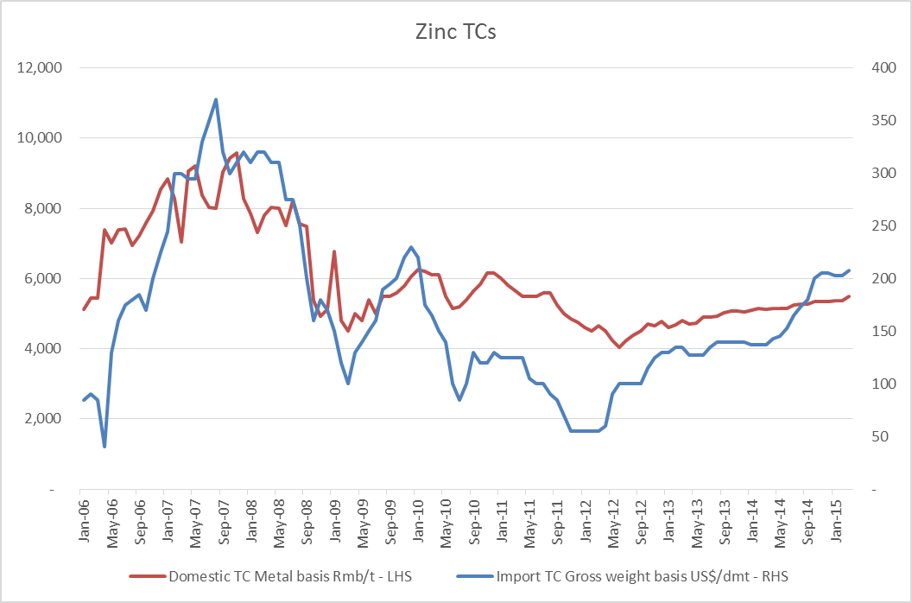
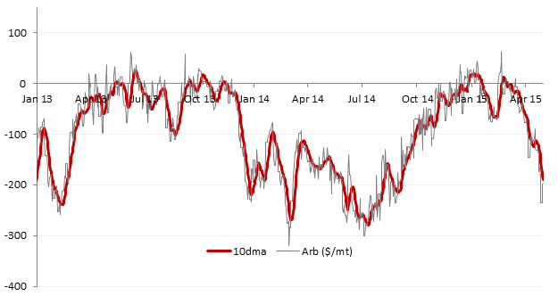

Zinc: Well stocked with improving S&D
Chinese Zinc Stocks
China’s demand for Zinc has largely been exported in HDG form
Source: HFZ Limited Estimates, CHR
Source: HFZ Limited Estimates, NBS
Treatment Charges Suggest Mine Supply is Performing Well
Zinc Import Arb Strongly Implies Weak Domestic Environment
Source: HFZ Limited Estimates, SMM
Source: HFZ Limited Estimates
HFZ Limited

Slide 17
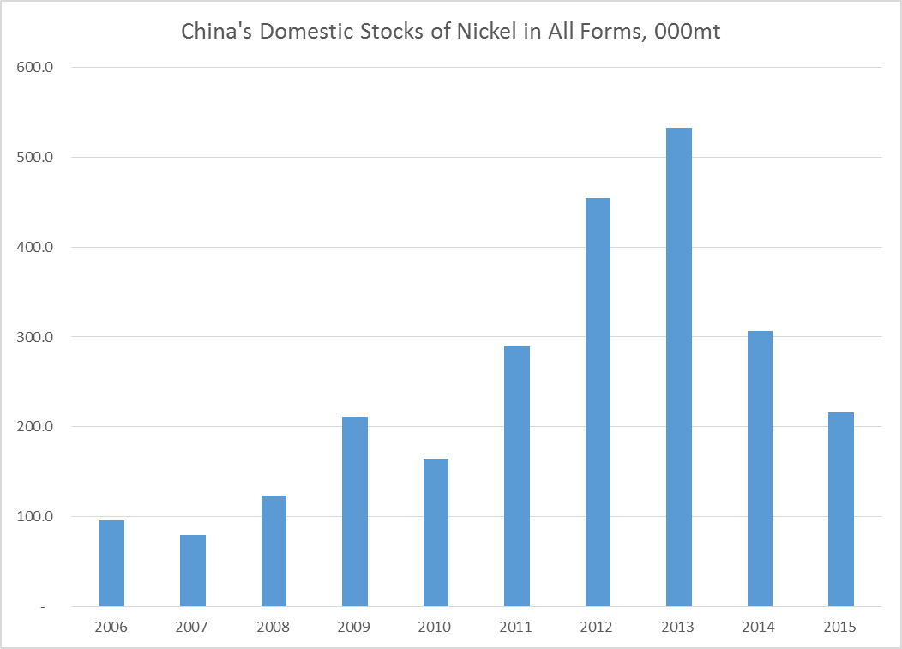
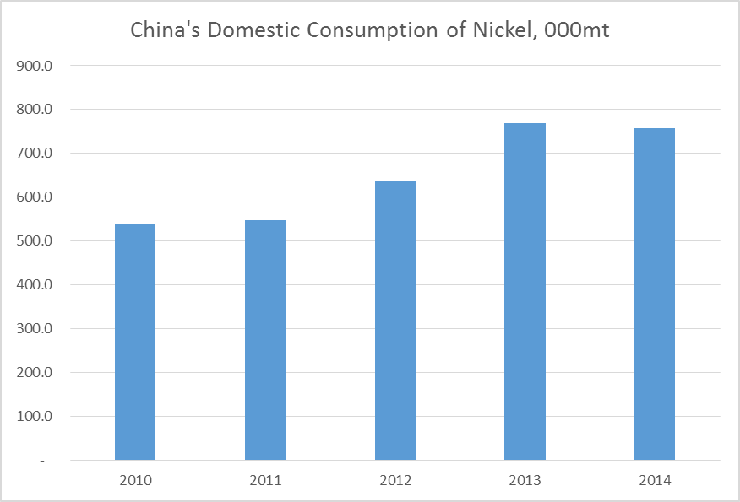
Nickel: Supply side bullish, demand side bearish
Chinese NPI production the base metal market’s main theme for the past 15-18 months; shrinking but not as quickly as original expectations. The expected demand for refined nickel (LME deliverable nickel) has improved marginally, with the balance of 2015 seeing also only further slight improvement.
The key constraint to a tighter refined nickel market is stainless steel production (i.e. nickel demand). Stainless steel production in Q1 in Europe was down 7%yoy, in China was down ~3%yoy and in the US was up strongly on new capacity, although this fed primarily into record levels of inventory at service centres.
The main headwind for Chinese nickel is that last year China exported ~200kmt of nickel in the form of stainless steel. With anti-dumping duties in place in Europe this flow has stopped. While exports to other destinations, such as the US will help, it is unlikely that Chinese stainless steel production in 2015 will grow. Chinese stainless production will fall 0% to 5% in 2015.
Destocking is the key global theme for nickel and stainless. The record levels of LME inventory will easily meet the expected increase in demand for refined nickel in China that results from NPI displacement.
Nickel premia have lifted marginally in recent weeks, but only for CIF China parcels, following likely temporary tightness in the SHFE deliverable contract. Demand for physical ex-China remains soft.
Source: HFZ Estimates, Bloomberg
Source: HFZ Estimates, Bloomberg

Slide 18
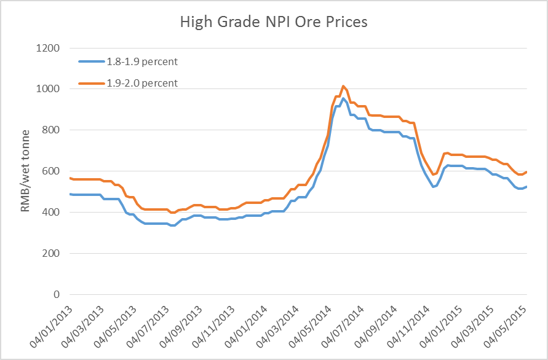
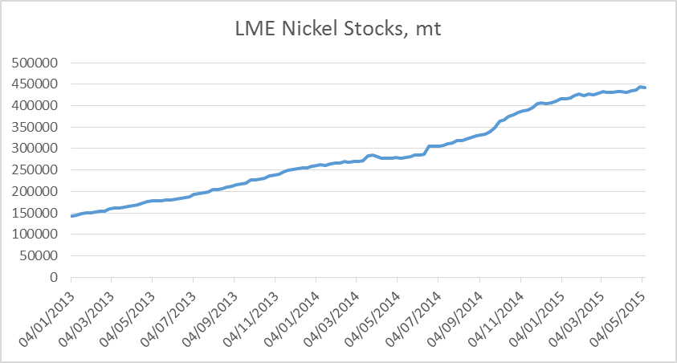
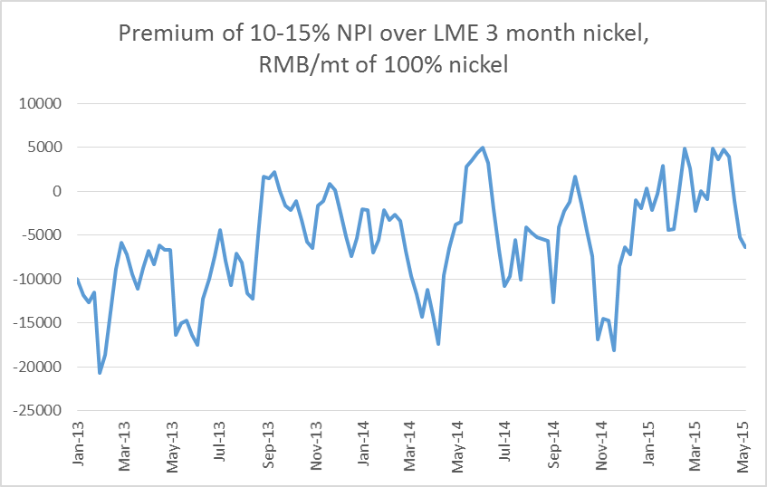
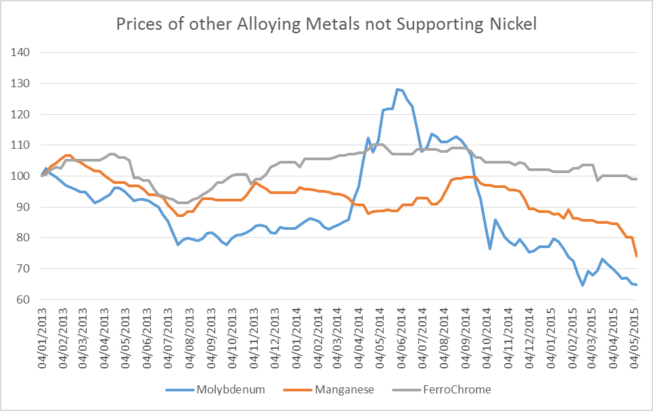
Nickel: Supply side bullish, demand side bearish
NPI ore prices suggest that NPI destocking is still continuing
LME Nickel Stocks are at a Record Level
Source: Bloomberg
Source: LME
NPI premiums to LME prices still not in place
Other Stainless Steel inputs remain weak
Source: HFZ Capital Management Limited Estimates
Source: HFZ Capital Management Limited Estimates, Metal Bulletin

Slide 19
Conclusions
Macro: US economy has lost some of its momentum, EU is doing better than expected, and China continues to shoot on the downside, but expectation of global and Chinese growth bottoming out remains high.
Copper: Small surplus but market can easily move into balance or even deficit. Price will be more dictated by market sentiment or macro perception than underlying supply and demand per se.
Aluminum: Supply is not an issue. Can demand be strong enough
Zinc: Mine supply deficit is coming, but when?
Nickel: There is simply too much metal out there.

Slide 20
Thank You.

