Slide 1
New Normal and New Business Landscape
—New Opportunities Emerged from China’s
Reform towards a Market-oriented Energy Industry
Wu Libo
Professor, Doctoral Advisor, School of Economics, Fudan University
Deputy Director, Research Center for Energy Economics and Strategy
Email: wulibo@fudan.edu.cn
2015.5.28

Slide 2
New normal of China’s economy and the energy industry
Philosophy and key measures of the reform towards a market-oriented energy industry
Mechanisms triggering the reform towards a market-oriented energy industry
New business landscape and new investment opportunities against the backdrop

Slide 3
New Normal of China’s Economy
As China’s economy and GDP growth rate slow down, there are debates as to whether it is new normal, abnormal or recession in effect.
Over the same period of last year (%)
Alert
Coincident
Alert

Slide 4
New Normal of China’s Economy
Investment is further depressed by the sluggishness of real economy, micro market’s lack of confidence and the virtual economy bubble.
National Bureau of Statistics
PMI: output
PMI: new order
PMI: import
National Bureau of Statistics
Central bank (right)

Slide 5
New Normal of the Energy Economy
As the growth of the energy sector slowed down as well in 2014, the revenues of main businesses slid in general, particularly oil and gas miners.
The margin and industrial added value of energy mining and manufacturing sector declined, except for gas manufacturing and provision.
The situation of oil and gas extraction and coal mining is especially grim.
Total profit of Oil and gas exploration: accumulated YoY
Total profit of power and heat generation and provision:
accumulated YoY
Total profit of coal mining and washing: accumulated YoY
Source: Wind Info
Oil and gas exploration: primary business revenue: accumulated YoY
Coal mining and washing: primary business revenue: accumulated YoY
Generation and provision of power and heat: primary business revenue: accumulated YoY
Industrial value added: power and heat generation and provision: MTD YoY
Industrial value added: oil and gas exploration: MTD YoY
Industrial value added: gas production and provision: MTD YoY
Industrial value added: coal mining and washing: MTD YoY
Industrial value added: oil processing, coal coking and nuclear fuel processing: MTD YoY
Source: Wind Info
Source: Wind Info

Slide 6
New Normal of the Energy Economy
Flows of capital into the energy industry decelerate and signs of insufficient investment into high energy-consuming industry emerge.
Energy demand is weak and end-consumption effect is limited.
Completed amount of fixed asset investment
(Accumulated YoY)
Coal mining and washing
Black metal mining and processing
Non-metal mining and processing
Oil and gas exploration
Non-ferrous metal mining and processing
Coal sales: nationwide: MTD YoY
Coal sales: nationwide:
accumulated YoY
Output: raw coal: MTD YoY
Output: raw coal: accumulated YoY
Source: Wind Info
Source: Wind Info
Gas output: nationwide: MTD YoY
Gas output: nationwide: accumulated YoY
Output: crude oil processing, MTD YoY
Output: crude oil processing, accumulated YoY
Source: Wind Info
Notes:
Gas output: nationwide: MTD YoY
Gas output: nationwide: accumulated YoY
Output: crude oil processing, MTD, YoY
Output: crude oil processing, accumulated, YoY

Slide 7
New Normal of the Energy Economy
The combined output of crude oil and oil products remains stable, and will grow slowly.
The demand for refined oil will grow faster than that for crude oil.
Natural gas maintains fast growth, and the growth rate of import is higher than domestic output.
An oversupply will occur in coal market.
Supply-demand Gap
Crude oil and oil products combined
(Accumulated)
Stream coal: MTD
Coking coal: MTD
Output
Export
Import
Apparent consumption
Source: Wind Info
Source: Wind Info
Refined oil (gas, coal and diesel combined)
(Accumulated)
Natural Gas (Accumulated)
Output
Export
Import
Apparent consumption
Output
Import
Export
Apparent consumption
Source: Wind Info
Source: Wind Info
Notes:
Output: natural gas: accumulated
Import: natural gas: accumulated
Export: natural gas: accumulated
Apparent natural gas: accumulated

Slide 8
New Normal of China’s Economy New Normal of the Energy Economy
The once full speed economic growth rate is moderated.
Economic structural adjustment furthers, and the structural adjustment of the second and tertiary industries and consumption in urban and rural areas accelerated.
Economic growth pattern shifts from element-driven and investment-driven to innovation-driven.
The growth of overall energy consumption decelerates, and the new pattern of effective demand deciding effective supply is taking shape.
Structural adjustment of energy consumption accelerates, and a energy development pattern that is clean, efficient and low-carbon becomes the new normal.
The growth pattern of energy economy shifts from investment-driven to consumption-driven and innovation-driven. The benefits of new business landscape and new mechanism is being felt.

Slide 9
Philosophy of the Reform towards a Market-oriented Energy Industry
Enhancing the role of the market;
Strengthening regulation
Relaxing administrative approvals;
Constraining monopoly
Reform of market entry rules
To build a well-developed entry, exit and exchange mechanism of oil, gas and mining permits and encourage all sorts of non-governmental capitals to flow into the oil and gas exploitation sector.
Reform of market trading mechanism
To promote reform of electricity grid and oil and gas pipeline network development and management system, and encourage direct trading between providers and users.
Reform of pricing mechanism
To promote the reform of market-oriented energy pricing, forming a pattern where natural gas wellhead and sales prices, and electricity generation and sales prices are determined by the market, while power transmission and distribution price and gas and oil pipeline transmission price are set by the government.
Reform of market management mechanism
To transform government functions, enhancing the formulation and implementation of strategic planning, policies and standards and intensifying energy regulation
Revolution of energy system
Revolution of energy production
Revolution of energy technologies
Revolution of energy consumption

Slide 10
Key Measures and Benefits of Energy Reform
Encourage Investment
Control Risk
Regulate market entry
Encourage non-governmental capital to invest in power distribution
Guide direct trading between multiple parties
Develop entry and exit mechanism
Reform of Market Entry Rules
Reform of Market Trading Mechanism
Facilitate long-term stable trading mechanism
Foster market participants through multiple channels
Build market trading platforms
Placing rights and obligations on market participants
Multiple Participants
Technology Spillover
Innovation Incubation
Enhance Opening-up
Enhance industry planning and coordinate multi-layered planning
Improve Efficiency
Enhance scientific regulation of the industry and relevant sectors
Independently approve power transmission price
Reform of Pricing Mechanism
All competitive prices decided by the market
Reform of Market Management Mechanism
Reduce and standardize administrative approvals
Appropriate cross-subsidization and adjust price relations
Improve credit system of market participants
Promote Transformation
Enhance Fairness
Amend energy-related laws and regulations

Slide 11
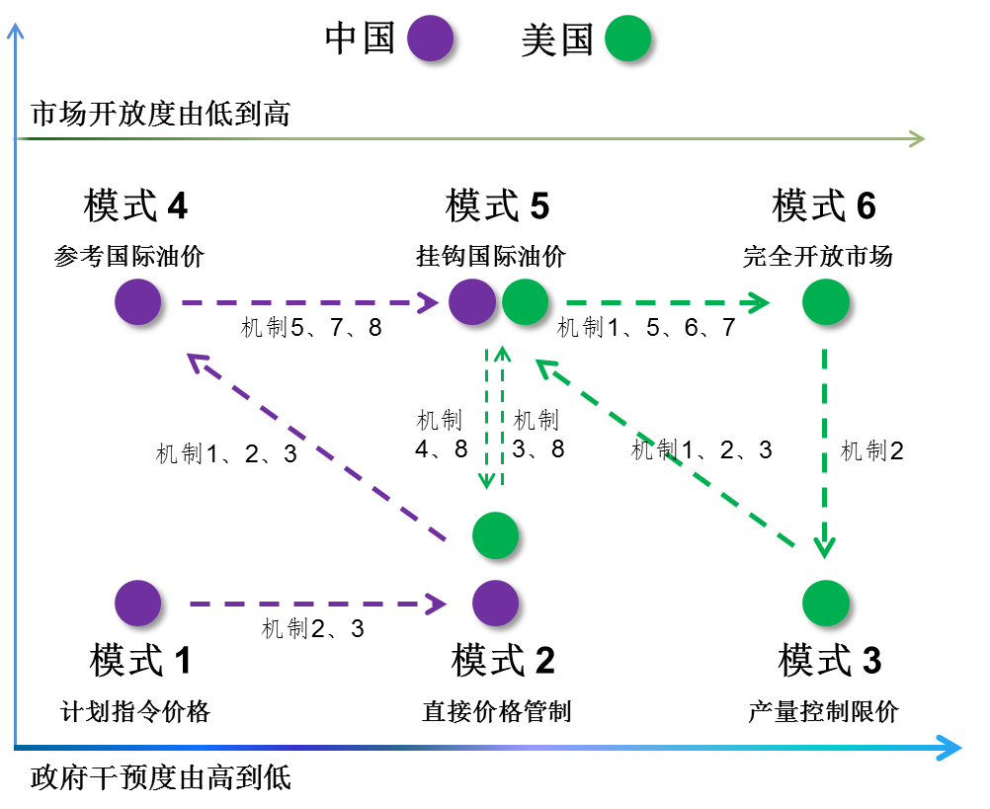
Mechanisms Triggering the Reform towards a Market-oriented Energy Industry
Triggering Mechanisms and Roadmap - Oil
China
U.S.
Mechanism 1：Diversified Oil Reservation
Mechanism 2：Domestic Output Changes
Mechanism 3：Domestic Demand Changes
Mechanism 4：Geopolitical Changes
Mechanism 5：Development of Market Mechanism
Mechanism 6：Development of Financial Market
Mechanism 7：Opening-up of Domestic Oil Industry
Mechanism 8：Impact of External Prices
Market Opening-up (Low to High)
Model 4
referring international price
Model 5
linked to international price
Model 6
Fully open market
Mechanism
Mechanism
Mechanism
Mechanism
Mechanism
Mechanism 1,2,3
Mechanism 2
Model 1
Planning price directive
Mechanism 2,3
Model 2
Direct price control
Model 3
Output and price control
Government Intervention (High to Low)

Slide 12
天然气部门市场化改革路径
Mechanisms Triggering the Reform towards a Market-oriented Energy Industry
Triggering Mechanisms and Roadmap – Natural Gas
中国
Mechanism 1- Cross Subsidization
Mechanism 2- Information Cost
Mechanism 3- Supply Uncertainty
Mechanism 4- Demand Uncertainty
Mechanism 5- Policies and Directives
Mechanism 6- Distortion of Price Control
Mechanism 7- Monopolistic Price Distortion
Mechanism 8- Specialized Capital
Mechanism 9- Standardized Contract
U.K.
France
Germany
U.S.
China
Model 2
Integrated operation (competitive)
Model 4
Competitive up-stream, bundling transmission and distribution (competitive)
Model 6
Fully un-integrated operation (competitive)
Com-petitive
Mechanism
Mechanism
Mechanism
Mechanism
Mechanism
Integrated operation
Competitive up-stream, bundling transmission and distribution (competitive)
Fully un-integrated operation (competitive)
Mechanism
Non-com-petitive
Mechanism
Mechanism
Mechanism
Model 1
Integrated operation (non-competitive)
Model 3
Competitive up-stream, bundling transmission and distribution (non-competitive)
Model 5
Fully un-integrated operation (non-competitive)

Slide 13
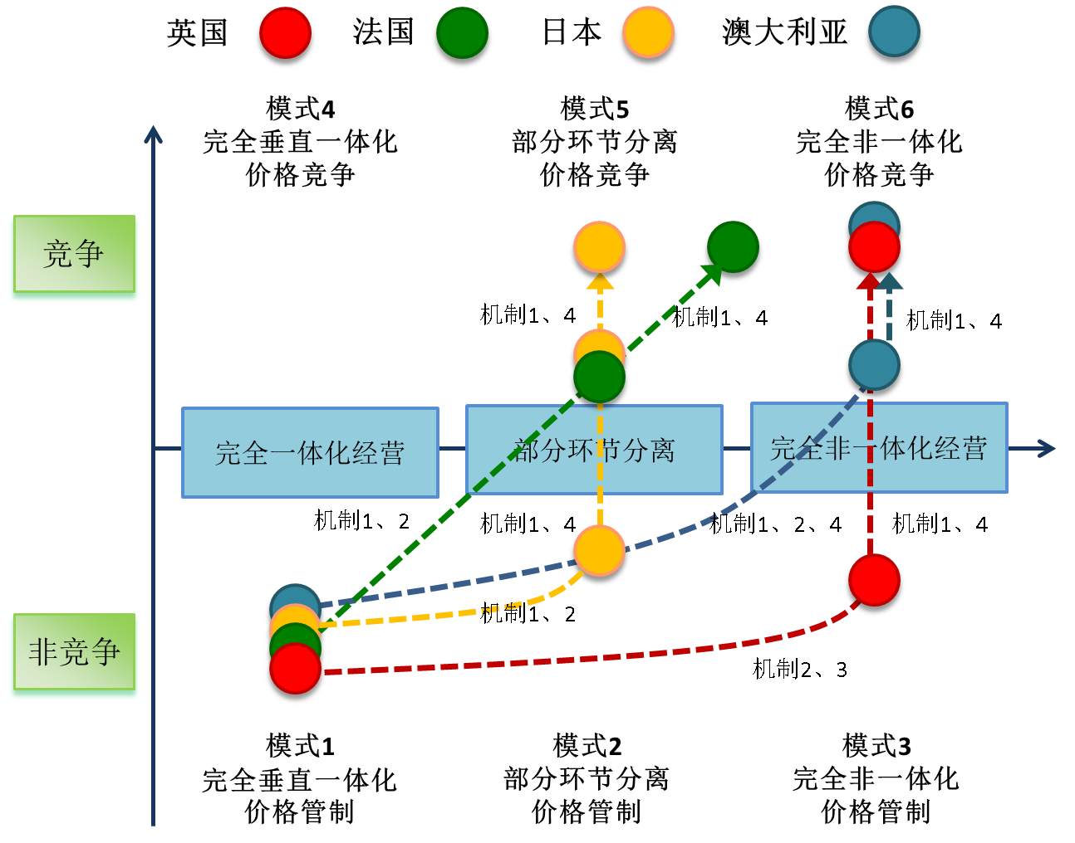
Triggering Mechanisms and Roadmap – Power
Mechanisms Triggering the Reform towards a Market-oriented Energy Industry
中国
U.K.
France
Japan
Australia
China
Mechanism 1：Loss of efficiency caused by monopoly out of vertically integrated operation
Mechanism 2：Loss of power plants caused by control over power generation
Mechanism 3：Gaming conflict among market participants caused by control over power transmission and distribution
Mechanism 4：Price distortion caused by control over power sales
Model 4
Fully vertically integrated,
price competition
Model 5
Certain segment separated,
price competition
Model 4
Fully un-integrated price competition
Com-petitive
Mechanism
Mechanism
Mechanism
Fully vertically integrated,
Certain segment separated,
Fully un-integrated price competition
Mechanism
Mechanism 1,4
Mechanism 1,2, 4
Mechanism 1,4
Non-com-petitive
Mechanism 1,2
Mechanism 2,3
Model 1
Fully vertically integrated,
price control
Model 2
Certain segment separated,
price control
Model 3
Fully un-integrated price control

Slide 14
Roadmap of China’s Reform towards a Market-oriented Energy Industry
Coal
Price adjustment;
Higher price for excessive output
Removing key coal contracts; Fully marketed-oriented open transaction
Price liberalization, supplemented by regulation; overall contracting of input and output
Full liberalization with market-decided price;
Steam coal controlled by the government
Nationally unified price
1979
1985
1993
2013
Planned economy
Coal price lower than it should be;
Coal miners making heavy losses
Coal price on the increase
Price affected much non-coal factors;
Wide spread between stock-in and stock-out price;
Disorder market competition

Slide 15
Roadmap of China’s Reform towards a Market-oriented Energy Industry
Oil
Improving pricing mechanism; Removing 4%; Shortened to 10 business days
Launching crude oil futures;
Researching to propose in-depth reform to open up pipe network
Higher price for excessive output;
“Dual Scheme”
Removing dual scheme; Quality-based pricing
Improving market structure and pricing mechanism
22+4%
Unified planned price
Linked to international price
1981
1994
1998
2009
2013
2015
Planned economy
Production contract responsibility system and pricing system reform
Oil price in disorder;
Oil industry making tremendous losses
International oil price fluctuation; Domestic companies in disadvantage
International oil price surged; Domestic market short of supply, leading to overshooting
Delayed response to price changes putting domestic market in a disadvantageous position
Growth of demand for crude oil decelerates; International oversupply and regional shortage of supply of crude oil; Domestic market remains slow in response to price change and thus disadvantageous

Slide 16
Roadmap of China’s Reform towards a Market-oriented Energy Industry
Natural gas
LNG started;
AP market pricing
Price reform pilot;
“Net market value pricing method”
Direct gas purchasing price pilots for key clients, Formulating overall reform proposal
Base contracting; Higher price for excessive output
Categorized prices;
“New prices for new pipelines”
Increasing price; Proposing reform objectives
Price set by government
Sorting out price relations; Building a linking system
1987
1992
2005
2012
2015
Planned economy
Domestic natural gas output and demand on the increase
International gas market keeping integrating;
China’s relative weak pricing power;
Distorted market price
Linked mechanism of gas pricing
High price hindering development
Monopoly of governmental grid hindering efficient allocation of resources
Weak gaming power in terms of pricing, international price acceptor

Slide 17
Roadmap of China’s Reform towards a Market-oriented Energy Industry
Power
Liberalizing power distribution and sales; Reform of power generation and usage plans; Independent approval of transmission and sales prices; Market-oriented transaction
Monopolized by the central government
Starting phase; Adjusting price structure
Pilot reform;
Pilot reform of transmission and distribution/ sales prices
Self-generated feed-in tariff
Multiple prices as set by individual power plants
Separating plants and grids
Price competition to get on grid
1979
1985
1998
2001
2003
2004
2013
2015
Planned economy
Power industry lagging behind;
Nationwide shortage of power
Power price in disorder and increasing year by year
Fast growth of demand for power;
Constrained development of power-generating sector;
Power transmission incapacity;
Constrained development of renewable energy
Severe competition between coal and power; Inefficiency of the allocation of on-grid transmission resources; Margins monopolized by the grid;
The demand party calling for better management

Slide 18
Benefits of Oil and Gas Reform
  Reform of market entry rules encourages investment, and promotes the diversification of participants, non-governmental risk control and technology spillover.
  Liberalization of up-stream conventional oil and gas exploration licenses bring investment from multiple resources in favor of small-and-medium-sized project, while equity investment favors the innovation spillover of energy companies, promoting all rounded technological advancement along the industry chain.
  The removal of barriers into unconventional oil and gas exploration market helps attracting non-governmental investment, dispersing risks and attracting the involvement of financial institutions.
  Liberalization of crude oil import licenses attracts more investors to partake in trading of spot oil and futures, effectively weakening monopoly and improving market allocation efficiency.
  The opening-up of governmental grid reflects the nature of pipelines and grids as public goods. Public-private-partnership brings private capital into public goods investment.

Slide 19
Pricing formation mechanism reform improves market efficiency in a comprehensive way
  Price of oil products being determined by the market will further reduce adjustment cost, reflecting refined oil’s actual price movement, and increasing the profitability of refineries and down-stream retailing sectors.
  Improving the pricing mechanism of natural gas. Supplying price for key clients being determined by the market helps to ensure gas price fall back to reasonable level and stimulate demand from key clients.
  Pipeline price being approved by the government and pipeline companies profiting in ways other than the difference between feed-in and feed-out prices will further open up pipelines, ensure reasonable allocation of pipeline resources and reducing transmission cost.

Slide 20
Reform of market trading mechanism improves price discovery capabilities, strengthening China’s influence on domestic and neighboring market price
  The development of crude oil and other energy futures will bring about the gaming between actual supply and demand and liquidity of local capital market, improving price discovery capabilities in Chinese and Asian markets, and China’s ability in price-negotiating as a crude oil consumer amid global oversupply and regional imbalance.
  The diversification of market participants will better reflect the fluctuating on the demand side, playing an important role in optimizing capacity allocation on the supply side, and avoiding oversupply disadvantages brought about by investment-driven growth.
  The establishment of open trading market will attract private capitals, driving the development of relevant financial services and increasing influence of the prices in neighboring markets. Crude oil and energy futures will play an important role in strengthening the link between financial market and real economy and increasing the diversity of financial products. The hand-in-hand development of spot and forward trading markets will future improve market functions.

Slide 21
Reform of market management mechanism promotes the all-round opening-up of energy industry, and the intensification of regulation over non-competitive pipeline resources reduces intervention of competitive segments and improves the market’s capabilities in resource allocation.
  As the central government decentralized certain approvals, and local government takes on a guiding rather than intervening role, more and more private and foreign capital will flow into energy sector, so that the profit of energy sector will flow into the market, thus bringing about the growth effect.
  Intensified regulation of non-competitive segments makes it no longer possible for long oil and gas companies to earn excessive profit by taking advantage of monopoly, ensuring fair allocation of pipeline resources.
  The opening-up of competitive segments promote the gaming between providers and users, while the diversified wholesale and retail participants reflect needs of different user groups, improving market efficiency.
  The ingrained problems of state-owned companies enjoying funding priorities, monopoly and government subsidies prevent Chinese energy companies from going global. The reform reduces the entry and exit cost of private capital, tearing down the barrier of going global and making innovation driven by the demand side possible.

Slide 22
Factors Potentially Hindering the Success of Energy Reform
Supply-driven Reform VS. Structure Adjustment Reform
    China’s reform of energy system tends to be supply-driven, and energy companies are internally driven to be involved in such reform. But what’s driving structure adjustment reform? Energy sector trying to make up for the decline of revenue out of traditional businesses? Private capitals looking for the lucrative returns of energy sector? Demand for green, efficient, clean and smart energy products? The driving forces from outside of energy sector is crucial to the success of such reform.
2. Reform of Pricing Mechanism VS. Reform of Market Trading Mechanism
    Reform of pricing mechanism has always been a key measure in China’s energy reform, while the reform of market trading mechanism remains lagging behind. A throughout reform of pricing mechanism is based on reform of market trading mechanism. There is no price without trading. The roadmap is essential to the success of reform.

Slide 23
3. Reform of Market Entry Rules VS. Reform of Market Management Mechanism
    Changing market entry rules and opening-up competitive segments does not necessarily bring about effective competition in the short run. SMEs will simply be pushed out of market by incumbent energy giants. The only way to make rooms for emerging capital is changing market management mechanism, splitting up competitive and non-competitive segments, preventing competitive segments from monopoly, imposing strict regulation on non-competitive segments and opening up the market.
    4. Administrative Reform VS. Fiscal and Personnel Reform
    To further the reform proposal, administrative, fiscal and personnel reform should be coordinated. Measure and entities to be held accountable should be defined and incentive and accountability mechanisms both established. The reform should being geared to international practices, polices based on public opinions and measures pragmatic are crucial to be success of such reform.

Slide 24
Thank you!

