Slide 1
one belt and one road initiative: Opportunities and challenges “一带一路”的机遇与挑战：国际投行视角
05/28/2015
SG - GLOBAL DERIVATIVES
HOUSE OF THE YEAR
全球最佳衍生品银行
Antoine CASTEL
Managing Director, Head of Global Market China

Slide 2
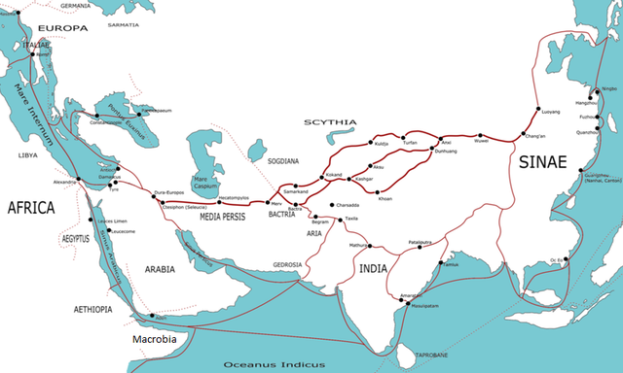
1. SILK ROAD brought prosperity and mutual understanding 丝绸之路打造繁荣和互信
More than two thousand years ago, China was East part of a link to Europe and opened up several routes of trades that linked the major civilization of Asia, Europe and Africa.
两千多年以前，中国是连接到欧洲东部的枢纽，并且开设了数条将亚洲、欧洲和非洲主要文明联系到一起的贸易路线。
Several Silk Roads have developed mutual respect and brought a stability based on mutual economic interest.
数条丝绸之路发展了相互间的尊重并带来了稳定的经济融通。
28/05/2015

Slide 3
2. one belt and one road: a new dream in a new world 一带一路：新梦时代
The initiative of “one belt and one road” further confirm China’s determination to move from participating to the joust of thalassocracy in the last century to the joust of land power. It aims to rebuild the silk road which linked cooperation between the East and the West more than two millennia ago.
中国“一带一路”倡议的提出，明确了国家决心从上世纪参与国际海权的角逐转向陆权的角逐，突破了二战以来中国海上出路相对狭窄的事实，重新恢复了中国两千年以前沟通西方世界的丝绸之路。
The core principle of one belt and one road is to promote peace and cooperation, openness and inclusiveness, mutual learning and benefit between China and related countries.
“一带一路”的核心思想是合作发展的理念和倡议，依靠中国与相关国家的多双边机制，建立政治互信、经济融合与文化包容。
France is always supporting multilateral world ideality, Charles De Gaulle was the first leader from Western countries to establish cooperation with China in 1964. This demonstrates the determination of France in supporting China on opening exchanges to the world.
法国一直赞同多元世界理想，戴高乐将军1964率先在西方国家中与中国建交，表明了法国支持中国重新走向世界的决心。
28/05/2015

Slide 4
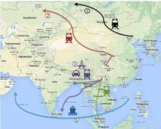
3. The “new roads of silk” needs infrastructure to develop commercial exchanges “新丝绸之路”需要通过基础设施建设来发展经济融合
At least 5 different routes, creating railroads, highways, airport, ports, electricity grid, optic fiber networks, telecom networks.
至少有5条不同的路线，建立铁路、公路运输、机场、港口、电网、光纤网络和电信网络。
All the big projects have been opening new routes like Panama, Suez waterways.
所有大的项目都在打开了新路线比如巴拿马，苏伊士运河航道新航线。
China development in the last 30 years is partly about strong drive on infrastructure.
中国过去发展30年的成功部分取决于基础设施建设的强大驱动力。
28/05/2015

Slide 5
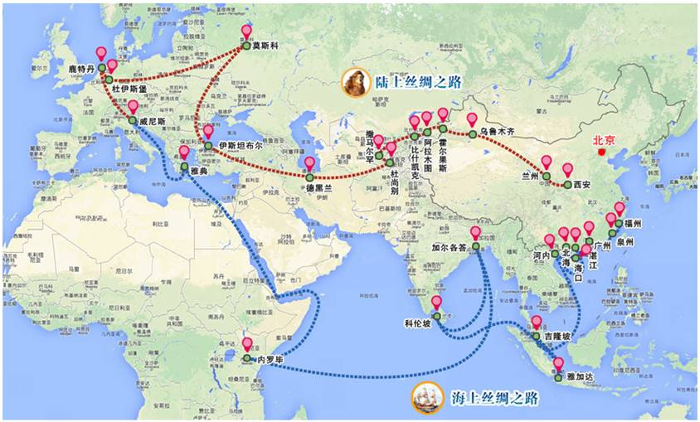
3. The “new roads of silk” needs infrastructure to develop commercial exchanges “新丝绸之路”需要通过基础设施建设来发展经济融合
28/05/2015

Slide 6
4. How banks & financial institutions will contribute 银行和其他金融机构如何做贡献
Financing activity is a key support to one belt and one road initiative. This initiative will require several hundreds of billions of investment.
资金融通是“一带一路”倡议的重要支撑。该倡议将需要几千亿的投资。
Financing will come from China and other countries through Banks, Silk Road Funds (40B$), Asian Infrastructure and Investment Bank (100B$ on which 30% China funded) and potentially other multilateral development banks.
融资将来源于中国和其他国家，通过银行、丝路基金（400亿美元）、亚洲基础设施投资银行（1000亿美元其中30%由中国提供）和其他多边开发银行。
Strong public & private expertise will be required to tackle with the numerous challenge of these New Roads.
强大的政府和商业专业知识可以帮助应付“一带一路”带来的各种挑战。
Structured Finance and Natural Resources and Energy Financing.
结构性融资、自然资源和能源融资。
Risk management including Emerging markets knowledge.
风险管理包括新兴市场知识。
28/05/2015

Slide 7
5. Sg cib awarded several deals of the year in the trade & export finance 法兴投资银行贸易和出口信贷业务载誉市场
For Natural Resources & Commodities Finance: 关于自然资源和商品融资
Best Overall Commodities Finance DOY: Tangsteel - China - USD 1.5bn pre-financing facility
最佳整体商品融资DOY：唐钢-中国-前期融资15亿美元
Best Asia-Pacific Commodities Finance DOY: Noble Agri USD 2.55bn Revolving Credit Facility最佳亚太金融商品DOY：来宝农业-循环信用贷款25.5亿美元
Best African Commodities Finance DOY: Glencore SHT (Chad) - Chad - USD 1.3bn limited recourse facility 最佳非洲金融商品DOY：Glencore SHT (Chad) - Chad - USD 1.3bn limited recourse facility
Best Middle Eastern Commodities Finance DOY: Tiryaki Agro USD 250m Revolving Credit Facility 最佳中东商品金融DOY：Tiryaki Agro-循环信用贷款2.5亿
For Export & Project Finance: 关于出口及项目融资
Best Innovative ECA/Project Finance DOY Sarulla Geothermal - Indonesia - USD 1.17bn geothermal power project financing 最佳创新ECA/项目金融DOY Sarulla地热-印度尼西亚-地热发电项目融资11.7亿美元
Best Overall ECA/Project Finance DOY: Star Refinery - Turkey - USD 3.29bn project financing comprising ECA covered loans for development of a 10 mpta crude oil refinery 最佳整体ECA/项目金融DOY：星炼油厂-土耳其-覆盖了10 个MPTA炼厂原油开发的ECA贷款项目融资
Best Project Finance DOY Cameron LNG - US : USD 7.9bn project financing for new natural gas liquefaction facilities at the existing Cameron LNG terminal 最佳项目融资DOY卡梅伦液化天然气：在现有的卡梅伦LNG接收站有79亿美元新天然气液化设施的项目融资
28/05/2015

Slide 8
6. The key fields of expertise of SG in structured finance 法兴在结构性融资上的主要优势
Infrastructure & Asset Based Finance 基础设施和基础金融资产
SG offers a broad range of products to our clients, whether corporate or public, including capital-raising, risk management and advisory services in: 法兴银行为我们的客户提供范围广泛的产品, 无论是企业还是公众, 包括融资、风险管理和咨询服务:
Project finance 项目融资
Public Private Partnerships (PPPs) 公私合作伙伴关系
Asset finance: asset-backed finance, tax leases, operating leases and export leases资产融资: 资产担保融资、税收租赁,经营租赁和出口租赁
Based on asset and sector expertise as well as structuring skills in tax, regulatory compliance and accounting areas, the team is involved in a wide range of assets and financing projects linked mainly to infrastructure and offers tailor-made solutions in dedicated sectors such as: 基于针对资产以及税收制定的技能、法规遵从性和会计领域的行业专业知识,我们的团队为广泛的资产和融资项目与主要基础设施和专业部门提供量身打造的解决方案，例如:
Transportation: ground (subways and buses), road, logistics and support services 交通:地面(地铁和公共汽车)、道路、物流和后勤支持
Sea : ports, vessels and cranes 海洋:港口、船舶和起重机
Air : airports, aircraft and baggage handling 空中:机场、飞机和行李处理
Public services: health, education, public infrastructure, defense and custodial 公共服务:卫生、教育、公共基础设施、国防和后勤支持
Debt Optimization 债务优化
SG is in charge of debt optimization and provides innovative financial solutions, combining various financial instruments, in order to ensure the best regulatory, tax and accounting terms. 法兴银行负责债务优化和提供创新的金融解决方案, 结合各种金融工具, 以确保最佳的监管,税收和会计条件。
Export Finance 出口融资
SG has global responsibility for the origination, structuring and implementation of financing for export of capital goods and associated services. This division is responsible globally for the Group‘s relationships with export credit agencies (ECA) and public agencies supporting exports. 法兴银行对于出口贸易业务融资中资本货物和相关服务的起始、结构和履行都负有全球责任。法兴有专门的部门负责与全球支持出口贸易的信贷机构 (ECA) 和公共机构建立集团关系。
28/05/2015

Slide 9
7. The key fields of expertise of SG in NATURAL RESOURCES and ENERGY FINANCING 法兴在自然资源和能源融资上的主要优势
The Natural Resources & Energy Financing Group provides a full range of finance and advisory services for producers, traders, processors and end-users of energy, metals and soft commodities through three key platforms: 自然资源和能源融资组通过三个关键平台面向能源、金属和软性商品的生产者、贸易商、加工者和最终使用者提供全方位的金融和咨询服务：
Energy group: financing and advisory services for energy projects worldwide as well as structured financings and reserve-based lending for energy players. 能源组:全球能源项目的融资和咨询服务以及向能源机构提供结构化融资和储备贷款。
Metals & mining finance group: structured financing and advisory services for metals & minerals sector players as well as financing of large and diversified mining companies. 金属和矿业金融组:为金属和矿产机构以及大型多元化矿业公司提供 结构化融资和咨询服务。
Traders, commodity finance & agribusiness group: financing of traders and commodity players/processors as well as trade finance to cover traders and commodity players against non-payment risk as further characterized 贸易商，大宗商品金融和农业综合企业组:为大宗商品融资机构/加工者以及贸易融资交易商和大宗商品交易者的非支付风险进一步描述: - with the exception of the bigger players, financings backed by short-term trade-related assets (inventories and receivables) of commodity traders, producers, processors, logistics companies, distributors, refiners, etc. 通过短期贸易融资对大型贸易机构以外的商品贸易商、生产商、 加工、物流公司、经 销商、炼油厂等提供融资支持（存货和应收账款）。 - covering of commodity clients and exporters against non-payment risk on end- users/banks, covering these end-users against the non-transferability of funds caused by political or economic events or due to corporate failure, granting secured financing to end- buyers. 覆盖出口商面临的对于因进口方/银行因政治、经济活动或企业经营失败造成无法支付资金的风险， 为进口方提供融资担保服务。
28/05/2015

Slide 10
8. The key fields of expertise of SG in DERIVATIVES 法兴在衍生品上的主要专业领域
Societe Generale is a recognized market player with a traditional stronghold in Europe and significant areas of global leadership in Equity Derivatives and Commodities
法兴银行是一个在市场广获认可的股票及商品衍生品的全球领先者
A world-leader in Equity Derivatives and Structured Products
#1: Global Derivatives House of the Year (Risk Award 2015) 最佳衍生品银行
#1: Global Equity Derivatives House of the Year (Risk Award 2015) 最佳股票衍生品银行
#1: Global Risk Solutions House of the Year (Risk Award 2015) 最佳风险方案银行
#1: Global Structured Product House (Risk Award 2014) 最佳结构性产品银行
A top Energy Risk rankings, #1 Best overall dealer on Commodities (Energy and Base Metals)
#1: Best overall dealer 最佳综合交易商
#1: Energy Dealer 最佳能源交易商
#1: Base metals dealer/broker 最佳基本金属交易商/经纪
#1: Soft Commodities 最佳软商品
World leading derivatives broker (Best global Prime Broker, HFM Award 2014) 全球领先衍生品经纪
Access to more than 85 cash & derivatives markets thanks to Newedge integration 受益于与新际集团的合并，接入超过85个现金和衍生品市场
28/05/2015

Slide 11
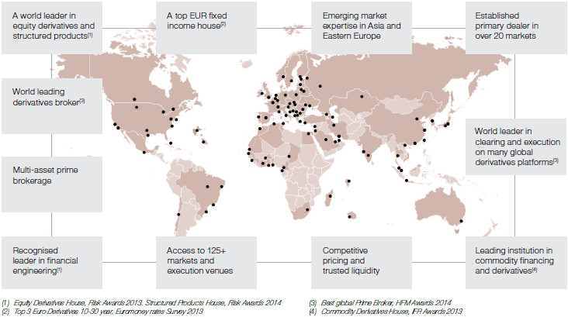
9. SG - GLOBAL presence 法兴银行 - 网络覆盖全球

Slide 12
10. sg presence in china on OTC derivatives
法兴银行在中国场外衍生品市场的发展情况
Full Derivatives license since 2004, Forex options license since 2014, appointed by PBOC as EUR/CNY direct market maker and FX trial market maker in 2014, CNY Interest Rate Swap active member in the interbank market since 2013, LME OTC Commodities hedging solutions since 2011, member of IRS Shanghai Clearing House since 2014 2004年获批开展衍生产品业务。2014年获外汇期权资格，并获批成为首批人民币对欧元直接交易做市商，获批外汇尝试做市商。自2013年起在人民币利率掉期市场上非常活跃。自2011年起在提供伦敦金属交易所场外商品套保解决方案。2014年成为上海清算所会员。
Discussion with local Exchanges (SHFE, CFFEX and SSE) for potential cooperation on Crude Oil contract, Bond futures and future development on listed options on ETF, index and single-stocks, mock trading on CFFEX index options (Jun 2015) 与当地交易所（上海期货交易所、中国金融期货交易所和上海证券交易所）探讨原油期货、国债期货、场内期权（ETF、股指和个股）产品上的潜在合作机会，参与中国金融交易所组织的股指期权模拟大赛（2015年6月） 。
Training on OTC and Risk management 场外及风险管理的培训
21 Jan 2015, arranged by Shanghai Stock Exchange, SG provided “Risk Management for Options Market Making” training to 108 securities and 13 futures companies 2015年1月21日在上海证券交易所组织的ETF期权风险管理培训会上，为中国108家证券公司和13家期货公司提供了期权做市商风险管理培训。
6 Dec 2014 Presentation on 10th China (Shenzhen) International Derivatives Forum: The concept of OTC risk management 2014年12月6日在第十届中国（深圳）国际衍生品论坛上分享海外场外衍生品风险管理的经验。
18 Nov 2014, SG shared options business experience to all futures companies in the 5th Summit for futures Institutional Investors arranged by CFA 2014年11月18日在中国期货业协会组织的第五届期货机构投资者年会上和中国期货公司分享期权业务经验。
21 Sep 2014 Training for Dalian Commodity exchange: An introduction to hedging in base metal markets + Option training 2014年9月21日在大连商品交易所提供了基本金属套保+ 期权培训。
15 Sep 2014 Training for Shanghai Futures Exchange: An introduction to hedging in base metal markets 2014年9月15日在上海期货交易所介绍关于基本金属套保的经验。

Slide 13
11. SG can participate to the otc derivatives development in china
法兴致力于参与中国场外衍生品市场的发展
SG has the unique expertise on derivatives and can contribute to the sound development of OTC derivatives in China across several assets
法兴拥有衍生品方面的专才，可以为中国场外多种资产衍生品的发展做出贡献
Global and cross-asset derivatives Risk Management expertise
Experience of several listed/OTC market take-off in Asia-Pacific and worldwide
Worldwide access and cross-asset research
SG has a local strong commitment + 30 years in derivatives + 25 years presence in Asia
法兴对中国的强力承诺 + 30年衍生品经验 + 25年在亚洲的业务覆盖
SG capitalistic presence in China through SG (China) Ltd, Leasing, Equipment Finance and Fortune
Local Regulators cooperation
Local training on OTC pricing and risk management
Development of local Global Markets teams in Shanghai and Beijing
SG can participate to the safe opening and sound development
of the OTC derivatives market
if SG can access to listed derivatives market in China

Slide 14
12. Why derivatives are important to one belf one road 衍生品对“一带一路” 发挥的作用
Locally and globally support Chinese Corporates and cooperate with Chinese and International Financial Institutions to develop exchanges between China, Asia, Europe, Middle-East and Africa and propose innovative financing and investment solutions.
支持中国的企业，与中国和国际金融机构合作，共同开发中国，亚洲，欧洲，中东和非洲之间的往来，并提出创新的融资和投资解决方案。
Bring our global Derivatives expertise in Shanghai Financial Center to participate to the development of the RMB domestic market and RMB internationalization, helping indirectly to fund the development.
将我行全球衍生品的专业知识带到上海国际金融中心，参与人民币国内市场的建设和人民币国际化，间接地为“一带一路”发展提供金融支持。
Participate to bring Shanghai financial markets platform in line with the economic capacity of China, i.e., the 2nd market in the world, by bringing a global OTC derivatives expertise in local liquid market, by bringing risk management best practices in China to secure a sustainable development.
参与建设与中国经济能力（世界第二大经济体）相匹配的的上海金融市场平台，将我行的全球衍生产品市场的专业知识和产品带到国内金融市场并提供相应的流动性，通过将风险管理方面的最佳实践带到中国来确保市场可持续的发展。
28/05/2015

Slide 15
13. Well managed, derivatives contribute positively to the global economy by securing the cash flows 衍生品对全球经济的贡献
One Belt One Road is firstly about infrastructure in emerging countries and secondly about developing commercial flows between East and West “一带一路”第一阶段是要在新兴国家建设基础设施，第二阶段是要发展东方和西方之间的金融贯通
Each step of this unique project will require safe cash flows in a volatile market
每一阶段都需要在波动的市场中保证稳定的现金流
Necessity to hedge forex, rates and commodities including in emerging markets 在新兴市场对冲外汇、利率和商品风险的必要性
Necessity for Corporates and Financial Institutions to access liquidity to finance their development 企业和金融机构融资获得流动的资金来支持其发展的必要性
Necessity to develop equity and credit derivatives to increase the liquidity and safety of the local markets 发展股票和信用衍生品来增加当地市场的流动性和安全性
Shanghai Derivatives Markets platform is ideally placed to benefit from this initiative if its local markets are efficient and accessible to foreign players 如果当地市场是有效的并且对外开放的，上海衍生品市场的平台将很大程度上受益于“一带一路”倡导
28/05/2015

Slide 16
谢谢
28/05/2015

