Slide 1
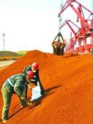
Connotations, Economic Impacts and Key Measures of “One Belt and One Road” Strategy
Head of Research Department of Foreign Economic Relations Zhao Jinping

Slide 2
Contents
Connotations of "One Belt and One Road" Strategy
3
1
Overlook on Economic Impacts of "One Belt and One Road" Strategy
2
Framework and Measures for Promoting "One Belt and One Road" Strategy
3
3
DRC Research Department of Foreign Economic Relations部

Slide 3
China has become a great power in the world
GDP of emerging economies in the world’s total (%)
GDP of developed economies in the world’s total (%)
DRC Research Department of Foreign Economic Relations

Slide 4
China issued the Vision and Actions on Jointly Building Silk Road Economic Belt and 21st-Century Maritime Silk Road
Historical inheritance, major power responsibility, opening-up and inclusion, cooperation and win-win, external and internal cultivation, marine and land coordination, east and west orientations, economy and trade first, facility interconnection, role of market
-- Connotations of “One Belt and One Road”
Notes:
China issued the Vision and Actions on Jointly Building Silk Road Economic Belt and 21st-Century Maritime Silk Road
Historical inheritance, major power responsibility, opening-up and inclusion, cooperation and win-win, external and internal cultivation, marine and land coordination, east and west orientations, economy and trade first, facility interconnection, role of market
-- Connotations of “One Belt and One Road”

Slide 5
The Silk Road region has playing an increasingly important role in the global economy
Population
Agriculture
Industry
Net foreign capital inflow
Imports
Outports

Slide 6
Contents
Connotations of "One Belt and One Road" Strategy
1
Overlook on Economic Impacts of "One Belt and One Road" Strategy
3
2
Framework and Measures for Promoting "One Belt and One Road" Strategy
3
3
DRC Research Department of Foreign Economic Relations

Slide 7
The economic development of the Silk Road region has made more obvious contributions to the global growth
DRC Research Department of Foreign Economic Relations

Slide 8
The economic growth of the Silk Road region is highly dependent on cross-border trade and investment growth
DRC Research Department of Foreign Economic Relations
Notes:
The economic growth of the Silk Road region is highly dependent on cross-border trade and investment growth
Dependence on trade (%)
World Silk Road
Dependence on net foreign capital inflow (%)
World Silk Road

Slide 9
Silk Road region is one of the regions enjoying the fastest growth in global trade and cross-border investment
DRC Research Department of Foreign Economic Relations
Notes:
Silk Road region is one of the regions enjoying the fastest growth in global trade and cross-border investment
Annual average growth rate of foreign trade (%)
World Silk Road
Annual average growth rate of net foreign capital inflow (%)
World Silk Road

Slide 10
Regions along “One Belt and One Road” boast huge development space
DRC Research Department of Foreign Economic Relations
Notes:
Regions along “One Belt and One Road” boast huge development space
Groups by per capita GDP in 2013 (%)
Above USD20,000 USD10,000-20,000 Below USD10,000
Average per capita GDP of the groups (USD)
World average
Average of Silk Road region
Below USD10,000
USD10,000-20,000
Above USD20,000

Slide 11
Countries along the Silk Road are important trade and investment partners of China
Notes:
Countries along the Silk Road are important trade and investment partners of China
Annual average growth rate of China’s trade with and investment in Silk Road region in recent 10 years
Trade Investment
Proportion in China’s total in 2013
Trade Investment Project contracting

Slide 12
1
经济持续增长的新动力
结构调整的助推器
对中国经济五大影响
2
3
能源和资源的安全保障
培育中国跨国企业的重要平台
4
5
互利共赢区域合作网络的桥梁和纽带
国务院发展研究中心对外经济研究部 赵晋平

Slide 13
Industries benefiting most from “One Belt and One Road” Initiative
Industries
obtaining benefit
Industries related to infrastructure construction
Industries related to resources and energy
Equipment manufacturing
Service industries such as financial and
telecommunications industries
Transportation industry
Notes:
Industries benefiting most from “One Belt and One Road” Initiative
Industries obtaining benefit
Industries related to infrastructure construction
Industries related to resources and energy
Equipment manufacturing
Service industries such as financial and telecommunications industries Transportation industry

Slide 14
Factors restricting trade and investment cooperation of “One Belt and One Road”
Difficulties
and obstacles
Slow progress in regional economic integration
Low proportion of trade investment in the region
Many obstacles for trade and investment relations
Lagging infrastructure construction
Interruption and adverse impacts of
non-economic factors
Notes:
Factors restricting trade and investment cooperation of “One Belt and One Road”
Difficulties and obstacles
Slow progress in regional economic integration
Low proportion of trade investment in the region
Many obstacles for trade and investment relations
Lagging infrastructure construction
Interruption and adverse impacts of non-economic factors

Slide 15
Contents
Connotations of "One Belt and One Road" Strategy
3
1
Overlook on Economic Impacts of "One Belt and One Road" Strategy
2
Framework and Measures for Promoting "One Belt and One Road" Strategy
3
3
DRC Research Department of Foreign Economic Relations部

Slide 16
Three opportunities for China in “One Belt and One Road” Initiative
Expand foreign trade
Three opportunities
Accelerate “going global” of enterprises
Promote interconnection with neighboring regions
Notes:
Three opportunities for China in “One Belt and One Road” Initiative
Expand foreign trade
Three opportunities
Accelerate “going global” of enterprises
Promote interconnection with neighboring regions

Slide 17
1
New impetus for sustainable economic growth
Booster for structural adjustment
Five major impacts on Chinese economy
2
3
Security support for energy and resources
Important platform for culturing China’s multinationals
4
5
Bridge between mutually beneficial regional cooperation network
Research Department of Foreign Economic Relations, DRC of the State Council Zhao Jinping
Notes:
Five major impacts on Chinese economy
New impetus for sustainable economic growth
Booster for structural adjustment
Security support for energy and resources
Important platform for culturing China’s multinationals
Bridge between mutually beneficial regional cooperation network

Slide 18
Reform in administration policy for “going global” is extremely urgent
Liberalization
Deepen opening-up, raise trade liberalization
Market-based
Give play to adjustment role of market, reduce administrative intervention
More convenient
Create a convenient environment for enterprises to conduct cross-border trade
DRC Research Department of Foreign Economic Relations
Notes:
Reform in administration policy for “going global” is extremely urgent
Liberalization Market-based More convenient
Deepen opening-up, raise trade liberalization
Give play to adjustment role of market, reduce administrative intervention
Create a convenient environment for enterprises to conduct cross-border trade

Slide 19
Key measures to promote “One Belt and One Road” Initiative
Key measures
Accelerate relevant free trade arrangements
Prepare to establish regional policy financial institutions
Select large projects to promote infrastructure interconnection
Make an overall plan and reasonable layout
DRC Research Department of Foreign Economic Relations
Notes:
Key measures to promote “One Belt and One Road” Initiative
Make an overall plan and reasonable layout
Accelerate relevant free trade arrangements
Key measures
Prepare to establish regional policy financial institutions
Select large projects to promote infrastructure interconnection

Slide 20
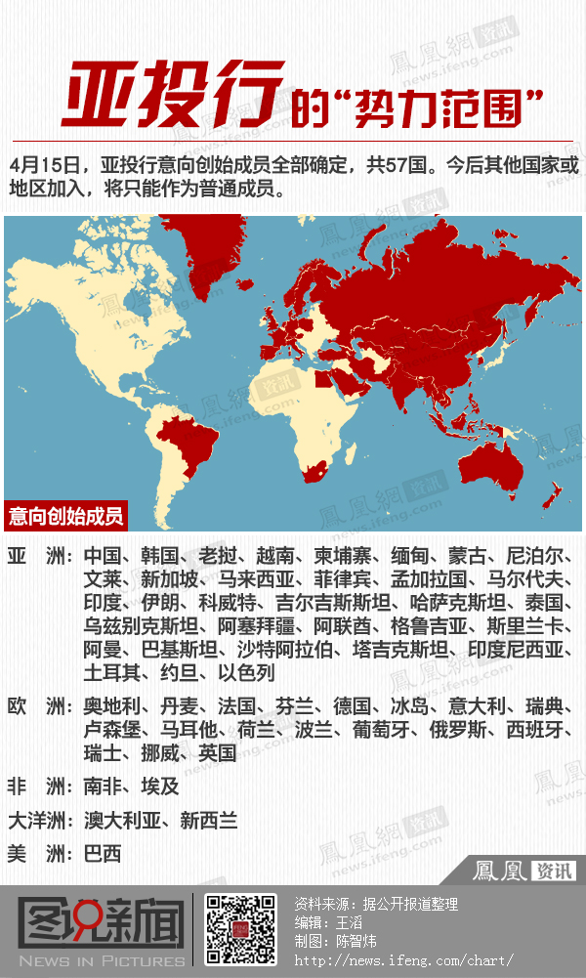
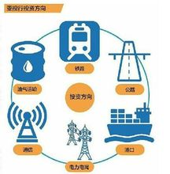

Slide 21
Focuses of domestic section
Build a new model for coordinated development of
East, Middle and West China
Construct an international corridor connecting
East, South, West and North China
Development focuses of domestic section of “One Belt and One Road”
Establish a new platform for trade and investment
cooperation and opening-up
Boost adjustment of domestic industrial layout
DRC Research Department of Foreign Economic Relations
Notes:
Focuses of domestic section
Development focuses of domestic section of “One Belt and One Road”
Build a new model for coordinated development of East, Middle and West China
Construct an international corridor connecting East, South, West and North China
Establish a new platform for trade and investment cooperation and opening-up
Boost adjustment of domestic industrial layout

Slide 22
Construct an international corridor connecting East, Middle and West China
Pilot Cross-border Development and Opening-up Zone (border opening-up platform)
China (Inland City) Pilot Free Trade Zone (estimated)
China (Tianjin) Pilot Free Trade Zone
China (Shanghai) Pilot Free Trade Zone
China (Fujian) Pilot Free Trade Zone
China (Guangdong) Pilot Free Trade Zone
China (Xinjiang) Pilot Asia-Europe Cooperation Zone (recommended)
Hainan International Tourism Island
Notes:
Construct an international corridor connecting East, Middle and West China
China (Inland City) Pilot Free Trade Zone (estimated)
China (Xinjiang) Pilot Asia-Europe Cooperation Zone (recommended)
Pilot Cross-border Development and Opening-up Zone (border opening-up platform)
China (Tianjin) Pilot Free Trade Zone
China (Shanghai) Pilot Free Trade Zone
China (Fujian) Pilot Free Trade Zone
China (Guangdong) Pilot Free Trade Zone
Hainan International Tourism Island

Slide 23
Thank You !

Slide 24
Thank You !

Slide 25
Thank You !

Slide 26
Thank You !

Slide 27
Thank You !

Slide 28
Thank You !

Slide 29
Thank You !

Slide 30
Thank You !

