Slide 1

Gold and Silver Markets
黄金和白银市场
10th Shanghai Derivatives Market Forum
Jeffrey Christian, Managing Partner CPM Group
28 May 2013

Slide 2
April and May Market Activity
四、五月市场情况

Slide 3
金价: 长期牛市中的一个周期性峰值

Slide 4
银价: 抵达周期性峰值

Slide 5
ETF实物黄金持有量降低至2011年9月水平
Through 14 May 2013

Slide 6
ETF实物白银持有量
Through 14 May 2013

Slide 7
美国铸金币溢价走弱

Slide 8
Net Long Gold Positions: Lowest Level Since November 2008
净多头仓位处于08年11月以来的最低位

Slide 9
2012和2013空头仓位大幅增加

Slide 10
The Economic Background
宏观经济环境

Slide 11
世界实际GDP增长预期减缓
Source: IMF, CPM Group
Note: Historical data are IMF statistics. Projections are made by CPM Group. Projections for "Emerging and Developing Economies are only for BRIC countries, which account for approximately 52.8% of this category. Projections for "Advanced Economies" are only for the U.S., U.K., Eurozone, and Japan. These countries accounted for 82.2% of this category.

Slide 12
黄金 Gold

Slide 13
主要结论 Key Conclusions
投资需求在2012年降低4.8%至3870万盎司。尽管下降如此之多，但2012年投资者净购买黄金量仍是历史第四高纪录。
  Investment Demand declined 3.5% in 2012, but at 38.7 million ounces the volume of gold bought by investors was the fourth highest on record. Likely to fall to around 34.3 million ounces in 2013.
最新精炼总供应2012年下降0.6%，主要由于市场经济国家的矿山供应比前年减少1.2%。
  Total Newly Refined Supply flat in 2012; mine production was up 2.0%. Total supply may rise 1.3% this year.
全球央行2012年买入950万盎司黄金，略超过2011年的920万盎司。其中，土耳其央行 的货币储备中增加了430万盎司黄金。这部分黄金是通过“准备金选择机制”增添的，因此从我们的官方交易数据里除却。
Central Banks purchased 9.5 million ounces of gold in 2012, up slightly from 9.2 million ounces in 2011. The Central Bank of Turkey added 5.3 million ounces to its monetary reserves through its Reserve Options Mechanism, which are excluded from our official transactions data.
珠宝和工业需求的增加，使黄金制造业需求2012年得以增长0.4%。Fabrication Demand rose 1.4% in 2012; both jewelry and industrial demand increased.

Slide 14
投资需求 Investment Demand

Slide 15
黄金投资需求 Gold Investment Demand
13p

Slide 16
投资需求 Investment Demand
投资需求是影响金价的最重要因素。Investment Demand is the most important influence on gold prices.
净投资需求在减少，但是仍然处于历史高位。Net investment demand is declining but is still at historically elevated levels.
投资者仍然热衷持有黄金，但是他们对金价越来越敏感。Investors remain interested in owning gold but have become increasingly price sensitive.
投资者对金价的敏感度上升是因为他们不认为一些引起担忧的情况会变成现实。Investors have become price sensitive because they do not believe that some of their worst fears will materialize.
  全球金融系统崩溃 collapse of global financial system
  高通货膨胀 hyper inflation
还有一些长期的经济问题没有解决。 There are still several long-term economic issues that remain unresolved:
  全球贸易和财政不平衡 global trade and fiscal imbalances
  货币市场波动 currency market volatility
对这些问题的担忧让投资者对持有黄金保有兴趣，但他们不再处于一个金价上升的环境。这将影响黄金的投资需求和金价。This should keep investors interested in owning gold, only not in a rising price environment. This is expected to both weigh on gold investment demand and the price of gold.

Slide 17
中国和印度的黄金需求

Slide 18
影响投资需求的因素 Factors Determining Investment Demand for Gold
Note: CPM estimates of market consensus.
Notes:
Alternative asset – used for its diversification purposes

Slide 19
黄金与各种经济指标的统计相关性
Statistical Relation of Gold to Various Economic Factors

Slide 20
金价与美国通货膨胀 Gold Prices and U.S. Inflation
Correlation: Gold with Inflation
Year | Real Gold Prices | Nominal Gold Prices
68-12 | 0.33 | 0.43
72-74 | 0.49 | 0.70
76-80 | 0.95 | 0.96
86-90 | -0.73 | -0.69
98-00 | -0.93 | -0.77
02-12 | 0.24 | 0.36
68-82 | 0.40 | 0.46
84-00 | -0.25 | -0.15

Slide 21
美国狭义货币供给与通货膨胀
U.S. Narrow Money Supply and U.S. Inflation
Correlation
Time Lag | Correlation
No lag | -0.20
One Year Lag | 0.13
Two Year Lag | 0.20

Slide 22
货币超发与高通货膨胀没有必然联系
Excessive Money Supply Does Not Necessarily Lead to Higher Inflation
Correlation
Time Lag | Correlation
No lag | -0.11
One Year Lag | -0.12
Two Year Lag | 0.01
Notes:
MZM: Money with zero maturity. It measures the supply of financial assets redeemable at par on demand
The relation between these two metrics can range from being negative to positive depending on the time lag used.

Slide 23
美联储公布量化宽松政策之后的金价走势
Gold’s Performance After Fed Announcements of Monetary Easing

Slide 24
黄金供应和制造业需求
Supply and Fabrication Demand

Slide 25
矿山黄金产量位于历史高位
再生金供应
Notes:
Total supply declined slightly during 2012, driven primarily by a decline in mine production and reduced exports from transitional economies. The decline in supply from these sources was offset to some degree by an increase in secondary recovery of the metal to a record high of 42.3 million oz.
Declines in mine production in SA, Indonesia, and USA were offset by increases in Chinese mine supply.
Total supply is forecast to rise strongly in 2013 driven by a rebound in mine supply and steady global secondary supply. Transitional economy supply is likely to continue declining in 2013, driven by increased demand for domestically produced gold from the Central banks of these countries.
2013:
Total supply to rise 4.6 million ounces to 123.6 million oz
Mine production to rise 4.6 million oz
Pueblo Viejo project to add around a million oz
2.4 million ounces to come from ramp up and expansions at existing mines
a million oz to come from other new projects (Brazil, Australia, Russia, mongolia)
Secondary supply to rise 300k and TE exports to decline 300k

Slide 26
Fact: Gold Mine Production
Has Risen 17%
Since 2008 And Is Set To Rise Sharply Over The Next Five Years Even In The Face Of The Recent Price Decline
Fiction: Dwindling Gold Supply

Slide 27
金矿供应在2000年至2013年之间变化不大
Gold Mine Supply Is Nearly Unchanged Between 2000 and 2013
0.4%

Slide 28
但2008年以来供应量上升1000万盎司
It Has Risen Over 10 Million Ounces Since 2008, However
17%

Slide 29
13年金矿供应预计达有史以来第三高位
Mine Supply Is Forecast To Be The Third Highest On Record in 2013

Slide 30
金矿产能年增长量预计
Estimated Annual Gross Additions to Gold Mine Production Capacity

Slide 31
事实是黄金矿产储量仍然可观
Fact: There Are Large Reserves of Gold Available

Slide 32
The World Is Not Running Out of Gold
Gold Reserves in 1981 and 2008, in millions of ounces.
1981
Reserve Base 1,010
Annual Production 44
Cumulative Production 1981-2007 1,833
2008
Reserve Base 7,073
Total, Cumulative Production and Reserve Base 8,906

Slide 33
黄金制造业需求

Slide 34
官方交易Official Transactions

Slide 35
官方交易 (调整过土耳其央行的黄金增量)

Slide 36
央行为什么增加黄金储备?
Note: 1995 Claims in Euros refers to the sum of claims in Deutschemarks, French frances, Netherland guilders, and the European Currency Unit. 2012 data is end-September. Other years is year-end data.
Source: IMF Statistics Department COFER database and International Financial Statistics.

Slide 37
白银 Silver

Slide 38
主要结论 Key Conclusions
投资需求2012年增长32.1%，达1.225亿盎司，创有史以来第六高记录。Investment Demand increased 32.1% in 2012. The 122.5 million ounces of net annual investment demand in 2012 was the sixth highest yearly volume on record.
最新精炼总供应2012年增长1.5%，得益于矿山和再生银产量的增长。Total Newly Refined Supply rose 1.5% in 2012, driven by increases in both mine supply and secondary supplies.
由于珠宝、摄影和光伏产业的需求疲软，白银制造业需求2012年降低1.8%。Fabrication Demand fell 1.8% in 2012, driven by lower jewelry, photography, and photovoltaic demand.

Slide 39
投资需求 Investment Demand

Slide 40
白银投资需求

Slide 41
白银投资需求分项趋势
Notes:
Monthly U.S. Mint Gold Coin Sales to Dealers
Sales during first two months was 314,500 ounces, up 86.6% over same period in 2012

Slide 42
银币制造需求2012年降低18%

Slide 43
制造业需求 Fabrication Demand

Slide 44
白银制造业需求2012年降低1.8%

Slide 45
电子领域白银需求增长放缓

Slide 46
去年光伏领域白银需求首次下降

Slide 47
供应 Supply

Slide 48
2012年矿产银年增长1.5%
Notes:
Total supply declined slightly during 2012, driven primarily by a decline in mine production and reduced exports from transitional economies. The decline in supply from these sources was offset to some degree by an increase in secondary recovery of the metal to a record high of 42.3 million oz.
Declines in mine production in SA, Indonesia, and USA were offset by increases in Chinese mine supply.
Total supply is forecast to rise strongly in 2013 driven by a rebound in mine supply and steady global secondary supply. Transitional economy supply is likely to continue declining in 2013, driven by increased demand for domestically produced gold from the Central banks of these countries.
2013:
Total supply to rise 4.6 million ounces to 123.6 million oz
Mine production to rise 4.6 million oz
Pueblo Viejo project to add around a million oz
2.4 million ounces to come from ramp up and expansions at existing mines
a million oz to come from other new projects (Brazil, Australia, Russia, mongolia)
Secondary supply to rise 300k and TE exports to decline 300k

Slide 49
白银矿山现金运营成本

Slide 50
套期保值 Hedging

Slide 51
有效的生产商套期保值项目
Effective Producer Gold Hedging Programs
Possible Gold Hedge 15 January 2013
Possible Gold Hedge 20 May 2013

Slide 52
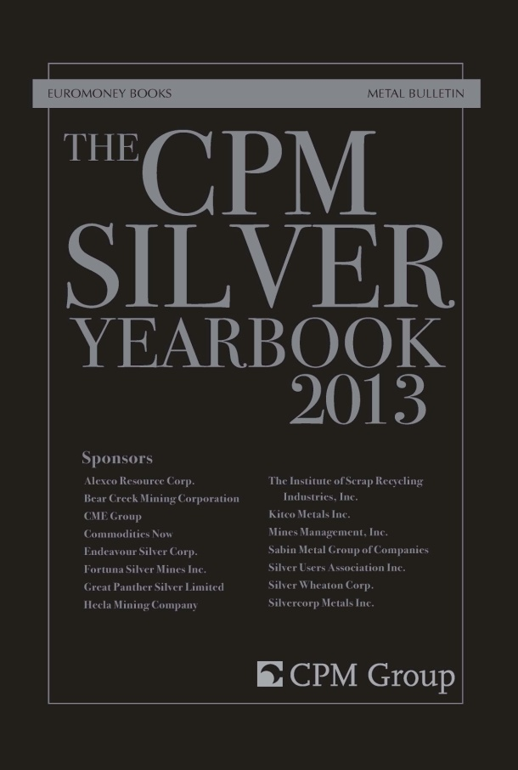
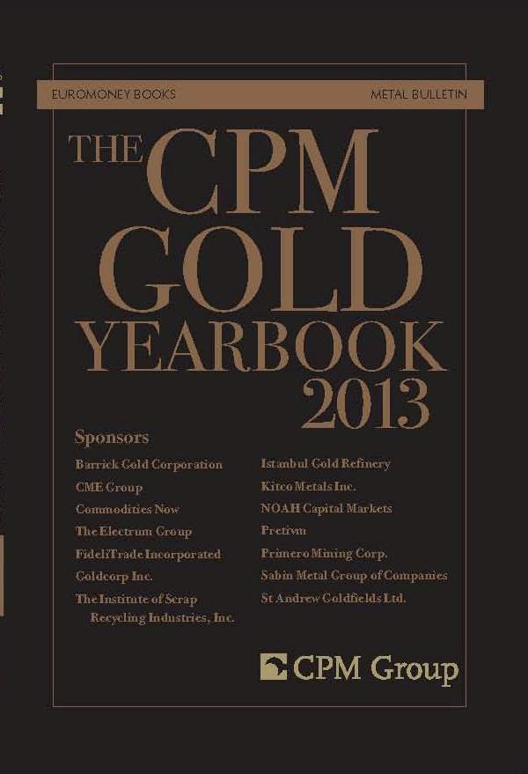
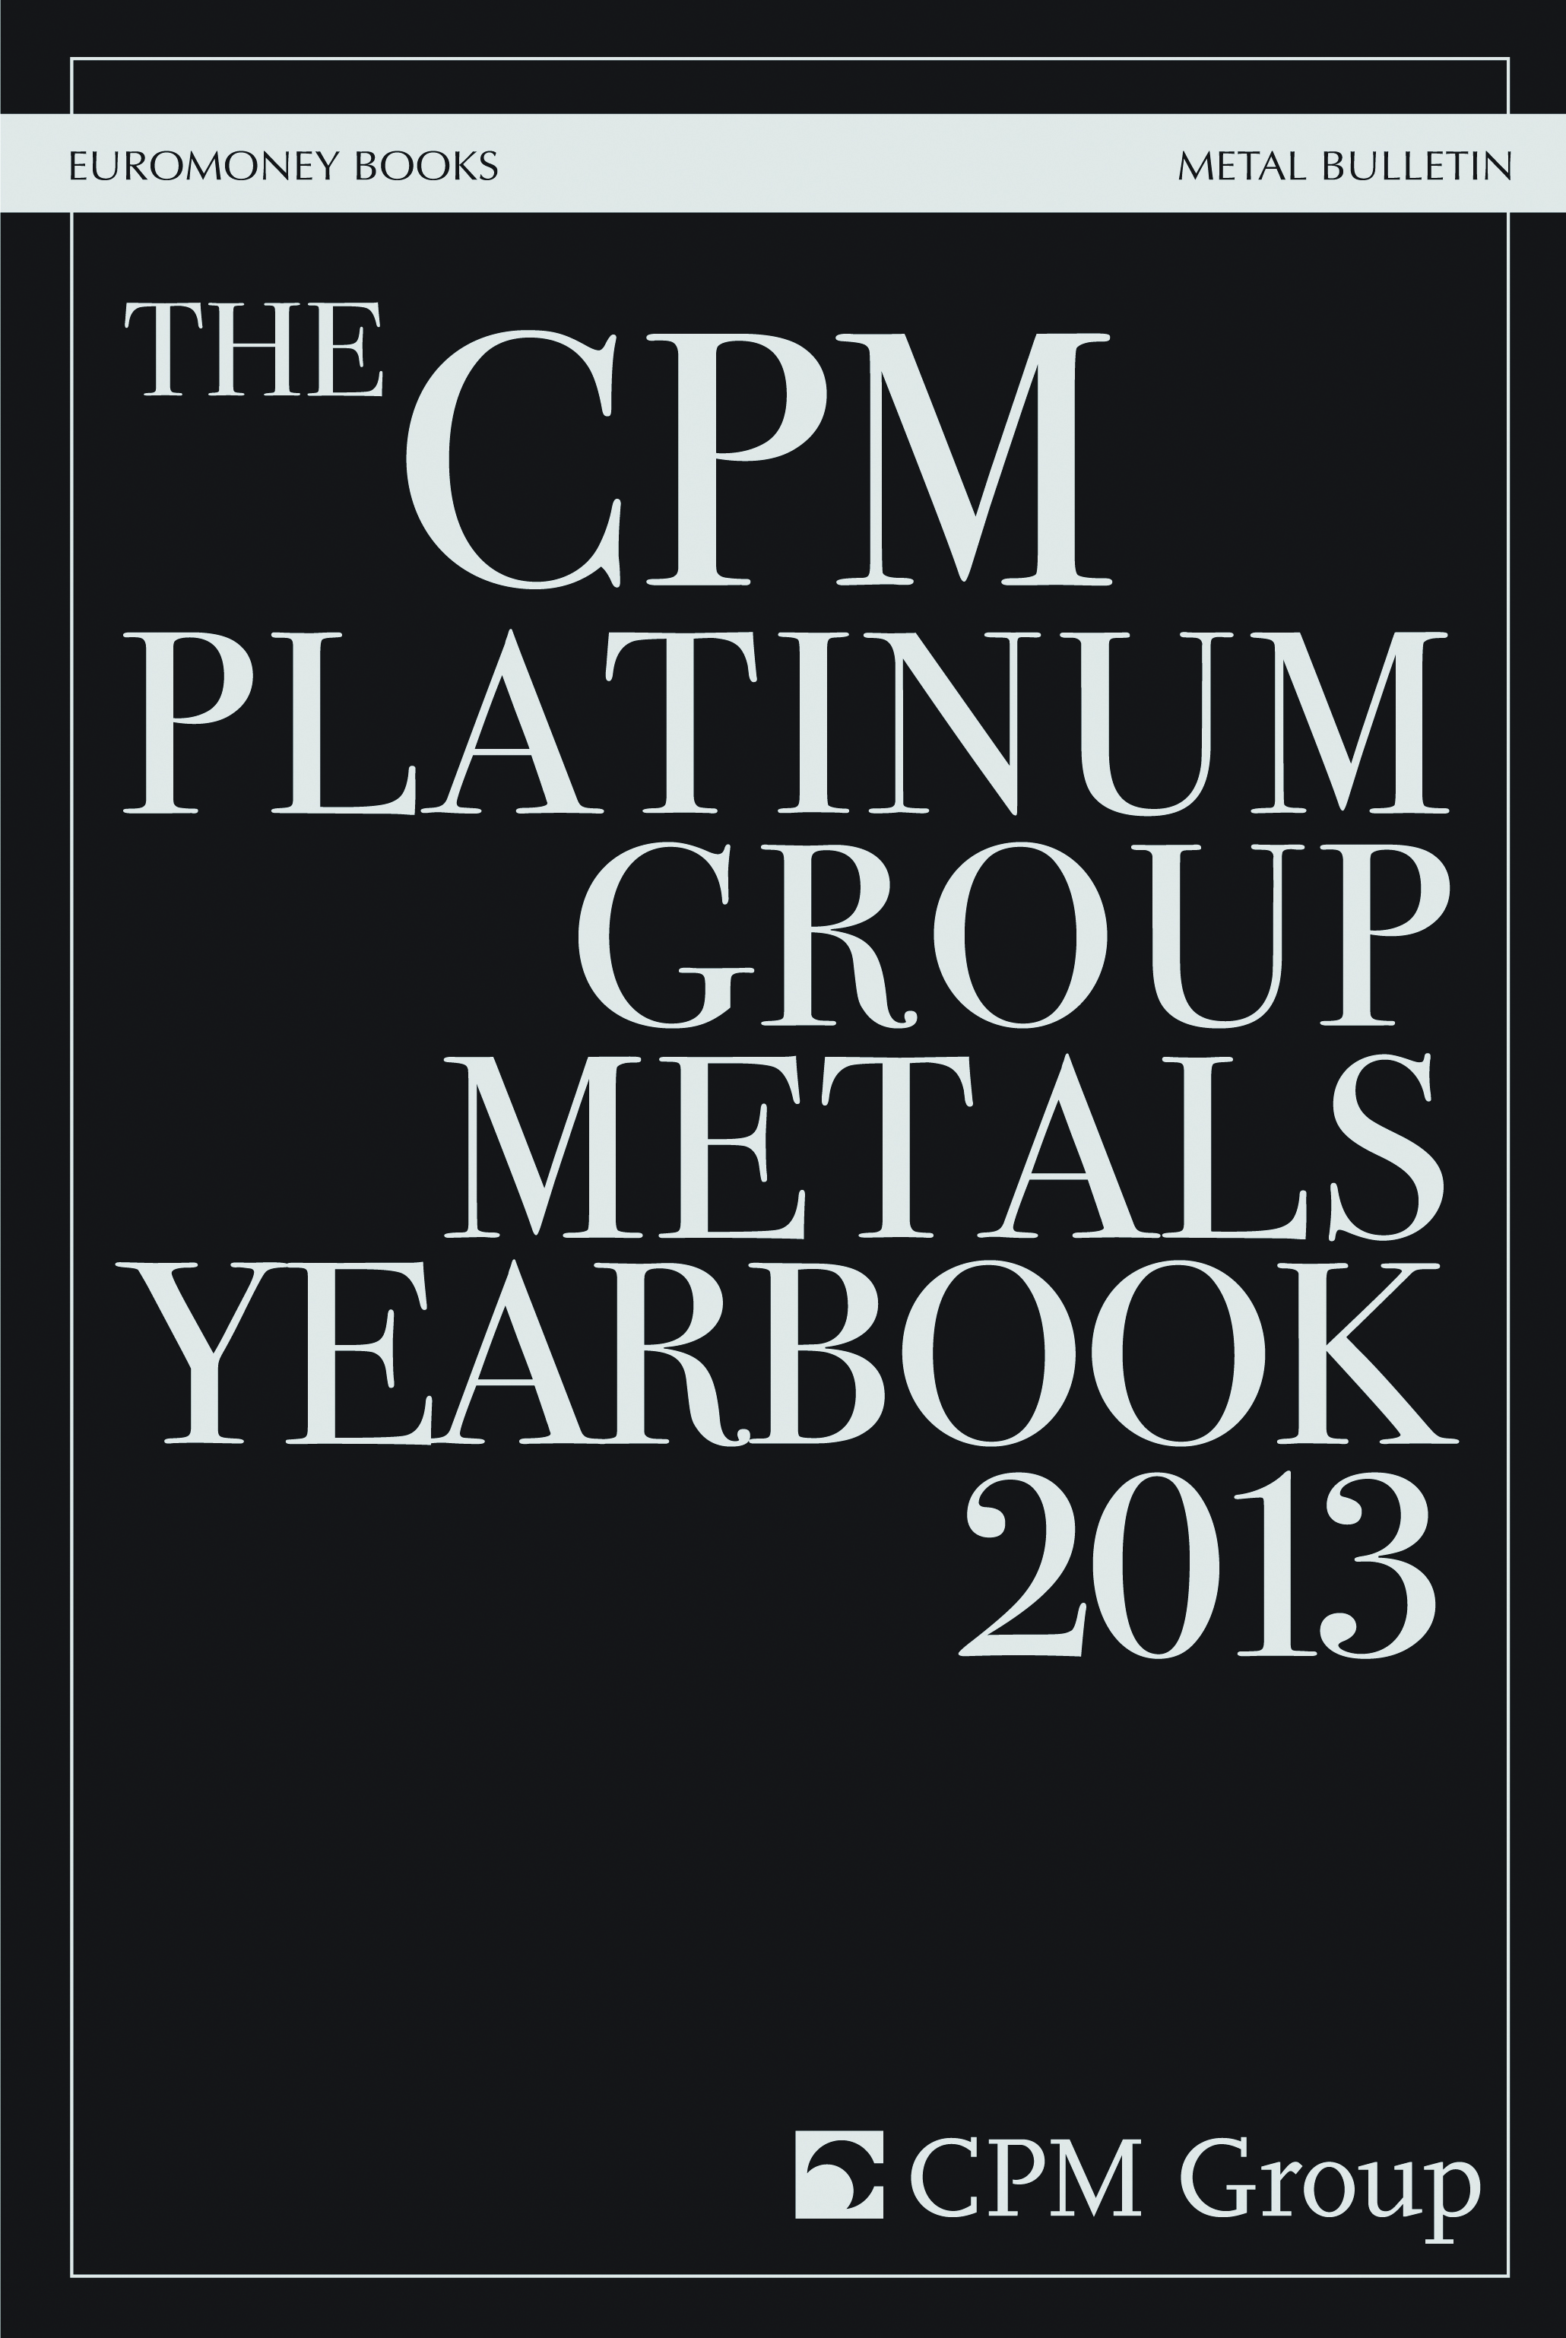
CPM Group Precious Metals Yearbooks & Other Reports
For general inquiries, email info@cpmgroup.com

Slide 53
谢谢！
Thank You!

