Slide 1
BASE METALS OUTLOOK
Offering a different perspective to the end of QE
Mark Keenan, Commodity Research & Strategy
Phone: +65 6326 7851
mark.keenan@sgcib.com
Important Notice: The circumstances in which this publication has been produced are such that it is not appropriate to characterise it as independent investment research as referred to in MiFID and that it should be treated as a marketing communication even if it contains a research recommendation. This publication is also not subject to any prohibition on dealing ahead of the dissemination of investment research. However, SG is required to have policies to manage the conflicts which may arise in the production of its research, including preventing dealing ahead of investment research.

Slide 2
CONTENTS
MACRO OUTLOOK & COMMODITY PRICES IN GENERAL
HOW THE END OF QE MIGHT AFFECT METAL PRICE DYNAMICS
  Offering a different perspective?
Individual base & PRECIOUS metals outlook

Slide 3
MACRO OUTLOOK & IMPACT ON COMMODITIES
The conditions are finally coming into place for a sustainable US economic recovery.
  This will provide support for pro-cyclical commodities.
Europe is not there yet, and China’s economic growth is likely to fade by mid-year as the Chinese government’s policies to rebalance the economy, act as a brake.
  This will reduce overall upside, but provide interesting opportunities within commodity sectors
Overall commodity upside moderately positive for the year and most of the upside is likely to come from energy prices.
  We see clear upside in Brent
The recent sharp sell-off in base metal prices is, in our view, now overdone, and we should see a partial recovery during the second quarter.
  But this is unlikely to be extended into the second half of the year as Chinese economic growth should be slowing by then.
SG GDP forecasts | 2013f | 2014f | 2015f | 2016f
Eurozone | -0.6 | 0.5 | 1.2 | 1.6
US | 2.1 | 3.0 | 3.3 | 3.7
Japan | 1.5 | 2.0 | 1.2 | 1.3
China | 7.6 | 7.2 | 6.9 | 6.9
Global (mkt FX weights) Global (PPP FX weights) | 2.7 3.3 | 3.3 3.8 | 3.5 4.0 | 3.8 4.2
Source: SG Cross Asset Research

Slide 4
THE END OF QE? - higher us bond yields, HIGHER USD?
Strength and sustainability in the US economic recovery suggests that the Fed’s QE program will likely be scaled back in Q4 2013.
US bond yields are likely to rise substantially ahead of the expected QE exit. Our economists have a central scenario of US 10-year bond yields reaching 2.75% by year-end
Would such a dramatic increase in US bond yields have the potential to push commodity prices lower?
Would the expected strength in the dollar have the potential to push commodity prices lower?
Our analysis of past yield increases suggest not:
    The key driver of pro-cyclical commodities is economic growth (apart from supply changes) rather than interest rates.
    Also - the US economy is unlikely to push real interest rates so high that it would weaken the economy.
Source: SG Cross Asset Research

Slide 5
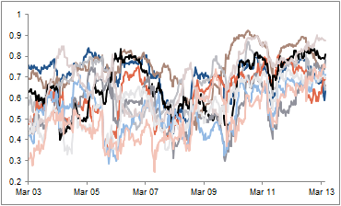
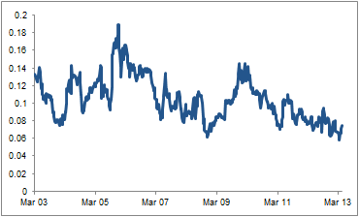
BASE METAL PRICE DYNAMICS & THE END OF QE
Academic literature suggests the following:
  Yields will rise, the dollar will rise and commodities should therefore fall.
In reality, the outcome is more likely to be:
  Commodity prices will rise as the end of QE signifies growth – economic growth is a key driver of commodity prices especially in the current climate
What else might happen?
  The average correlation between each metal is likely to fall.
  The standard deviation of the correlations between the metals is likely to increase – i.e. the metal’s innate character returns
12m rolling correlation between metals
Standard deviation of metal correlation
Source: SG Cross Asset Research

Slide 6
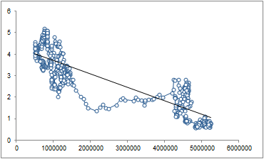
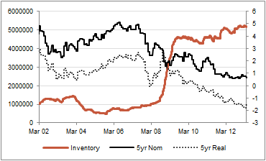
THE RELATIONSHIP BETWEEN INTEREST RATES & COMMODITIES?
High (Low) interest rates generally lead to lower (higher) commodity prices in real terms - these results are supported empirically.
Higher interest rates can influence the price of commodities (by lowering them) through a number of channels:
  By appreciating the USD – therefore increasing their price in foreign terms
  Influencing speculators out of commodities into higher yielding assets (bonds)
  Reducing inflation possibilities and therefore reducing the appeal of commodities as a hedge
  Increasing the incentive to extract today rather than tomorrow (sell commodity and earn interest on proceeds)
  Influencing the desire to carry inventories – carry trade, increased convenience yield, decreased opportunity cost.
Aluminium Inventory vs. 5YR Bond Yield
Aluminium Inventory vs. 5YR Bond Yield (nom & real)
Source: SG Cross Asset Research

Slide 7
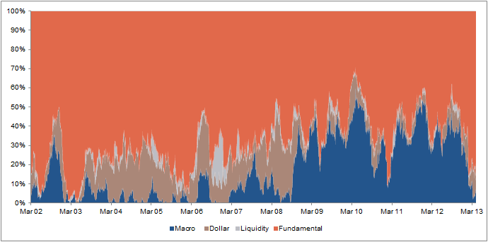
RISK ATTRIBUTION AS A FUNCTION OF INVENTORIES
We are interested in how interest rates affect inventory levels and in turn how this might affect volatility (risk attribution) and hence correlation.
Specifically we look at how the distribution between systemic risk (market (macro) driven volatility) and idiosyncratic risk (specific supply/demand driven volatility) has changed, and suggest that this change is linked to low interest rates driving higher inventories which changes the risk attribution.
We use principal component analysis (PCA) to decompose the individual price variance for each metal.
Idiosyncratic Volatility
(Fundamentals)
PCA output for Aluminium (23 factor)
Systemic Risk
(Macro / Dollar etc)
Source: SG Cross Asset Research

Slide 8
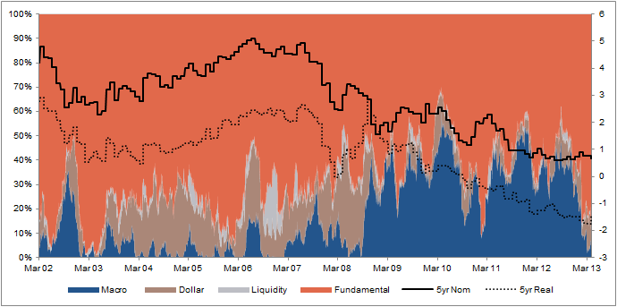
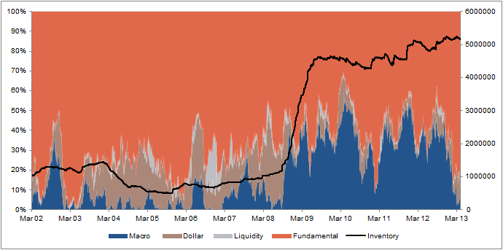
Interest rates, inventory, volatility and correlation – the link
Low interest rates ～ high inventories
High inventories act as a cushion to supply / demand shocks.
Idiosyncratic risk becomes less significant as a key driver of volatility.
Systemic risk becomes more significant as a key driver of volatility.
The recent economic climate has increased the frequency of systemic risk shocks
Without idiosyncratic risk to balance the volatility, markets become highly correlated as individual supply &demand dynamics become less relevant and macro dynamics dominate.
This significantly impacts hedging strategies and investment methodologies (“risk on, risk off”)
PCA output for Aluminium + Interest Rates
PCA output for Aluminium + Inventory
Source: SG Cross Asset Research

Slide 9
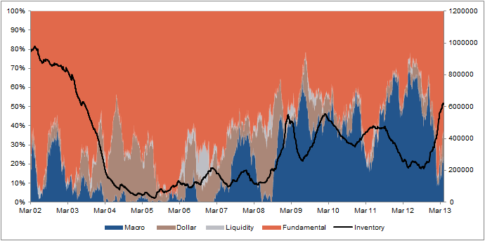
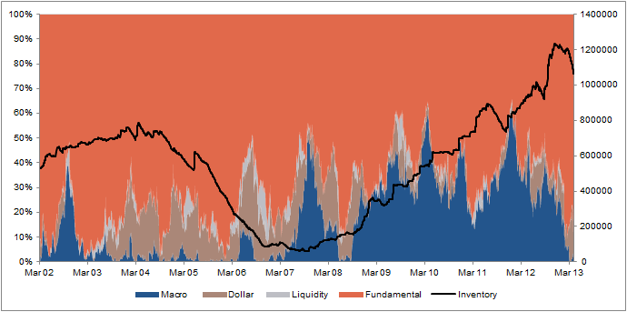
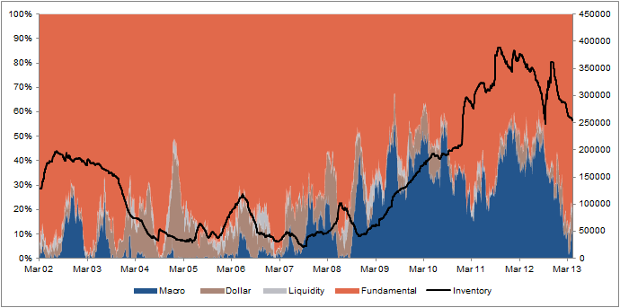
What do the other metals look like?
PCA output for Copper + Inventory
PCA output for Aluminium + Inventory
PCA output for Zinc + Inventory
PCA output for Lead + Inventory
Source: SG Cross Asset Research

Slide 10
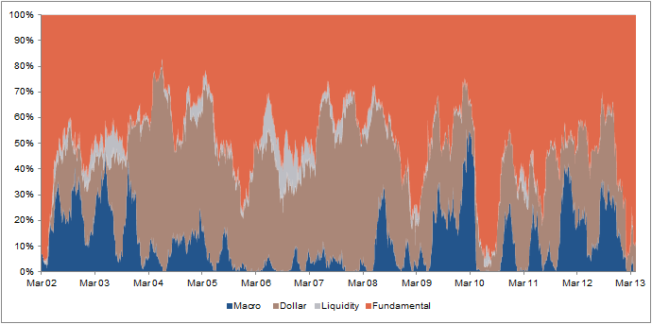
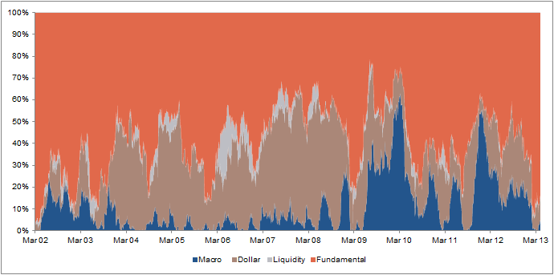
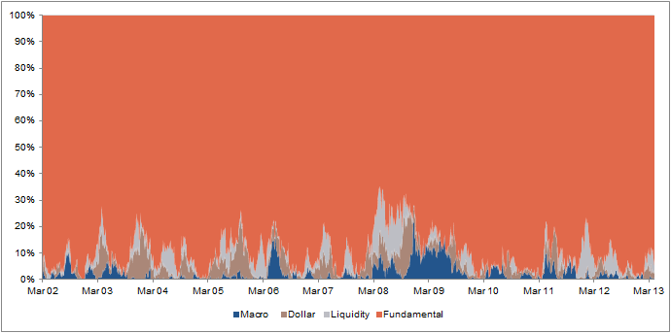
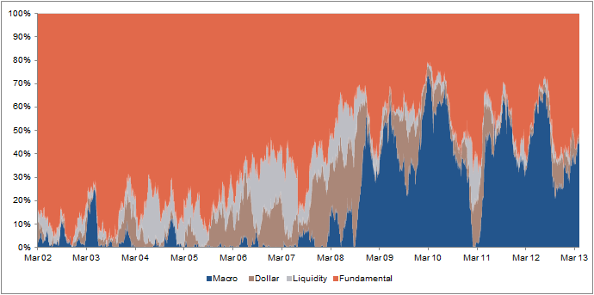
What do other commodities look like?
PCA output for Gold
PCA output for Silver
PCA output for Natural Gas
PCA output for Crude Oil (WTI)
Source: SG Cross Asset Research

Slide 11
TO RECAP...
Signs that suggest QE is ending, will likely cause prices to increase. This will be a function of economic growth returning and despite the anticipated higher yields and a higher dollar, we anticipate prices to respond positively to this.
Inventories are likely to decline – this will also support prices, but more specifically will act to reduce the cushion that dampens each market from its own specific supply & demand dynamics.
We therefore expect a realignment of the risk attribution profile (idiosyncratic risk vs. system risk) to historical norms and we expect supply & demand dynamics to re-exert themselves as a key driver of variance .
As idiosyncratic risk (driven by supply & demand dynamics) can be hedged reasonably effectively, and systemic risk (macro shocks) cannot. This should increase the efficiency of hedging programs and investment strategies as fundamentals return.
With this in mind we can now have a brief look into each of the SHFE metal markets.
Source: SG Cross Asset Research

Slide 12
GOLD
What caused the fall and why was it so sudden?
  Inflationary outlook remains muted
    50% of EM inflation driven by agriculture & food prices – SG forecasts weaker prices going forward
  Cyprus
    Proposed monetisation of gold reserves – extending to Italy?
  Significant investor outflows
    Accelerating from the ytd average of $145m / day to $600m / day (week of 10th – 16th April)
Physical Buying and Producer Selling
  Physical buying– how much was going to be done anyway?
  Producer hedging – capping upside & exacerbating downside?
Downside Support?
  The latest Gold Survey from Thomson Reuters GFMS records “all-in costs” at $1,211/ounce
  Our forecast average of $1,500/ounce this year, puts 10% of world mine production on the marginal–to-loss making threshold
Current Forecasts
    2013 Q4 - $1375/oz
    2014 - $1400
    Future decline of $100/oz/year to $1,000/oz by 2018
Source: SG Cross Asset Research

Slide 13
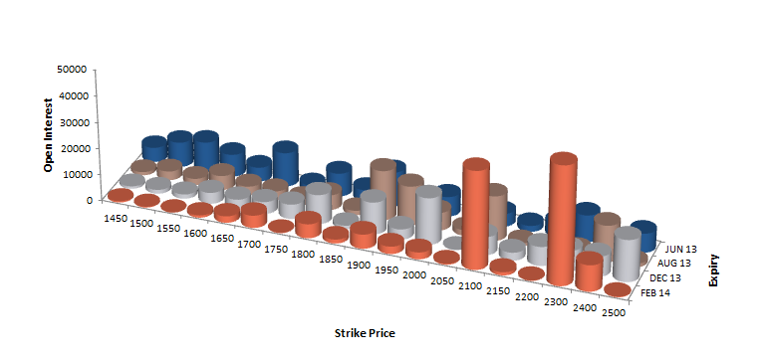
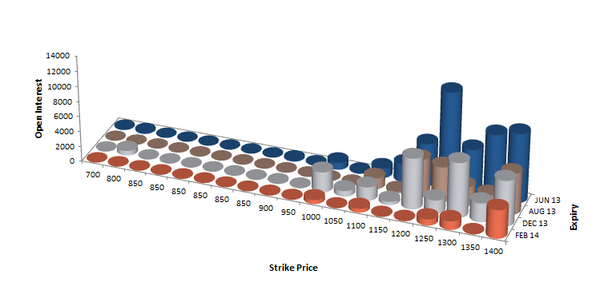
EXCHANGE TRADED GOLD OPTIONS – what do they tell us?
Call Open Interest
Put Open Interest

Slide 14
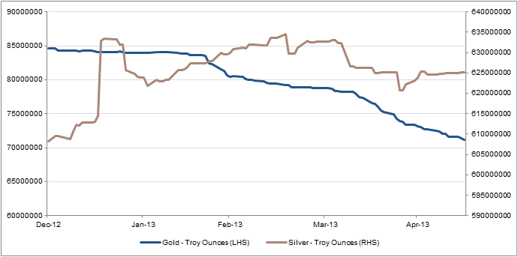
SILVER
Relative to Gold, investor flows remain relatively stable
Identifiable bullion stocks stood at a 17-year high of almost 42,490 tonnes at the end of 2012.
  The vast majority of these bullion stocks were with European dealers, reflecting continued interest among investors – these stocks increased by 5800 tonnes last year.
We continue to believe that the longer-term bear market in gold will take silver prices lower.
  The average price for the year to date is $29/oz; we are expecting an annual average in the region of $27/oz this year.
  High stock levels however, particularly across the investment products, could exacerbate price falls as investors liquidate positions.
Gold & Silver Total ETF Holdings YTD

Slide 15
Base metals – general ouTlook
We consider the recent sell-off in base metals prices to be overdone and expect prices to rally in Q2 2013 on the back of seasonal restocking and the emerging signs of an economic recovery taking root.
We also expect China’s economic growth to fade by mid-year as the Chinese government’s policies to rebalance the economy act as a brake.
Within the base metals complex, copper should increasingly underperform as China seeks to rebalance the economy away from infrastructure spending to a more consumer driven economy, with metals like Aluminum likely to outperform.
Copper C1 Cost Curve
Aluminium C1 Cost Curve

Slide 16
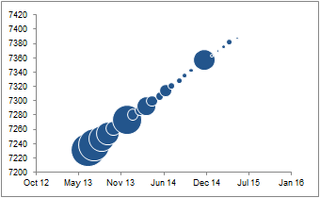
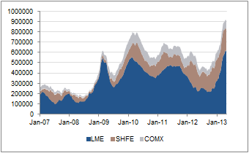
COPPER
Commodity | 2013 Q4 Forecast (average) | 2014 Forecast (average) | Highest Operational Cost | 90 Percentile Operational Cost | Current Mkt Price (15th May 2013)
Copper ($/mt) | 7000 | 7000 | 7000 | 4500 | 7198
Copper has been trading significantly above C1 cost curve in order to dampen demand in supply constrained market.
With mine supply growth now accelerating due to restarts, numerous expansions, and greenfield projects combined with the anticipated Chinese slowdown, Copper is likely to flip into a surplus this year and also in 2014
Increasing substitution from Aluminum, but also plastics and fiber optics will contribute to the surplus. Substitution reduced demand by approximately 500,000 tons in 2012.
Source: SG Cross Asset Research

Slide 17
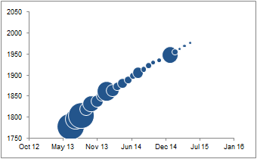
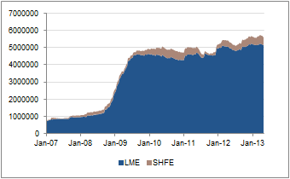
ALUMINIUM
Commodity | 2013 Q4 Forecast (average) | 2014 Forecast (average) | Highest Operational Cost | 90 Percentile Operational Cost | Current Mkt Price (15th May 2013)
Aluminium ($/mt) | 2100 | 2200 | 2400 | 2200 | 1839.50
Aluminium has been trading at or below its C1 cost despite robust consumption growth. We see this increasing 7.8% this year. Strengthening global growth and receding systemic risk from Europe is also likely to boost restocking.
Aluminum is less exposed to infrastructural spending than other metals as aluminum consumption is very diversified. Aluminum is also steadily taking market share for copper in the wiring market.
Significant amounts of Aluminum remain tied up in financing deals.

Slide 18
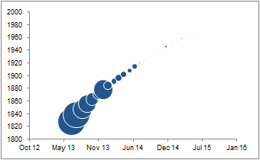
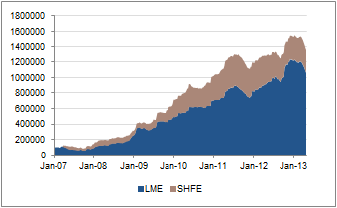
ZINC
Commodity | 2013 Q4 Forecast (average) | 2014 Forecast (average) | Highest Operational Cost | 90 Percentile Operational Cost | Current Mkt Price (15th May 2013)
Zinc ($/mt) | 2000 | 2200 | 1800 | 1700 | 1823
Global zinc consumption is estimated to have increased by 3.2% in 2012 and is set to accelerate further this year by 5.4% due to a pick-up in global manufacturing activity. Developing economies should continue to drive global zinc consumption, led by China, with growth in the developed economies more subdued, with the exception of the US.
We forecast that last year’s deficit will continue this year, which suggesting that reported stocks will decline
A significant tonnage of LME stocks is tied up in long-term warehouse financing. Cancelled warrant % are very high and with lengthy delivery queues flat price should be firmly supported.

Slide 19
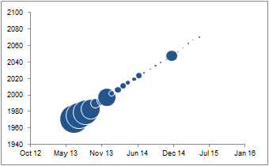
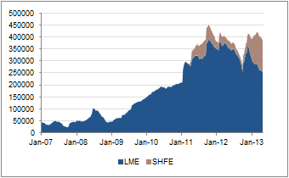
LEAD
Commodity | 2013 Q4 Forecast (average) | 2014 Forecast (average) | Highest Operational Cost | 90 Percentile Operational Cost | Current Mkt Price (15th May 2013)
Lead ($/mt) | 2300 | 2400 | 1475 | 1350 | 1969
Fundamentals are tight.
Global lead consumption grew by 5% YoY last year. We forecast further growth of 5.7% yoy in 2013 on the back of Chinese and US demand, offsetting more subdued conditions in Europe.
While the automotive sector is strong, non-automotive applications for lead, including industrial and standby/emergency battery power uses, telecoms and motive applications, are experiencing robust demand.
As with Zinc, significant tonnage of LME stocks is tied up in long-term warehouse financing. Cancelled warrant % are very high and with lengthy delivery queues flat price should be firmly supported.

Slide 20
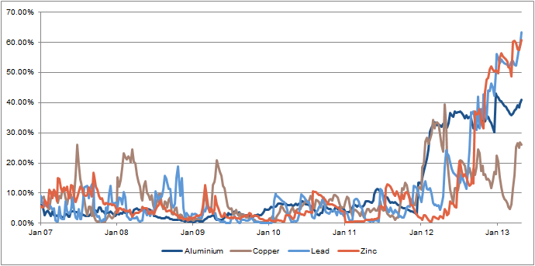
Cancelled warrant ratios (%)
Cancelled warrant ratio calculated as: Cancelled Warrants / Total LME stocks
We estimate that >90% of cancelled warrants are related to trade finance

Slide 21
CONCLUSION
The end of QE will be supportive for prices
The end of QE will likely cause inventories to decline
The end of QE will likely cause correlations among the sector to decrease
The end of QE will cause Fundamentals to return
Trade Ideas:
    Long Aluminum / Short Copper
    Long Lead / Short Zinc

Slide 22
Appendix - Disclaimer
ANALYST CERTIFICATION
Each author of this research report listed on the cover hereby certifies that the views expressed in the research report accurately reflect his or her personal views, including views about subject securities or issuers mentioned in the report, if any. No part of his or her compensation was, is or will be related, directly or indirectly to the specific recommendations or views expressed in this report.
The information herein is not intended to be an offer to buy or sell, or a solicitation of an offer to buy or sell, any securities or other financial instrument and including any expression of opinion, has been obtained from or is based upon sources believed to be reliable but is not guaranteed as to accuracy or completeness although Société Générale (“SG”) believe it to be fair and not misleading or deceptive. SG, and their affiliated companies in the SG Group, may from time to time deal in, profit from the trading of, hold or act as market-makers or act as advisers, brokers or bankers, in relation to the securities, or derivatives of persons, firms or entities mentioned in this publication, or be represented on the board of such persons, firms or entities. Employees of SG, and their affiliated companies in the SG Group, or individuals connected to them may from time to time have a position in or be holding any of the investments or related investments mentioned in this publication. SG and their affiliated companies in the SG Group are under no obligation to disclose or take account of this publication when advising or dealing with or for their customers. The views of SG reflected in this publication may change without notice. To the maximum extent possible at law, SG does not accept any liability whatsoever arising from the use of the material or information contained herein. Dealing in warrants and/or derivative products such as futures, options, and contracts for differences has specific risks and other significant aspects. You should not deal in these products unless you understand their nature and the extent of your exposure to risk. This publication is not intended for use by or targeted at retail customers. Should a retail customer obtain a copy of this report they should not base their investment decisions solely on the basis of this document but must seek independent financial advice.
The financial instrument discussed in this report may not be suitable for all investors and investors must make their own informed decisions and seek their own advice regarding the appropriateness of investing in financial instruments or implementing strategies discussed herein. The value of securities and financial instruments is subject to currency exchange rate fluctuation that may have a positive or negative effect on the price of such securities or financial instruments, and investors in securities such as ADRs effectively assume this risk. SG does not provide any tax advice. Past performance is not necessarily a guide to future performance. Estimates of future performance are based on assumptions that may not be realized. Investments in general and derivatives in particular, involve numerous risks, including, among others, market, counterparty default and liquidity risk. Trading in options involves additional risks and is not suitable for all investors. An option may become worthless by its expiration date, as it is a depreciating asset. Option ownership could result in significant loss or gain, especially for options of unhedged positions. Prior to buying or selling an option, investors must review the "Characteristics and Risks of Standardized Options" at http://www.optionsclearing.com/publications/risks/riskchap.1.jsp.
CONFLICTS OF INTEREST
This research contains the views, opinions and recommendations of Société Générale (SG) analysts and/or strategists. Analysts and/or strategists routinely consult with SG sales and trading desk personnel regarding market information including, but not limited to, pricing, spread levels and trading activity of a specific fixed income security or financial instrument, sector or other asset class. Trading desks may trade, or have traded, as principal on the basis of the analyst(s) views and reports. In addition, analysts receive compensation based, in part, on the quality and accuracy of their analysis, client feedback, trading desk and firm revenues and competitive factors. As a general matter, SG and/or its affiliates normally make a market and trade as principal in fixed income securities discussed in research reports.
.

Slide 23
Appendix – DisclaimeR (CONT’D)
Notice to French Investors: This publication is issued in France by or through Société Générale ("SG") which is authorised and supervised by the Autorité de Contrôle Prudentiel and regulated by the Autorite des Marches Financiers.
Notice to U.K. Investors: This publication is issued in the United Kingdom by or through Société Générale ("SG"), London Branch. Société Générale is a French credit institution (bank) authorised and supervised by the Autorité de Contrôle Prudentiel (the French Prudential Control Authority). Société Générale is subject to limited regulation by the Financial Services Authority (“FSA”) in the U.K. Details of the extent of SG's regulation by the FSA are available from SG on request. The information and any advice contained herein is directed only at, and made available only to, professional clients and eligible counterparties (as defined in the FSA rules) and should not be relied upon by any other person or party.
Notice to Polish Investors: this publication has been issued in Poland by Societe Generale S.A. Oddzial w Polsce (“the Branch”) with its registered office in Warsaw (Poland) at 111 Marszałkowska St. The Branch is supervised by the Polish Financial Supervision Authority and the French “Autorité de Contrôle Prudentiel”. This report is addressed to financial institutions only, as defined in the Act on trading in financial instruments. The Branch certifies that this publication has been elaborated with due diligence and care.
Notice to US Investors: SG research reports issued by non-US SG analysts or affiliates on securities are issued solely to major US institutional investors pursuant to SEC Rule 15a-6. Any US person wishing to discuss this report or effect transactions in any security discussed herein should do so with or through SG Americas Securities, LLC to conform with the requirements of US securities law. SG Americas Securities LLC has its registered office at 1221 Avenue of the Americas, New York, NY, 10020. (212) 278-6000.
Notice to Canadian Investors: This publication is for information purposes only and is intended for use by Permitted Clients, as defined under National Instrument 31-103, Accredited Investors, as defined under National Instrument 45-106, Accredited Counterparties as defined under the Derivatives Act (Québec) and "Qualified Parties" as defined under the ASC, BCSC, SFSC and NBSC Orders.
Notice to Singapore Investors: This publication is provided in Singapore by or through Société Générale ("SG"), Singapore Branch and is provided only to accredited investors, expert investors and institutional investors, as defined in Section 4A of the Securities and Futures Act, Cap. 289. Recipients of this publication are to contact Société Générale, Singapore Branch in respect of any matters arising from, or in connection with, the publication. If you are an accredited investor or expert investor, please be informed that in SG's dealings with you, SG is relying on the following exemptions to the Financial Advisers Act, Cap. 110 (“FAA”): (1) the exemption in Regulation 33 of the Financial Advisers Regulations (“FAR”), which exempts SG from complying with Section 25 of the FAA on disclosure of product information to clients; (2) the exemption set out in Regulation 34 of the FAR, which exempts SG from complying with Section 27 of the FAA on recommendations; and (3) the exemption set out in Regulation 35 of the FAR, which exempts SG from complying with Section 36 of the FAA on disclosure of certain interests in securities.
Notice to Hong Kong Investors: This report is distributed in Hong Kong by Société Générale, Hong Kong Branch which is licensed by the Securities and Futures Commission of Hong Kong under the Securities and Futures Ordinance (Chapter 571 of the Laws of Hong Kong) ("SFO"). This publication does not constitute a solicitation or an offer of securities or an invitation to the public within the meaning of the SFO. This report is to be circulated only to "professional investors" as defined in the SFO.
Notice to Japanese Investors: This publication is distributed in Japan by Societe Generale Securities (North Pacific) Ltd., Tokyo Branch, which is regulated by the Financial Services Agency of Japan. This publication is intended only for the Specified Investors, as defined by the Financial Instruments and Exchange Law in Japan and only for those people to whom it is sent directly by Societe Generale Securities (North Pacific) Ltd., Tokyo Branch, and under no circumstances should it be forwarded to any third party. The products mentioned in this report may not be eligible for sale in Japan and they may not be suitable for all types of investors.
Notice to Australian Investors: This publication is issued in Australia by Société Générale (ABN 71 092 516 286) ("SG"). SG is regulated by APRA and ASIC and holds an AFSL no. 236651 issued under the Corporations Act 2001 (Cth) ("Act"). The information contained in this publication is only directed to recipients who are wholesale clients as defined under the Act.
http://www.sgcib.com. Copyright: The Société Générale Group 2013. All rights reserved.
This publication may not be reproduced or redistributed in whole in part without the prior consent of SG or its affiliates.

Slide 24
Thank You!

