Slide 1
2017 14th Shanghai Derivatives Market Forum
Conduct Warrant Trading To Better Serve China’s Real Economy
Shanghai Futures Exchange
Bao Jianping, Director of Commodities Service Department

Slide 2
Contents
1
Background Meaning
2
Overall Planning
3
Business Pattern
4
Implementation Plan

Slide 3
Background Meaning
Project background
Platform significance
Grow upwardly
Conduct high-end derivatives trading, such as index futures and futures option
Create a futures ecosystem
Build a diversified commodities market
Leaves: Derivatives
Grow laterally to expand branches
Docking with other trading platforms, conduct new non-futures and derivatives trading
Trunk: Futures
Look for the root and take root downwardly
Conduct non-futures and OTC derivatives trading
Root: Non-futures
Realize interconnection between futures and non-futures, floor and OTC, and domestic and overseas markets

Slide 4
Background Meaning
Project background
Platform significance
Respond to the national Internet+ plan, utilize the Internet technology and Internet of Thing technology and rely on big data and cloud computing to realize effective connection between futures and non-futures, and floor and OTC markets, expand the capacity and space of futures market serving the non-futures market, better promote the market to exert its function and the reform of supply side.
E-commerce
Modern logistics
Futures
option
Internet of Thing technology
Internet technology
Forward/swap
OTC
Non-futures
Big data & cloud computing
Commodities trading platform

Slide 5
Background Meaning
Project background
Platform significance
Address the contradiction between the futures market standardization and clients’ diversified demand, so as to better serve the real economy
Venue
Concentrated delivery venues vs. scattered industrial distribution
Address such problems as inconsistencies between the warrant distributed by the buyers in futures delivery and actual demand; instable futures/non-futures price relationship, lowered convergence, and clients’ risk management demand unable to be met, etc.
Time
Fixed delivery time fixed vs. flexible non-futures trading time
Specification
Delivery specification standardization vs. non-futures trading quality
diversity
Product
Less listed products vs. enterprises need hedging against all kinds
of commodities risk
Method
Unitary trading method in call auction vs. many demands e.g.
OTC trading

Slide 6
Contents
1
Background Meaning
2
Overall Planning
3
Business Pattern
4
Implementation Plan

Slide 7
Overall Planning
Futures/non-futures docking
Feasibility
Business planning
Market participants
Process interface
I. Break through the industry chain
Realize effective docking of futures/non-futures
and serve the real economy
The platform established may form an aggregation effect, promote industry chain development and drive the supportive services and related industries to develop
Certification
Service
Trading
Service
Finance
Service
Information
Service

Slide 8
Overall Planning
Futures/non-futures docking
Feasibility
Business planning
Market participants
Process interface
II. Futures/non-futures docking
Current futures and option businesses
Commodities trading business
EFP
Warrant trading
Meet clients’ individualized demands in terms of pickup time, venue, brand and quantity
Futures
Futures/non-futures price
Hedging
EPF
Non-
futures
Auction trading
Form reasonable premium/discount
Quote counter
Incubate new futures products
Option
Manage futures risk
Enrich investment strategy
Sight
Meet the enterprises’ diversified risk management demand
OTC derivatives
Forward
Risk management
Share the market resources
Swap

Slide 9
Overall Planning
Futures/non-futures docking
Feasibility
Business planning
Market participants
Process interface
Commodities Trading Platform
Standard warrant management system
Futures trading system
Futures clearing system
Warrant resource
Market resources
Financial support
Risk control experience
Rule and regulation system
Law & policy
Technical support
Measures on Management of Standard Warrant, Settlement Rules, Delivery Rules
Measures on Management of Delivery Warehouse
Contract Law, regulations and policies such as No. 37 and No.9 Documents

Slide 10
Overall Planning
Futures/non-futures docking
Feasibility
Business planning
Market participants
Process interface
In the initial stage, develop warrant B/S, warrant swap, warrant auction, EFP and warrant quote system; once it operates steadily, expand the business along the commodities industry chain and gradually introduce non-futures contract, middle and forward transaction and swap transaction to realize convergence of dealer flow, capital flow, information flow and material flow, utilize advanced Internet and Internet of Thing technology to build into an efficient warrant trading platform.
Third stage
Online shop
Option, spread trading
Diversified commodities trading method
Second stage
OTC derivatives trading, such as sight and forward trading
Regional pricing baseline
First stage
Warrant B/S, warrant swap, quote counter
Meet the physical enterprises’ individualized risk management demand
Activate the warrant inventory
Meet the physical enterprises’ advanced pricing demand
Meet the physical enterprises’ individualized delivery demand

Slide 11
Overall Planning
Futures/non-futures docking
Feasibility
Business planning
Market participants
Process interface
Market participants | Description
Dealer | Enterprise legal person engaged in trading and financing, etc. in the trading platform.
Market maker | Special dealer engaged in product query and quote service to earn B/S spread and provide market liquidity.
Quoter | Related institutions providing quote service to dealer, including commodities quote, financing quote and transport quote, etc.
Clearing member | Market participant who provides agent settlement service to dealer or directly settles with the trading platform for their own trading.
Bank | Commercial bank providing fund deposit, management and clearing service for the platform and market.
Warehouse | Our appointed delivery warehouse for futures, which opens fund account on the platform to charge storage fee and transfer fee.

Slide 12
Overall Planning
Futures/non-futures docking
Feasibility
Business planning
Market participants
Process interface
I. Process
⑧Logistics
⑦Financing
①Account opening
②Trading
③Clearing
④Delivery
⑤Information
⑥ Risk control

Slide 13
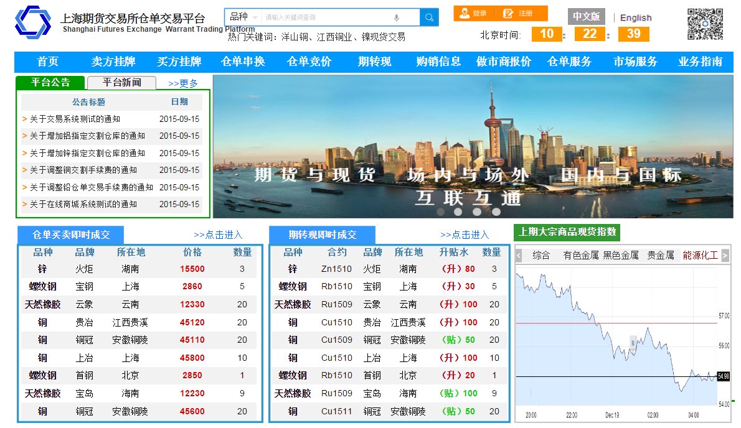
Overall Planning
Futures/non-futures docking
Feasibility
Business planning
Market participants
Process interface
Shanghai Commodities Trading Platform

Slide 14
Contents
1
Background Meaning
2
Overall Planning
3
Business Pattern
4
Implementation Plan

Slide 15
Business Pattern
Account opening
Trading
Clearing
Delivery
Storage
Information
Risk control
Standard warrant management
System user
Warrant trading platform
Participants
Confirmed by the platform
Sign entry agreement
Submit supplementary materials

Slide 16
Business Pattern
Account opening
Trading
Clearing
Delivery
Storage
Information
Risk control
I. Trading mode
Transaction type
Warrant B/S
Listing by buyer
Listing by seller
Quote counter
Warrant swap

Slide 17
Business Pattern
Account opening
Trading
Clearing
Delivery
Storage
Information
Risk control
II. Market maker
In order to improve the market immediacy and liquidity, the market maker mechanism is introduced to the warrant swap on the trading platform.
Futures risk management subsidiary, trade and warehousing company, production enterprise, investing bank and other financial institutions which have professional qualification, capital strength and good reputation are selected as the market makers.
Rights and obligations are clearly provided for the market maker.
A preferential policy is provided through negotiation between the trading platform and market maker.
The market maker shall be subject to assessment system; and the preferential policy will be adjusted for those who are inconsistent with the assessment criteria.

Slide 18
Business Pattern
Account opening
Trading
Clearing
Delivery
Storage
Information
Risk control
III. Trading objects
1
Warrant trading
Standard warrant
Non-standard warrant
Standard warehouse warrant
Standard factory warehouse warrant
Appointed delivery non-standard warrant
Tax-inclusive warrant
Non-standard warrant certified by the warrant system
Bond warrant
3
2
4
5

Slide 19
Business Pattern
Account opening
Trading
Clearing
Delivery
Storage
Information
Risk control
IV. Trading products
Active products in the SHFE
Nonferrous metals
All listed products in the SHFE
Upstream and downstream products of industry chain
Futures reserve products

Slide 20
Business Pattern
Account opening
Trading
Clearing
Delivery
Storage
Information
Risk control
V. Formation of premium/discount
Region premium/discount
Warrant B/S
Warrant swap
Three types of premium/discount, i.e. region, brand and level are formed through market price or quoted price.
Price
Effective
quote
Brand premium/discount
Level premium/discount

Slide 21
Business Pattern
Account opening
Trading
Clearing
Delivery
Storage
Information
Risk control
I. Clearing principle
Effective isolation of futures/non-futures risk
Ensure immediacy of non-futures trading
Clearing principle
Non-futures capital account is established for warrant trading
Capital may be withdrawn from the warrant trading to transfer capital in good time

Slide 22
Business Pattern
Account opening
Trading
Clearing
Delivery
Storage
Information
Risk control
II. Clearing form
Clearing form
Immediate clearing
(The goods are delivered and the bill is cleared in the trading time)
Day-end clearing
(Handling in a unified manner in 1h after day-end)
Immediate clearing refers to immediate transfer of payment and warrant after trading confirmation. Before confirming trading, the warrant buyer shall deposit the full payment into the capital account, while the warrant seller shall have the warrant available for delivery.
Day-end clearing means, after trading confirmation, the platform freezes the buyer’s performance bond and seller’s warrant first and then calculates and transfers the payments collected/paid and warrant by the dealer in the fixed clearing time after the trading time that day.
9: 00-15:00 15:00-16:00
Immediate
clearing
Day-end
clearing

Slide 23
Business Pattern
Account opening
Trading
Clearing
Delivery
Storage
Information
Risk control
III. Clearing structure
Trading platform
Clearing member
Trading member
Institutional dealer
Personal dealer

Slide 24
Business Pattern
Account opening
Trading
Clearing
Delivery
Storage
Information
Risk control
Warrant turnover
Billing process
The buyer deposits the full capital into the capital account, the platform transfers the capital and releases the seller’s warrant frozen previously. The platform notifies the warehouse to transfer the warrant.
Warrant B/S
The seller submits value added tax invoice and the platform releases the performance bond.
Both sides deposit full capital into the capital account, the platform transfers the capital and releases both sides’ warrant frozen previously. The platform notifies the warehouse to transfer the warrant.
Warrant swap
Both sides submit value added tax invoice and the platform releases the performance bond.

Slide 25
Business Pattern
Account opening
Trading
Clearing
Delivery
Storage
Information
Risk control
Warrant certification system
Delivery warehouse
Warehouse, warrant
Entire process monitoring
Support warrant-related business
Shanghai warehouse
Tianjin warehouse
Guangzhou warehouse
...
B/S
Swap
non-futures market
...
Login the warrant
management system
Shanghai Futures Exchange Commodities Trading Platform Warrant Certification Service
...
Establish unified warrant registration and management system and realize docking with the non-futures market

Slide 26
Business Pattern
Account opening
Trading
Clearing
Delivery
Storage
Information
Risk control
In warrant trading, it is very important to provide information service for the participants. While the market fulfills the trading function, it shall provide trading information to the participants and is responsible for keeping their information.
The information service management mainly includes the following aspects: ensuring information completeness and accuracy; ensuring information immediacy and effectiveness; ensuring information security; and ensuring information availability, etc.
Information about the dealers
Trading data
Quote information
Goods turnover information
Financial service information
trading information processing and publish
Research report service
In-depth trading data
Information gathering,
integration, processing and publish
Non-futures market trading data
Domestic and foreign futures market trading data
Domestic and foreign futures inventory data
Non-futures, non-futures derivatives index product
in-depth information value-added service
Futures/non-futures market information collection and publishing
Publishing via the platform website, warrant trading system
and member management system

Slide 27
Business Pattern
Account opening
Trading
Clearing
Delivery
Storage
Information
Risk control
Risk
Classification
Trading
risk
Clearing
risk
Delivery
risk
Market maker risk
Financing
risk
Other
risk
Compared with traditional commodities trading, the warrant trading features large volume and large amount. Due to these features, the risk in the process of trading cannot be ignored; the trading platform should predict the possible risk and work out effective risk prevention measures.

Slide 28
Business Pattern
Account opening
Trading
Clearing
Delivery
Storage
Information
Risk control
Risk prevention
Trading risk
Delivery risk
Performance bond system
1
1
Strict management of warehouse, warrant and goods
Price limiting system
2
2
The goods quality is controlled by appointed quality inspection organization
Market maker system
3
3
Invoice margin system

Slide 29
Contents
1
Background Meaning
2
Overall Planning
3
Business Pattern
4
Implementation Plan

Slide 30
Implementation Plan
Implementation plan
Launch online to conduct warrant B/S, warrant swap and quote counter, etc.
System development
Simulated trading
Conduct market promotion and communication.
Complete the warrant trading platform development and realize the docking with our system.
Market participants are invited in testing.
Market promotion
Launch online
First stage | Second stage | Third stage | Fourth stage

Slide 31
Thank you!

