Slide 1
INSG April Meeting 2017
Nickel Market Analysis of China, Indonesia and the Philippine
Xu Aidong
Beijing Antaike Information Development Co., Ltd.
May 25th 2017 Shanghai
Notes:
China is the leading primary nickel producing and consumption country in the world. Although the growth rate slow down when entering into “the new normal” situation, but China still contribute the most of the increase in nickel consumption side, the NPI output also a key factor to influence the supply side.
Indonesia and the Philippine is the new emerging force in the nickel market, esp. the mining policy change frequently since 2014, which
1

Slide 2
Main Content
Raw material supply
Consumption
Stockpile
Trade
Output
Philippine
Indonesia
China
2
Notes:
So there are 5 parts of the presentation. I will put the emphasis in China, Indonesia and the Philippine, then briefly analysis the situation in Myanmar and Vietnam
2

Slide 3
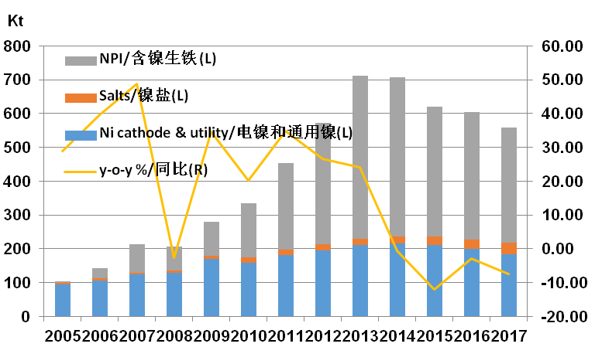
China-primary Ni output
Primary nickel output in China
Source: Antaike
Notes:
Primary nickel output of China in 2016 was 606kt, down by 2.4% compared with 2015.Of which, NPI output was 375kt, accounting for 62% of the total.
That in 2017 is forecasted to be 560Kt. Output of nickel cathode and utility nickel will be 183kt, NPI output will be 340kt and nickel salt will increase to 36kt.

Slide 4
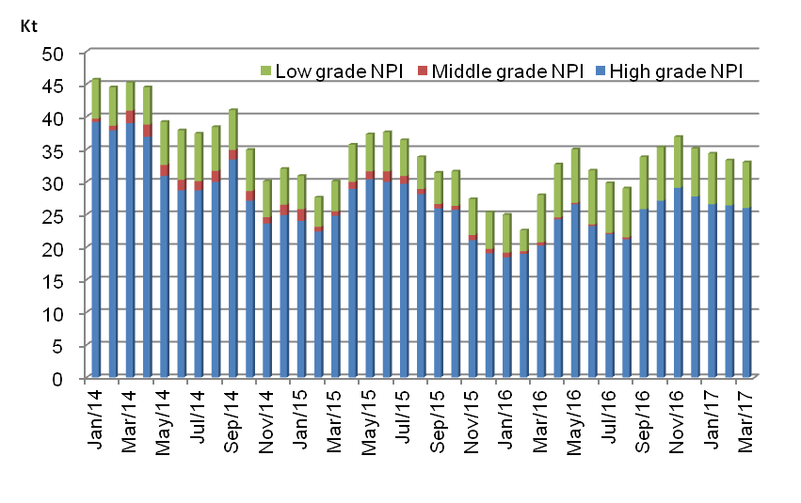
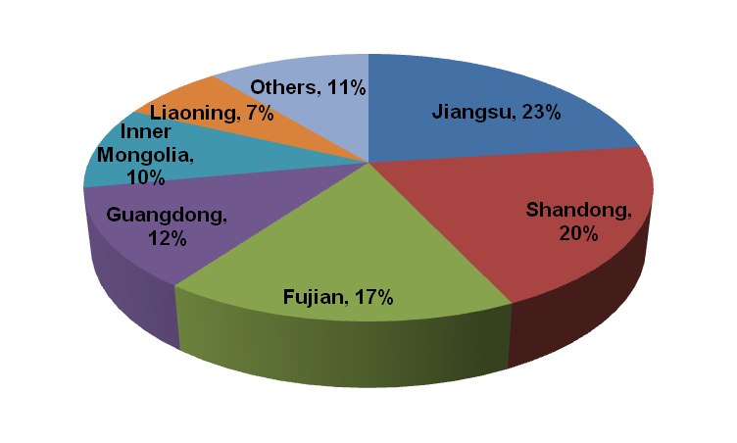
China-primary Ni output
NPI output in different grade and region
Source: Antaike
Notes:
Jiangsu is the leading producing region of NPI, accounting 23% of the total production, following by Shandong, Fujian, Inner Mongolia and Liaoning;
The integrated NPI output with STS is around 175Kt, accounting for 47%,the NPI in spot market is around 200Kt, which mainly come from Shandong\Inner Mongolia and Liaoning.

Slide 5
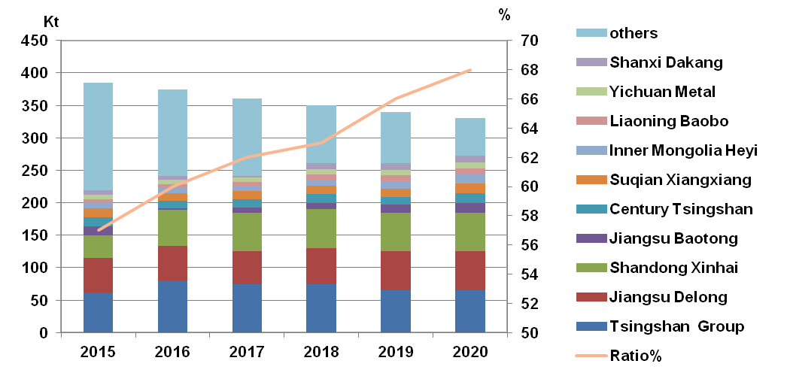
China-primary Ni output
Output of Chinese top 10 NPI factories
Source: Antaike
Notes:
NPI output of top 10 producers is 134Kt in 2016, accounting for 60% of the total;
Most of the leading producers will keep their capacity, but move the capacity to Indonesia, so the total output will not reduce sharply in the future, but the concentration will lift to 68% in 2020.

Slide 6
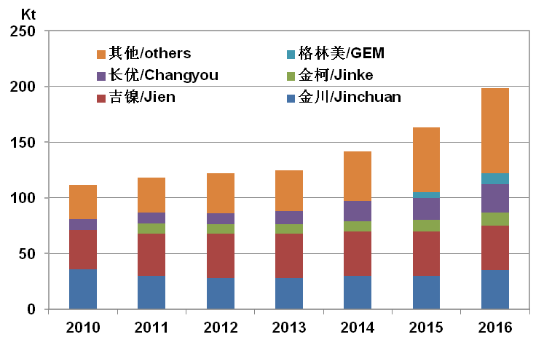
China-primary Ni output
Nickel sulphate output increase Y-o-Y
Source: Antaike
Notes:
Nickel sulphate output in 2016 is 151Kt(gross weight), increasing by 23.8%, 80% of them use primary materials, 20% use recycled materials;
In 2017, the output of nickel sulphate will increase futher to173kt, and more primary raw materials will be used in 2017;

Slide 7
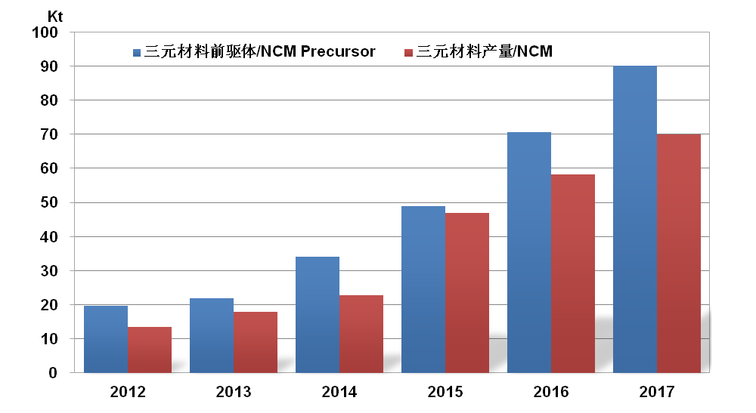
China-primary Ni output
Output of precursor and ternary materials
Some precursor expansion plans
Company | Capacity (Kt) | Output 2016 (Kt) | Output 2017 (Kt)
Hunan Brump | 30 | 11 | 15
GEM | 20 | 6 | 10
Huayou | 20 | 1.5 | 10-12
JNMC | 10 | 1.7 | 5
Jinhe | 41 | 6.5 | 10
…….
Source: Antaike
Notes:
55%-60% consumed in battery sector, and the balance consumed in plating sector and others; Some time, there is little price premium between nickel sulphate and cathode;
Due to capacity transfer to sulphate is easy, and some new build and
expansion line in construction; The price premium will disappear soon with the
increasing capacity and output.
Most of the increase aim at the battery sector, esp. ternary materials
of power battery;
据调研，华友钴业2万吨前驱体线6月份完全达产，预计17年产量将达到1-1.2万吨（16年产量为1500吨）。
邦普现有产能1.5万吨，年底产能达到3万吨。预计17年产量在1.5万吨（16年产量1.1万吨）。
格林美现有产能2万吨，预计17年产量在1万吨左右（16年产量6000吨）
广东方圆2017年计划投产1万吨前驱体，下半年投产。
上述几家今年产量如果顺利的话产量将增加2.4万吨，所以前驱体产量破9万不是什么难事儿。

Slide 8
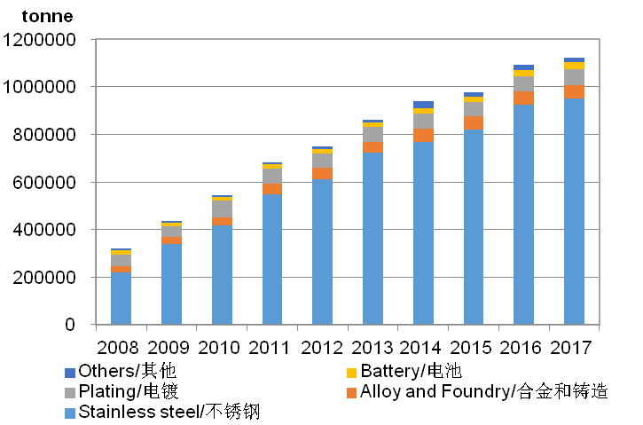
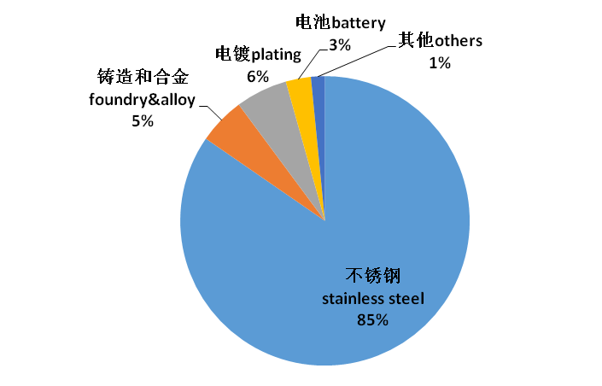
China-primary Ni cons.
Nickel consumption 2008-2017
Nickel consumption breakdown in 2017
Source: Antaike
Notes:
Primary nickel in consumption of China in 2016 increased by 11.6% and reached 1090Kt. Stainless steel industry takes up 85% of the consumption while 6% for plating, 5% for alloy, 3% for battery, 1% for others. The consumption of nickel in China is expected to reach 1123Kt in 2017, increasing by 3%.
2016: STS=821Kt, +6.6%, Battery=27Kt, +17%
2017: STS=950Kt, +15.7%,Battery=32Kt,+18.5%

Slide 9
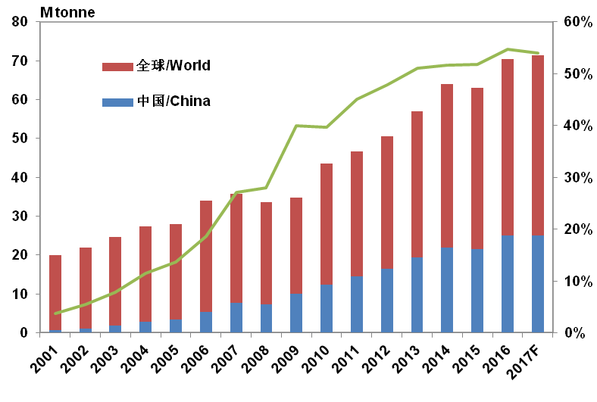
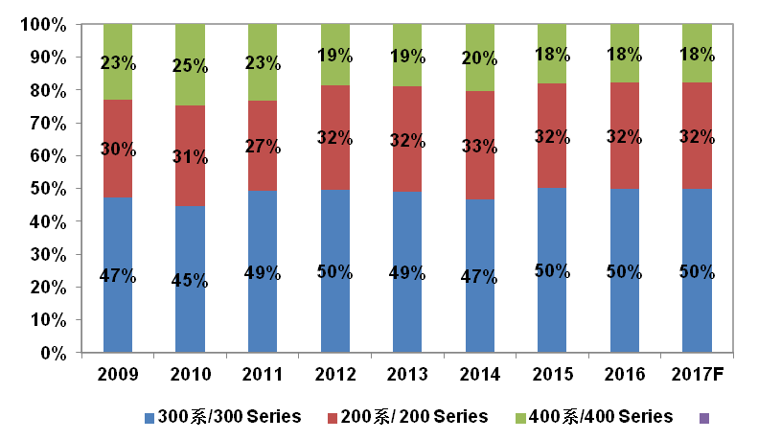
China-primary Ni cons.
Output of Chinese STS and different series
Source: Antaike
Notes:
In 2016, the stainless steel output in China increased by 15.8% to 24.9Mt, share of 300 series keep the level of 50%. Output of STS is expected to further increase to 25Mt in 2017, with 50% of 300 series.

Slide 10
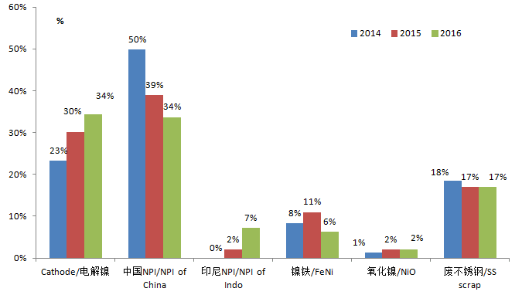
China-primary Ni cons.
Nickel usage in STS sector 2014-2016
Source: Antaike
Notes:
In 2016, the consumption of nickel in stainless steel industry increased by 13.8% to reach 1110Kt. The primary nickel increased by 12.5% to reach 924Kt, including 41% of NPI, 7% of nickel from Indonesia, 34% of electrolytic nickel, 6% of imported ferronickel and 2% of nickel oxide from Cuba. The drop in imported ferronickel is due to the reduction of import from Japan and Burma.

Slide 11
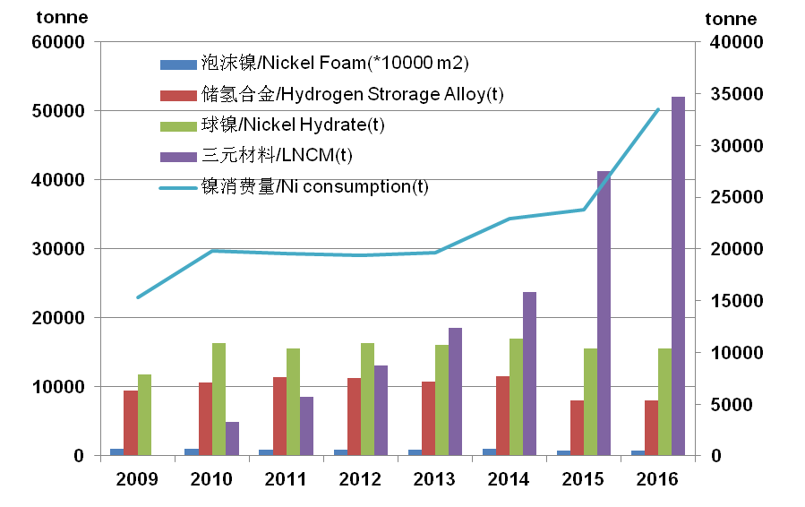
China-primary Ni cons.
Nickel usage in battery sectors
Source: Antaike
Notes:
In 2016, the consumption of nickel in battery field increased by 16.7% to reach 28Kt. The consumption of nickel in hydrogen storage/spherical nickel dropped while increased in ternary materials. In 2015, ternary materials became a main field of nickel application with more than 10Kt of nickel consumed, and it will continue to rise in 2017.

Slide 12
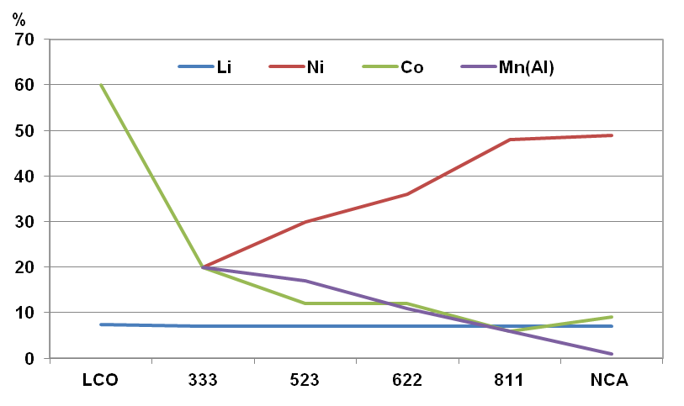
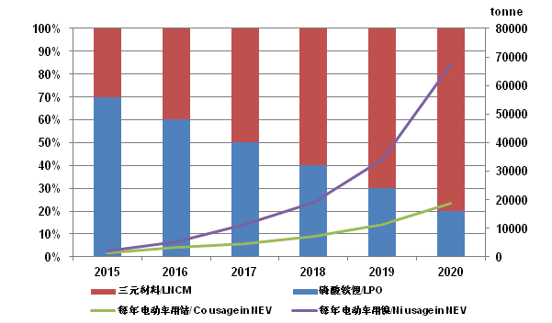
China-primary Ni cons.
Ratio of various metals in cathode materials
Output ratio of EV and consumption Ni & Co
Source: Antaike
Notes:
In 2017, ternary material batteries will takes up 50% of the power for domestic NEV, driving a 11.2Kt increase of nickel consumption and 4.8Kt of cobalt consumption. In 2020, the proportion of ternary material batteries in NEV will rise to 80%, driving a 67Kt of nickel consumption and 19Kt of cobalt consumption. Global sales of NEV increased by 58% to reach 861.9 thousand in 2016. By the end of 2016, the accumulative sales of NEV was over 2 million. With China taking up 50% of the market, cobalt consumption will double.

Slide 13
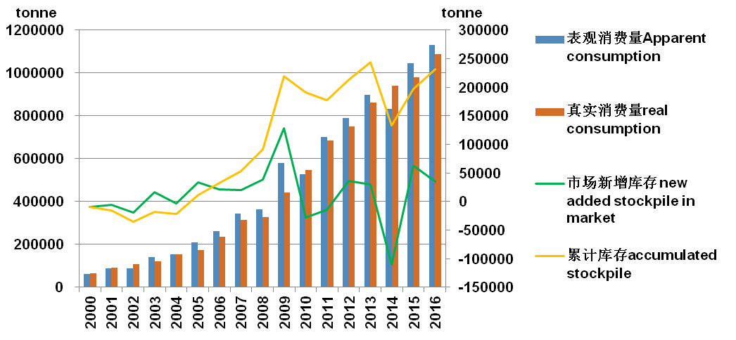
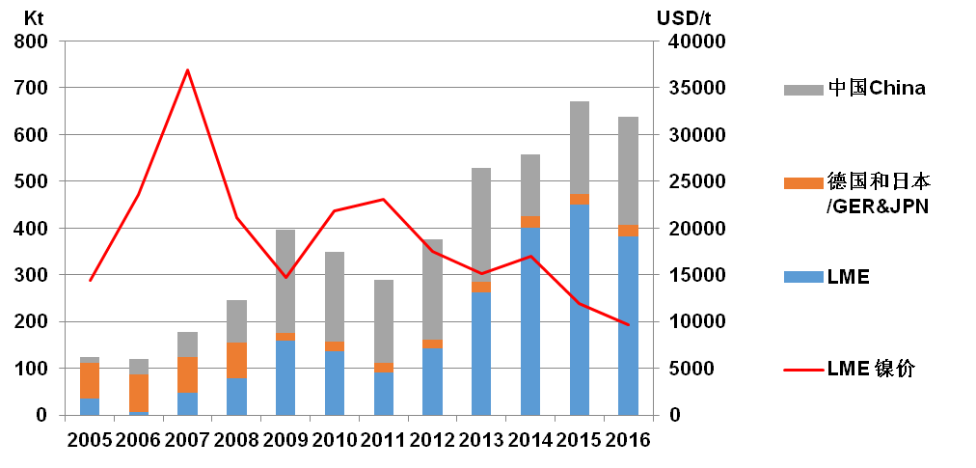
China-trade & stockpile.
Nickel stockpile in China
Nickel stockpilke in China and LME
Source: Antaike
Notes:
The apparent consumption in 2016 is 1.13M tonne in 2016, a little higher than the real consumption. So there are some new adding stockpile in China market. Till the end of 2016, the accumulated stockpile is nearly 231Kt.
In Mar. 2017, China’s total nickel inventory decreased by 90Kt to 179Kt, including 84Kt in SHFE, 63Kt in bonded warehouse and 32Kt in others.

Slide 14
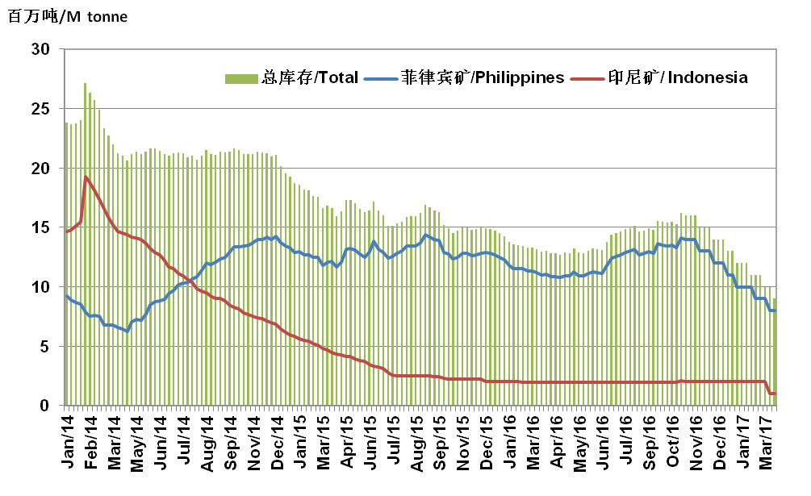
China-trade & stockpile.
Nickel ore inventory in main ports
Source: Antaike
Notes:
In 2016, China’s import of nickel ore has dropped by 9% to 31.9Mt, including 30.57Mt from the Philippines, dropped by 11%. After several months digest, now the nickel inventory in main ports is less than 9Mt, dropped by 64% from high spot, including 3.5Mt of middle and high grade ore and 5.4Mt of low grade ore ;
Ore inventories in most domestic nickel plants aren’t enough to keep 2 months’ of production. After April, the tension of supply shortage will relieve with the end of rainy season in the Philippines and nickel ore from Indonesia is arriving.
2016年我国镍矿进口量为3190万吨，同比减少9%，其中从菲律宾进口量为3057万吨，同比减少11%；
目前中国镍矿进口正在向多元化方向发展，印尼、新喀以及危地马拉等国家补充了菲律宾的供应下滑；
2016年我国从危地马拉和新喀进口镍矿量为61万吨；另外由于部分镍铁厂使用镍精矿/电镍 提高镍铁品位，2016年我国镍铁企业镍精矿进口量为17.2万吨，比2015年增加207%。

Slide 15
Outlook 2017
Global nickel market supply-demand balance 2014-2017
 | 2014 | 2015 | 2016 | 2017
Global Output (Kt) | 1970 | 1950 | 1930 | 2010
Global Consumption | 1870 | 1900 | 2000 | 2080
Balance | 100 | 50 | -70 | 10
China Output | 700 | 620 | 600 | 560
China Consumption | 940 | 980 | 1090 | 1130
Price (USD/t) | 16956 | 11865 | 9640 | 9900
Price (CNY/t) | 116000 | 88000 | 76000 | 80000
Source: Antaike
Notes:
In 2017, global nickel supply will continue to rise, but the growth of consumption will slow down. The nickel market will be tight balance or a little surplus. Nickel price will recover in a narrow room from to 9000-13000USD/t.

Slide 16
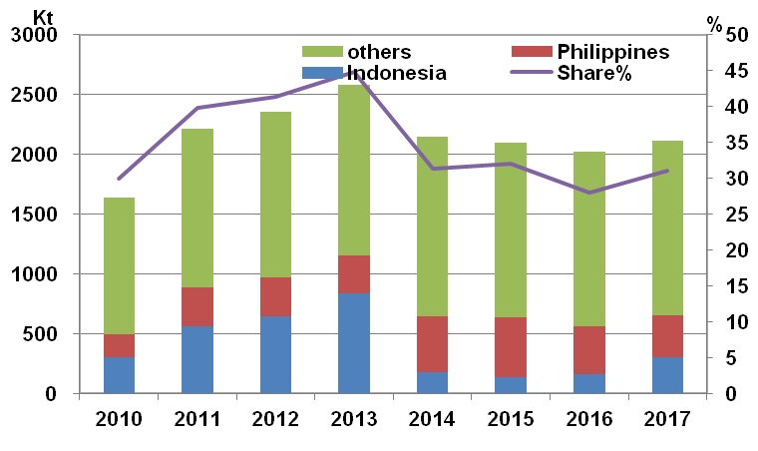
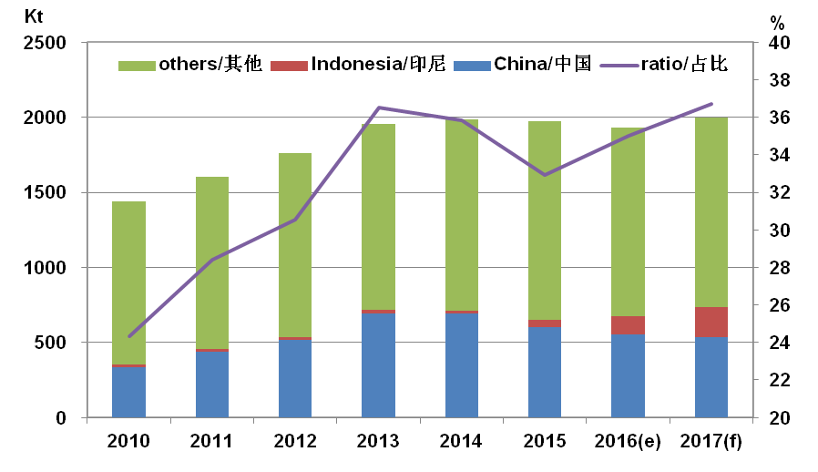
Indonesia & the Philippines
Share of Indonesia and the Philippines in global nickel mine market
Share of Indonesia and China global primary nickel market
Source: INSG, Antaike.
Notes:
Key of nickel supply-side structural reform is in Indonesia and the Philippine. Nickel mine output from Indonesia and the Philippines takes up 30% of global output, while primary nickel from Indonesia and China takes up 35% of global output. Nickel industry chain is the pioneer of China’s cooperation in production capacity with foreign countries.

Slide 17
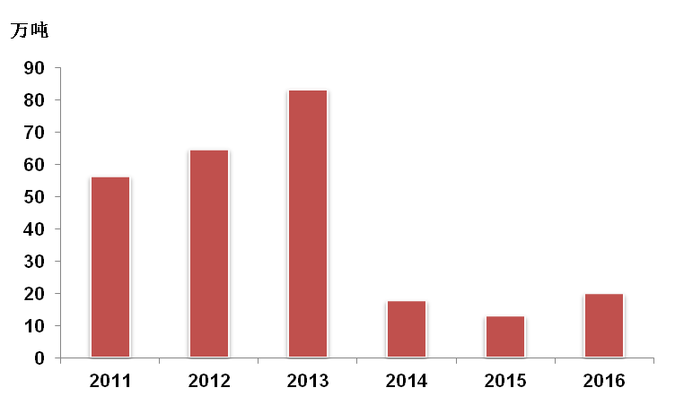
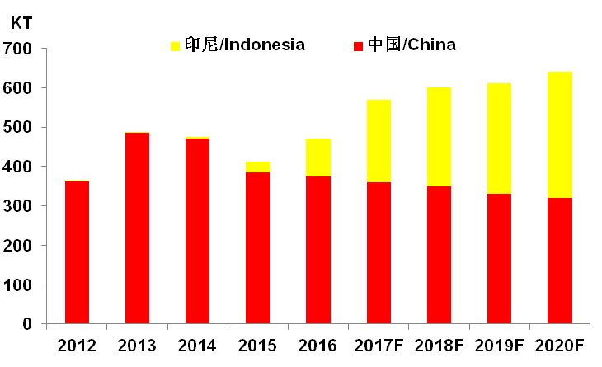
Indonesia & the Philippines
Nickel mine output in Indonesia 2011-2016
NPI output of China and Indonesia
Source: INSG, Antaike
Notes:
In 2016, output of nickel ore in Indonesia increased by 53% to reach198Kt. On Jan.12th, 2017, government of Indonesia announced to resume the export of nickel ore under certain conditions. PT Antam and one Chinese company are allowed to export 3.7M tonne nickel ore in2017. So the future ore supply will depend on the Philippine.
In 2016, output of NPI in Indonesia was 100Kt, and it’s expected to reach 210Kt in 2017. The increase mainly comes from Tsingshan’s third-stage work and Xinxing Ductile Iron Pipes’ project. Another focus is Delong’s production progress of its15 RKEF lines.

Slide 18
Indonesia & the Philippines
The progress of main nickel projects in Indonesia
Company | Progress | Capacity (Kt Ni/a)
Vale | Nickel matte smelter in Sorowako is in production. The construction of 2 smelters planned to be built in Pomalaa and Pahadopi haven’t got started. | 80
ANTAM | Ferronickel smelter in Pomalaa is in production. The construction of smelter planned to be built in Halmahera Timur haven’t got started. | 25
INDOFERRO | A 450m³ blast furnace of 1st stage is in production. Another 450m³ blast furnace will be constructed during 2nd stage. | 0.9
Sub-total |  | 105.9
Total | With other projects invested by Chinese companies (see next slide) | 407.4
Notes:
Nickel smelting capacity of Indonesia in 2017 is 377.4Kt, with Jinchuan’s new project taken into consideration, the capacity will be above 400Kt, 72% , most of which was built by Chinese enterprises in recent 4-5 years. Tsingshan signed a memorandum about the development of Wed Bay project with Eramet and signed a cooperation agreement with NML, which will improve Indonesia’s nickel capacity further.
印尼安塔姆年报显示，公司2017 年计划产镍铁2.41 万镍吨，同比2016 年度计划量增长30%，
因Pomalaa 扩建项目完成。
2017 年镍铁计划销售2.41 万镍吨，同比2016 年年度计划量增长25%。
2017 年公司资本支出达2.56 万亿印尼盾，同比增长158%，主要用于东哈马黑拉岛镍铁项
目（P3FH）的建设和提高生产效率，其中P3FH 项目投资占到总量的56.52%至1.17 万亿印尼
盾，项目一期预计将在2018 年底完成，年产能1.35 万镍吨,届时公司镍铁年产能将从2.7-3.0 万
镍吨增至4.05-4.35 万镍吨。

Slide 19
Indonesia & the Philippines
The progress of main nickel projects in Indonesia
Company | Progress | Capacity (Kt Ni/a)
Tsingshan | 1st and 2nd stages are in production. On Mar 5th, 3rd stage put into operation. 20 RKEF production lines will be put into production this year. | 120
Jiangsu Delong | 15 RKEF production lines of 1st stage are being constructed and 2 of them will be put into production this year. | 90
Xinxing Ductile Iron Pipes | 3 RKEF production lines have been put into production, while 9 of 2nd stage are still being constructed. | 18
Zhenshi Holdings Group | 4*80m³ blast furnaces are in production. | 8
Macrolink | 2* 80m³ blast furnaces are in production while another 2 are being debugged. They’re expected to be put into production this year. 2nd stage project of 4 RKEF and power plant is going through the procedures. | 8
Vansun Holdings Group | 8*80m³ blast furnaces are being constructed and will be put into production this year. 4 RKEF lines are in preparation. | 16
Tsingdao Hengshun | 6* 50m³ blast furnaces have been built but are temporarily shut down. 2nd stage project of RKEF and power plant is in preparation | 6
Ningbo Brillimetal | A 60m³ blast furnace has been built but is temporarily shut down. | 3.5
Wenzhou Huadi | 2*6500kVA electric furnaces of 1st stage have been basically constructed and will be put into production this year. 4*33000kVA RKEF lines will be constructed during 2nd stage project. | 2
JNMC | 4 RKEF production lines is in construction this year, will put into operation in 2018 | 30
Sub-total |  | 301.5

Slide 20
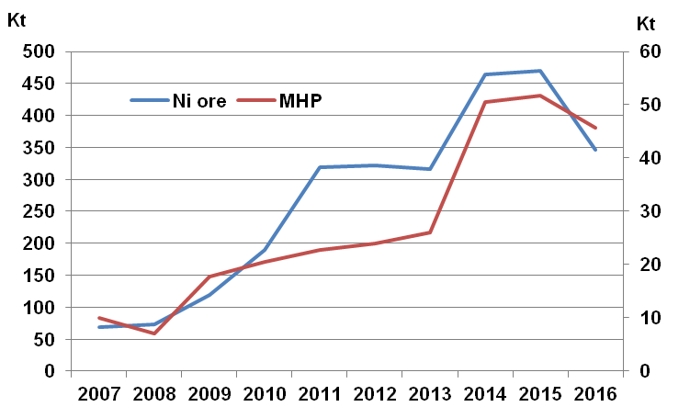
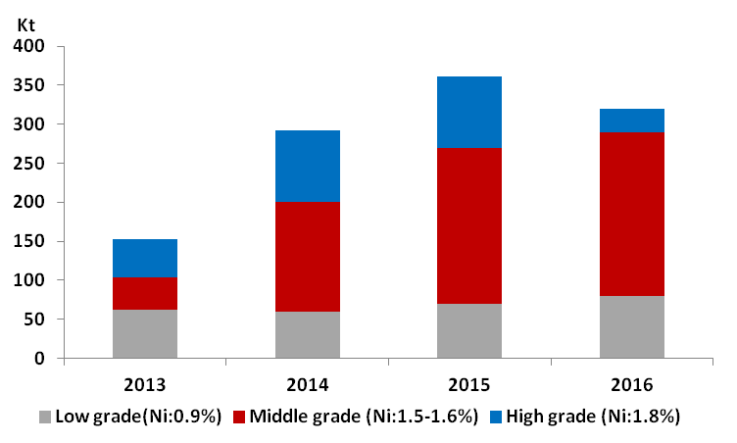
Indonesia & the Philippines
Nickel mine and MHP output of the Philippines 2007-2016
Philippines’ nickel ore export by different grade
Source: INSG, Antaike
Notes:
Nickel output of the Philippines dropped by 27% to 342Kt in 2016 due to the lower nickel price and mining regulation. And it will continue to reduce in 2017.
2016年我国从危地马拉和新喀进口镍矿量为61万吨；另外由于部分镍铁厂使用镍精矿/电镍 提高镍铁品位，2016年我国镍铁企业镍精矿进口量为17.2万吨，比2015年增加207%。

Slide 21
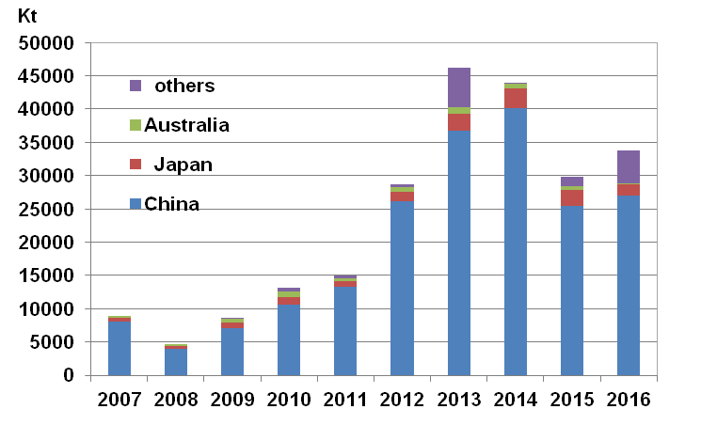
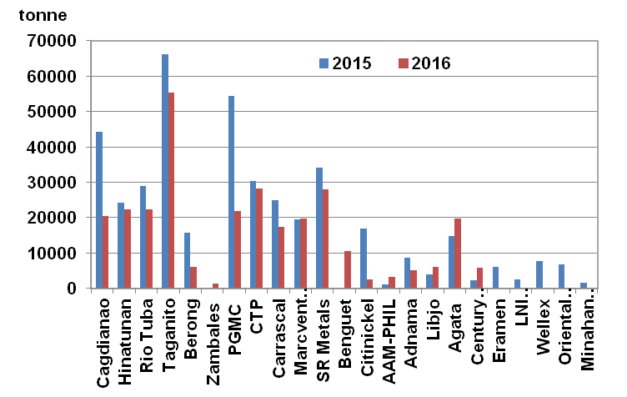
Indonesia & the Philippines
Philippines nickel ore export and trade flow
Mine export of main producers
Source: INSG, MGB
Notes:
The ore export in 2016 is 33.8 M tonne, increasing by 13.1%, esp. Both to China and China HK, increase y-o-y which is conflict from what we get from Chinese customs.
But the data from MGB shows that total ore export is 24.7M tonne (gross weight), decreasing by 23%, and nickel content in ore 296Kt, decreasing by 29%.

Slide 22
Indonesia & the Philippines
Philippines’ Reorganization of Mining Industry
2016.06.21, At the first day of being the minister of DENR, Regina Lopez shutdown Benguet, Eramen, LNL, DMCI.
2016.07.08, Minister Lopez signed an executive order asking for investigation of every mine administered by government, and stop the authorization of new mineral rights.
2016.07.15, DENR Muslim autonomous region branch announced to suspend all mineral work in Tawi-Tawi area to cooperate with the environmental investigation.
2016.07.15, Mines from different regions including Berong, Citinickel and CMDC were shutdown.
2016.10.10, Result of preliminary investigation was published. Only Rio Tuba in Palawan, and TMC, CMC, PGMC in Surigao got passed, others would face closure.
2017.02.02, Final result was published. Only Rio Tuba in Palawan, and TMC, CMC, CPC, Agata in Surigao got passed, others were instructed to shutdown.
2017.02.09, DENR minister Lopez and Finance minister Carlos Dominguez signed a document to do a 3-month recheck of DENR’s investigation result. Tawi-Tawi area is governed by autonomous region, so the environmental policy didn’t have a huge impact. However, two large mines in that area are not able to put into production for various reasons.
2017.02.14, Minister Lopez canceled 75 MPSA.
Recent news shows that Lopez will still take the chair of the the minister of DENR. So there are still some illusion in the nickel market.
Notes:
Now Philippine is the key influence factor to the global nickel market, but the mining policy is too unpredictable and bewildering to judge what will happen in this country. To reorganize the mining industry is necessary to reduce the pollution, but the voise from DENR is too noisy. Here we just list the main news released from the Philippine, what a mess!

Slide 23
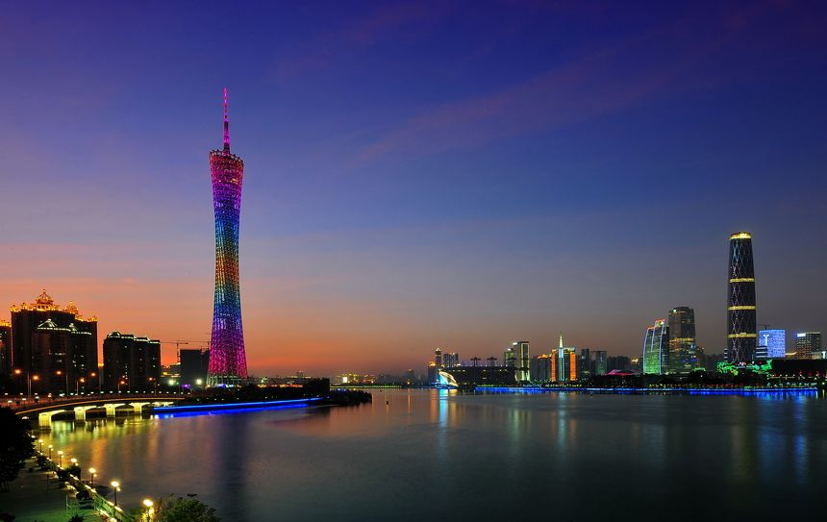
2017 China Nickel and Cobalt Industry Forum will be held in Guangzhou, Guangdong Province in November 6-9 2017.
Welcome your attendance!

Slide 24
Thank you for your attention
Nickel team：
Xu Aidong 8610-63971195
xuad@antaike.com
Fan Runze 8610-63971644
fanrunze@antaike.com
Lilian Liu 8610-63978092
lyj@antaike.com
Website： www.metalchina.com
24

